Slide 1
UNCG
2025-2026
STAFF SENATE
Full Body Meeting
March 12, 2026
Notes:
Kimberly

Slide 2
Agenda
10:00am | Call to Order | Carla Wilson, Staff Senate Chair
10:05am | Roll Call | Scott Wilkens, Staff Senate Secretary
10:10am | Approval of Minutes
10:15am | Guest Speaker – Jennifer Boggs (Commencement)
10:20am | Guest Speaker – Employee Field Day
10:25am | Ex-Officio Reports
10:50am | Project/Committee Reports | Upcoming Reminders
11:00am | Adjournment | Carla Wilson, Staff Senate Chair
Notes:
Kimberly

Slide 3
Roll Call
Senators joining virtually please let us know!

Slide 4
Approval of Meeting Minutes
February 2026

Slide 5

Jennifer Boggs Special Events
Commencement
Spring 2026
Commencement

Slide 6
We need you to volunteer at Commencement!
Event Details:
May 6
2:30 PM – 3:30 PM | Walkthrough for Doctoral and Master’s Commencement
May 7
May 8
Meet at The Terrace
8:00 AM | Volunteers Arrive
8:30 AM | Doors Open
10:00 AM | University Commencement Starts
1:30 PM | University Commencement ends
8:00 AM | Volunteers Arrive
8:30 AM | Doors Open
10:00 AM | Doctoral & Master’s Commencement Starts
12:00 PM | Doctoral & Master’s Commencement ends
2:30 PM – 3:30 PM | Walkthrough for University Commencement
Meet at The Terrace

Slide 7

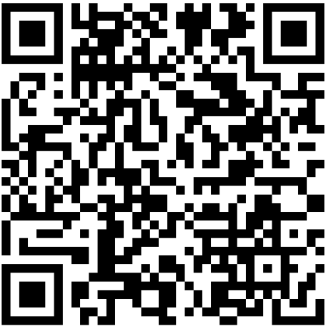
We need you to volunteer at Commencement!
go.uncg.edu/commencementinterest

Slide 8
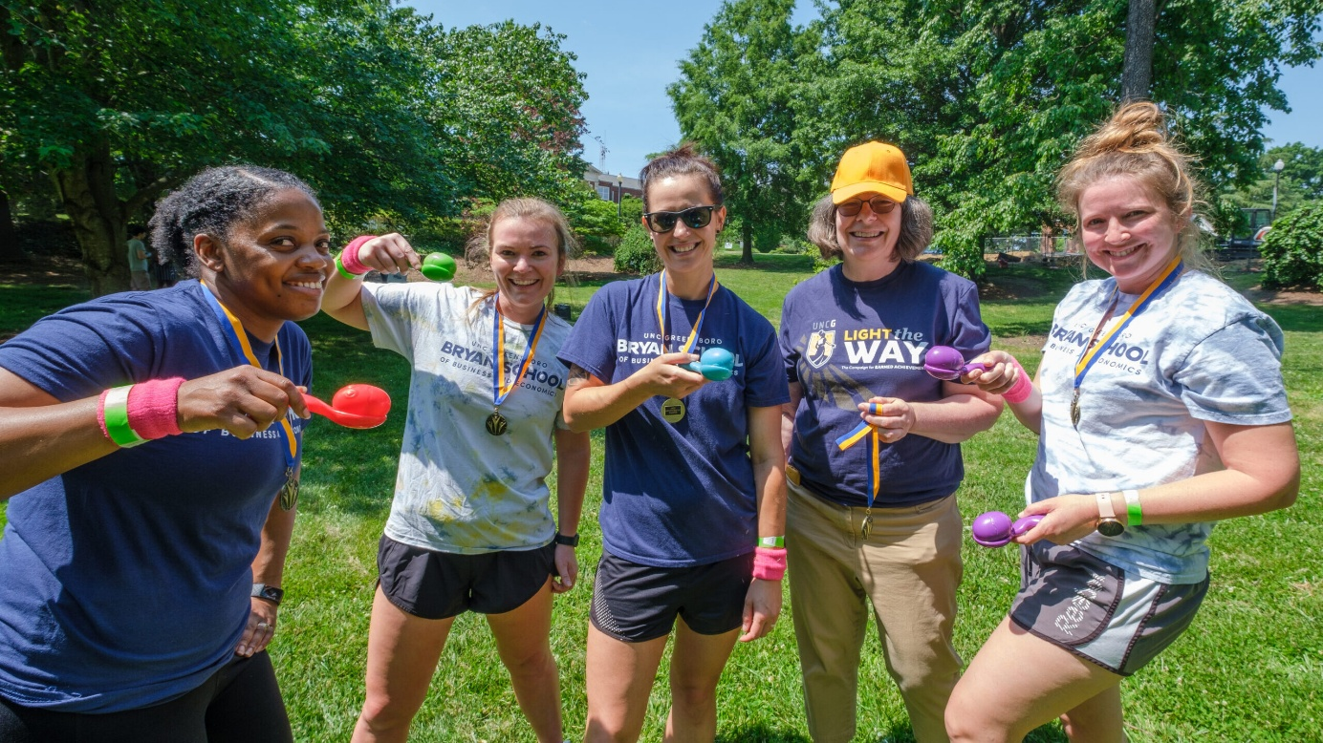
healthyuncg.uncg.edu/employee-field-day/
Employee Field Day
Individual players, teams, and cheerleaders welcomed!
Food, prizes, and fun for everyone.
Wear your blue and gold!
Snag a picture with Spiro!
APRIL 24, 2026
11 AM – 1 PM
FOUST PARK

Slide 9
Ex Officio Reports/Updates

Slide 10
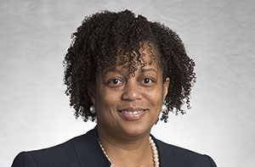
Human Resources Update
UNCG Human Resources website
Patricia Lynch Director of ER and EEO/AA
Human Resources Officer

Slide 11
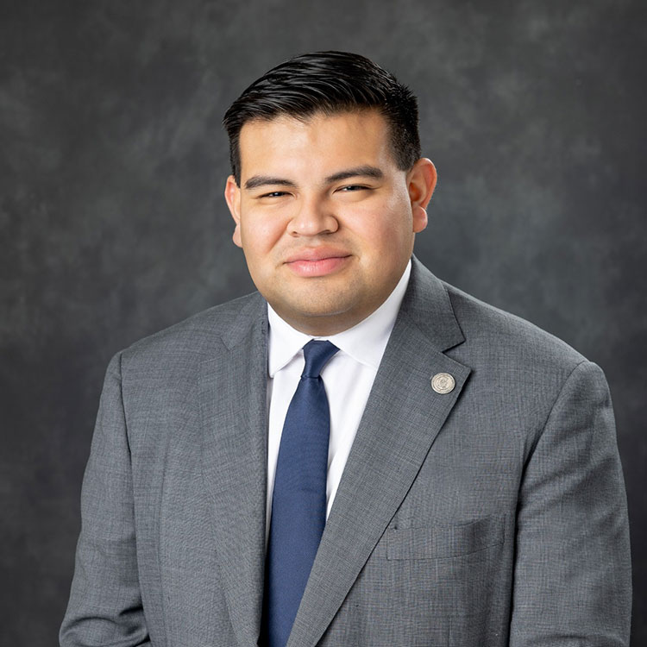
Juan Pleitez Director of External Affairs Strategy and Policy
Chancellor’s Update

Slide 12
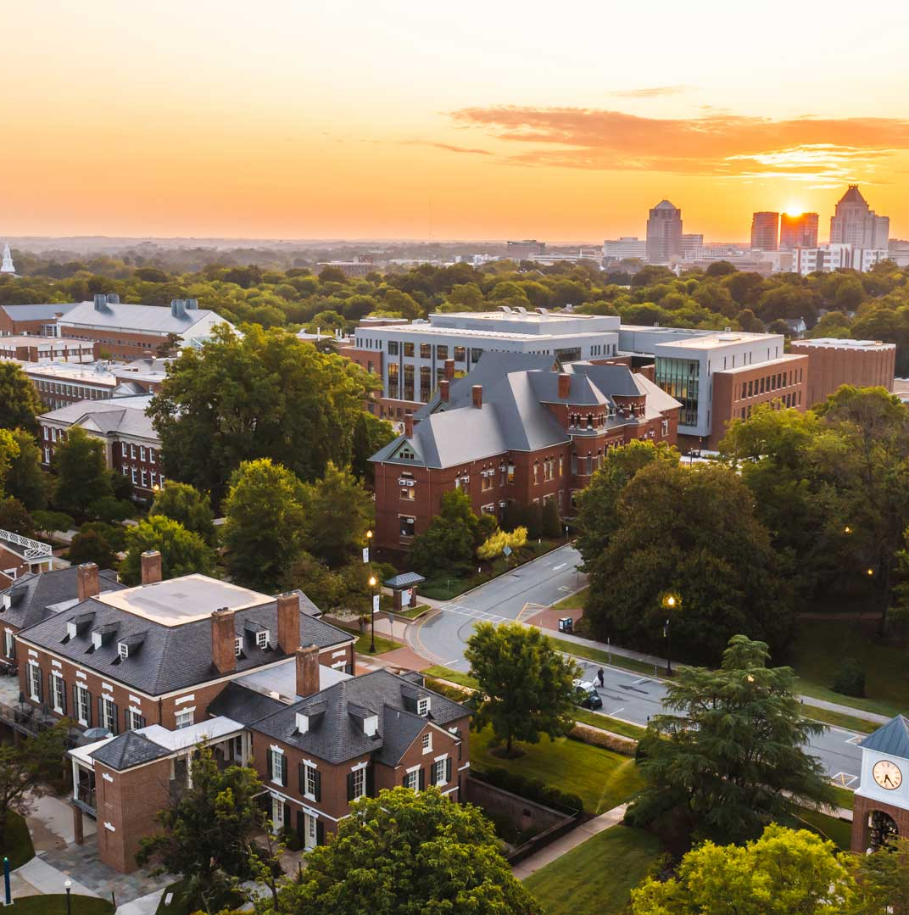
MARCH 2026 UPDATES
TECHNOLOGY
INITIATIVES
Todd Sutton
Associate Vice Chancellor for Learning Technology and Customer Success

Slide 13
EARLY ENGAGEMENT: Data Retention Initiative
Purpose: To responsibly manage institutional data in Microsoft services in alignment with UNC System Records Retention and Disposition schedule
ITS is in early conversation with campus partners
Proposed milestones:
Spring 2026 – Low Impact changes
Mid 2027 – Begin Automated Retention rules
https://its.uncg.edu/tech-initiatives/data-retention

Slide 14

WHAT IS DATA RETENTION?
Data retention refers to the policies that define how long information is stored before it is deleted or archived.
A practical way to think about retention: Keep what you need. Remove what you no longer need.
Supports compliance, cost control, and performance
Applies to Outlook, OneDrive, SharePoint
Notes:
Data retention refers to the policies that define how long information is kept and what happens to it over time. This applies to Outlook, OneDrive, and SharePoint. Effective retention supports compliance, cost control, and system performance by managing the full lifecycle of data rather than keeping everything indefinitely.

Slide 15

WHAT TO DO NOW (FACULTY/STAFF)
Move records subject to UNC retention schedule to department SharePoint (see UNC retention requirements).
Delete files no longer needed.
Avoid using personal cloud storage or USB drives for university data.
Participate in upcoming data management training (coming soon).
Notes:
Faculty and staff should begin reviewing where official records are stored. Records subject to the UNC retention schedule should live in departmental SharePoint. This is also a good opportunity to delete files that are no longer needed and avoid personal cloud storage or USB drives for university data. Data management training is being developed to support this transition. This training will provide practical guidance on organizing, storing, and preserving files appropriately, and a link will be shared once it is available.

Slide 16

FEEDBACK & ENGAGEMENT
Nothing is finalized.
We want your input and ideas.
Share feedback via ITS sessions or online form.
Notes:
Nothing presented today is finalized. We want input and ideas from across campus. Feedback can be shared through ITS sessions or online channels as this work continues.

Slide 17
IT Assessment
Purpose: Evaluate how IT services are organized and delivered across campus. ​​
Implementation Approach
Phase 1 – Pilot Centralization
Phase 2 – Role discovery and alignment
Transition Timeline
April 30, 2026: All decisions regarding role management will be finalized
July 1, 2026: Salary lines and funding for positions transitioning to ITS will move to ITS
https://tech-assessment.uncg.edu/

Slide 18
Managed Print Services (MPS) Program
Purpose: Streamline print operations, reduce costs, improve efficiency, and support sustainability through centralized printer management
Update:
eGoldFax discovery in process
Review and departmental consultations – extend into March 2026
Implement in Campus Departments – Spring 2026
Convert Student Facing Printing – Summer 2026
https://go.uncg.edu/mps

Slide 19
Identity and Access Management Initiative
Purpose: UNCG is developing a strategic plan to modernize how we manage sign-ins and system access—improving security, user experience, and efficiency across campus.
Update:
Project team has selected SailPoint as the IAM platform
Implementation plan in development
https://its.uncg.edu/tech-initiatives/identity-and-access-management

Slide 20
Banner Web Time Entry
Purpose: Streamline and improve our current time and leave entry process
Update:
Exempt leave-earning employees: 2026 leave report deadlines and WTE resources available at https://hrs.uncg.edu/hr-operations/banner-hr/
Date TBD: Hourly Student and Temp employees will begin using Banner Web Time Entry timesheets
Date TBD: Non-Exempt and Non-Exempt LEO employees will begin using Banner Web Time Entry timesheets
https://its.uncg.edu/tech-initiatives/banner-web-time-entry/

Slide 21
Academic-Link
Purpose: Strengthen indoor wireless connectivity at UNCG, ensuring fast, reliable Wi-Fi where it’s needed most
Update:
Mid-Spring 2026: Access Point installation anticipated to begin for academic and administrative buildings
Summer 2026: Access Point installation residence halls
https://its.uncg.edu/tech-initiatives/academic-link/

Slide 22
ITS Project Status Dashboard
https://its.uncg.edu/project-status-dashboard/
Notes:
ITS Project Status Dashboard view provides all active projects status across all three technology portfolios (AAF/EM, F&A, and ITS)

Slide 23
MARCH TECH TRAINING – Digital Storytelling
Mar 3 | Refresh your Rubrics (Canvas Rubrics)
Mar 5 | New! Slide Smarter, Not Harder – Designing Impactful Presentations
Mar 10 | Getting Started with WordPress at UNCG: The Basics
Mar 12 | New! Like Canva? You’ll Love Adobe Express.
Mar 16 | Creative Infographics with Everyday Tools - Part 1
Mar 17 | Advanced Qualtrics Survey Workshop
Mar 17 | Getting Started with Cognito Forms
Mar 19 | Address&Reduce Bias (Canvas - Rubrics, SpeedGrader)
Mar 23 | New! Infographics with Everyday Tools - Part 2
Mar 26 | Canvas & CARE (Canvas - Assign To, Gradebook Policies, Roll Call, MS Education)
Every Tuesday - Open Office Hours with ITS: Learning Tech’s Instructional Design Team
Register: workshops.uncg.edu

Slide 24
WORKSHOP REGISTRATION
Register at:
workshops.uncg.edu
Notes:
ITS Project Status Dashboard view provides all active projects status across all three technology portfolios (AAF/EM, F&A, and ITS)

Slide 25
Project/Committee Reports

Slide 26

Outreach Committee
Congratulations to our newest Staff Stars
Suzanne Ingram
Vickie Carter
Dean's Office: School of Education
Deans Office: School of Health and Human Sciences
Ghazala Bibi
Finance: Controllers Office
Jennifer Permar
Colleen Burford
Recreation and Wellness
Maria Hayden
The Graduate School
Maryann Arterbridge-Whitten
Dean of Students Office
CPVA Dean's Office
Human Resources
Rhys Fetner

Slide 27
Excellence Awards
Staff Excellence Award & Ezekiel Robinson Staff Emeritus Award
Nominations being reviewed and awardees will be announced next month!

Slide 28
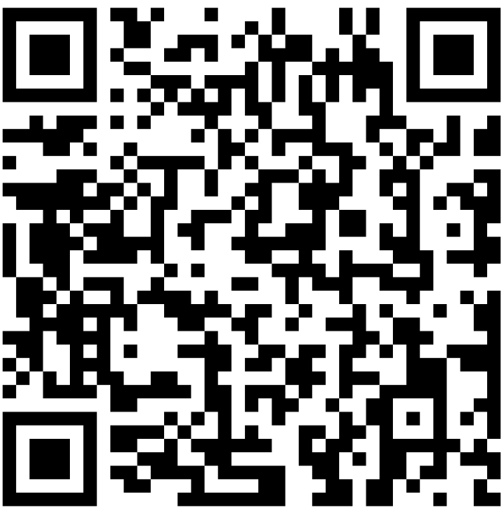
UNCG Staff Senate Endowed Scholarship
FAFSA Requirement | Submit a completed FAFSA by March 25th.
Employment Status
Be a permanent full-time UNCG staff member with at least one year of service in the North Carolina State System, or the dependent, spouse, or domestic partner of an eligible employee.
Enrollment in a Degree Program @ UNCG
Employment Continuity
Remain a permanent employee of UNCG (or the dependent, spouse, or domestic partner of an eligible employee) during the scholarship period.
Meet Requirements in the Satisfactory Academic Progress Policy
Scholarship Application Open *Deadline: March 25, 20206
Apply →
Notes:
The Staff Senate Scholarship is designed to support the educational goals of UNCG staff and their families.
If you or a dependent, spouse, or domestic partner meet the eligibility criteria referred on the application, we encourage you to apply and take advantage of this opportunity to further your academic journey.

Slide 29
Elections are Underway
Nominations Submitted
Gathering Supervisor Approval
Ballots going out soon!

Slide 30
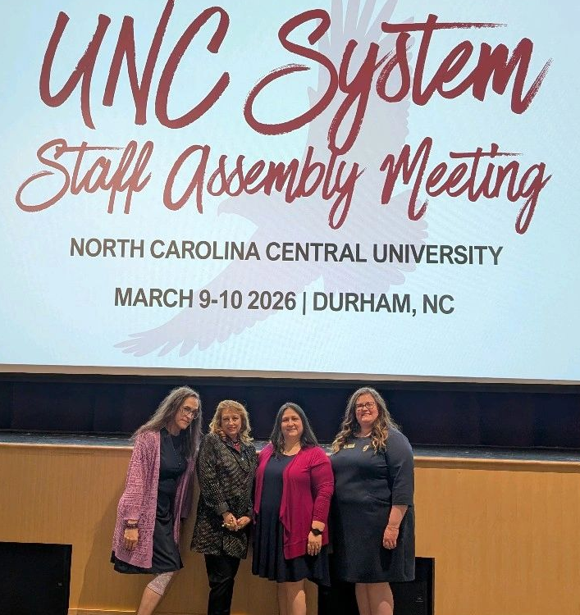
UNC System Staff Assembly
Lantern Benefit – Novant Health has added itself to Lantern's list of providers.
OSHR approved a new performance management policy for agencies only. It will be reviewed for further direction for the UNC System.
MAYBE exploring the policies surrounding condition 2
Assembly considering proposing a voluntary shared leave program to aid those who are unable to work during to condition 2.
SAVE THE DATE June 11th Staff Assembly leadership joining our EOY celebration

Slide 31
Any Questions or Comments?

Slide 32
Adjournment

Slide 33


