Slide 1
UNCG
2025-2026
STAFF SENATE
Full Body Meeting
February 5, 2026
Notes:
Kimberly

Slide 2
Agenda
10:00am | Call to Order | Carla Wilson, Staff Senate Chair
10:05am | Roll Call | Scott Wilkens, Staff Senate Secretary
10:10am | Approval of Minutes
10:15am | Guest Speaker - Believe in the G (BITG)
10:30am | Ex-Officio Reports
10:45am | Guest Speaker – Surplus
10:50am | Project/Committee Reports | Upcoming Reminders
11:00am | Adjournment | Carla Wilson, Staff Senate Chair
Notes:
Kimberly

Slide 3
Guest Speaker
Believe in the G
Sam Logan
Senior Assistant Director of Digital Strategy, Advancement Communications

Slide 4
MARCH 3-4
believeintheg.uncg.edu

Slide 5
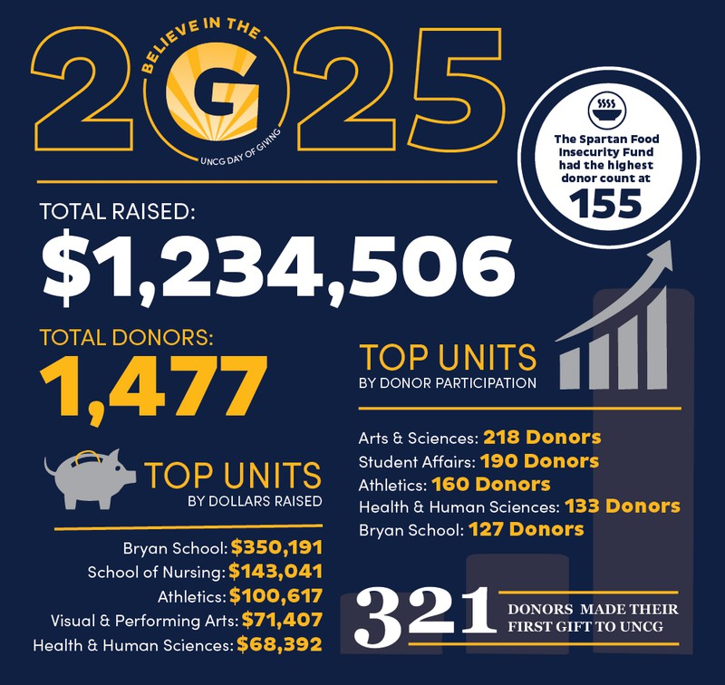
STAFF DONORS
180 unique donors
$26,153 raised
38 first-time donors
TOP 5 FUNDS
Spartan Food Insecurity (19) Spartans Finish Strong (13) Chancellor’s Greatest Needs (11)
Staff Senate Endowed Scholarship (11) Weatherspoon Art Museum (10)

Slide 6

2026 FOCUS AREAS
INCREASE CONSTITUENT PARTICIPATION
Orienting focus around participation at any amount
ELEVATE COMMUNICATION AROUND TOP FUNDS
Highlighting results achieved in previous years, impact stories, and importance of funds
INCREASE EMPLOYEE ADVOCACY
Focus on encouraging staff and faculty (esp. donors) to help champion giving

Slide 7
BITG EVENTS
FACULTY-STAFF BREAKFAST
Tuesday, March 3
Marcus T. Johnson Alumni House 7:30am - 9:30am
ALUMNI & FRIENDS COMMUNITY EVENT
Tuesday, March 3 Steelhands Brewing (across from Coliseum)
5:30pm - 7:30pm
STUDENT PHILANTHROPY CELEBRATION
Wednesday, March 4 Moran Commons (inside)
11:00am - 1:00pm
Free park-and-ride shuttle available!

Slide 8
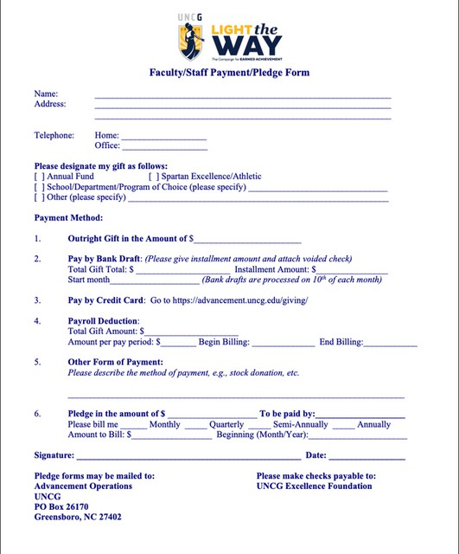
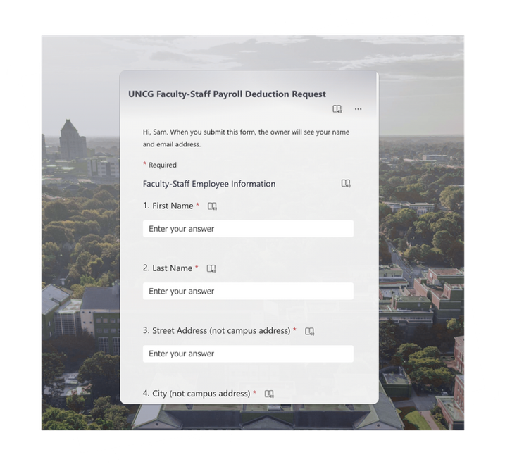
PAYROLL DEDUCTION
New & Improved Form
Minimum Gift Amount: $5/month go.uncg.edu/payrolldeduction

Slide 9
QUESTIONS?
Sam Logan,
Advancement Communications
swlogan2@uncg.edu

Slide 10
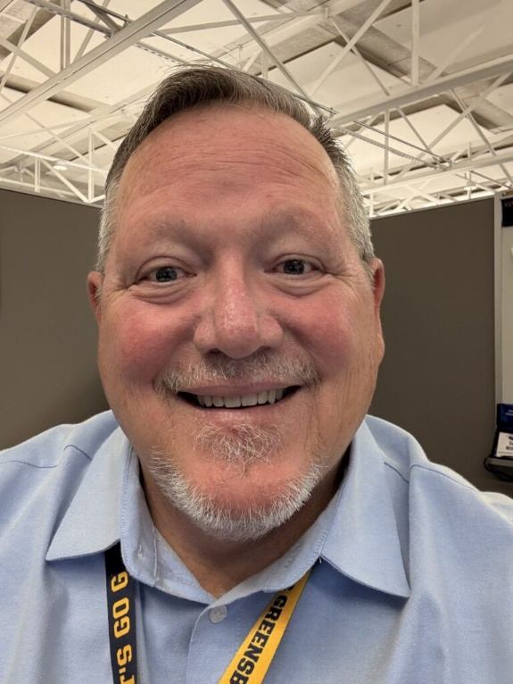
Scott Wilkens Secretary
Roll Call
Senators please let us know your attendance through the Q&A chat.

Slide 11
Roll Call
We will pull the attendance report from today’s virtual meeting to mark Senators present.

Slide 12
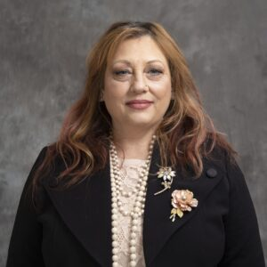
Kimberly Mozingo Past Co-Chair
Approval of Meeting Minutes
January 2026

Slide 13
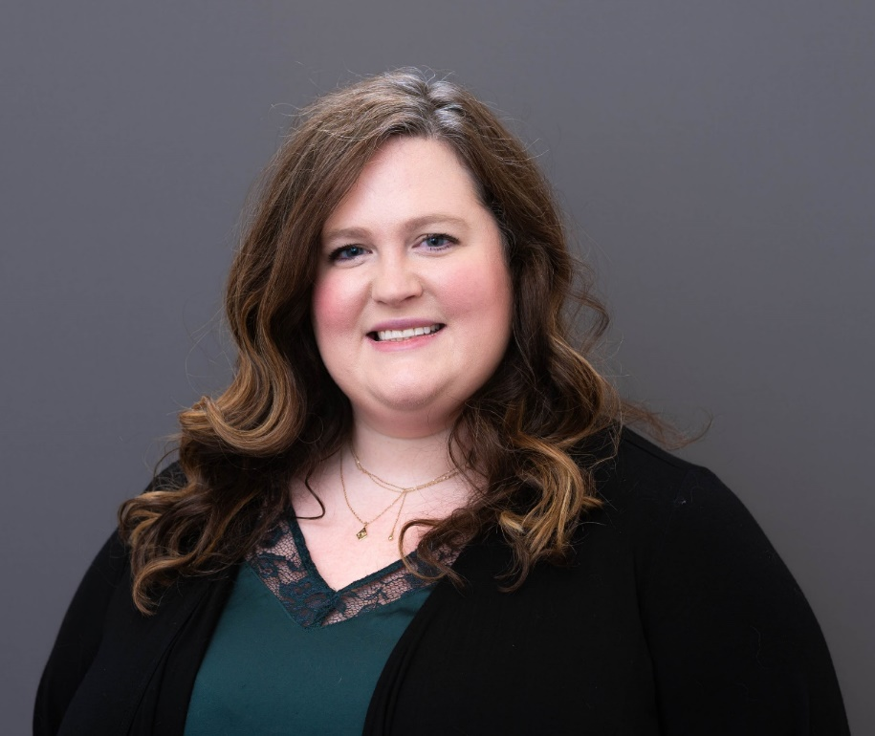
Brynne Pulver Vice Chair
Approval of Meeting Minutes
November 2025

Slide 14
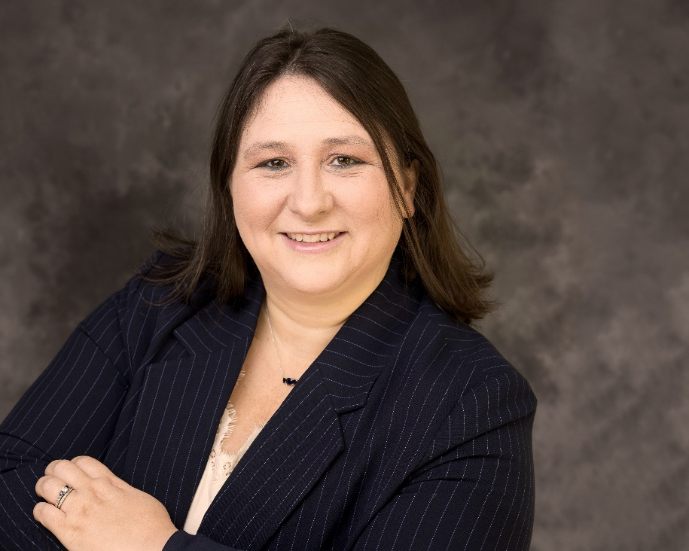
Carla Wilson Chair
Approval of Meeting Minutes

Slide 15
Ex Officio Reports/Updates

Slide 16
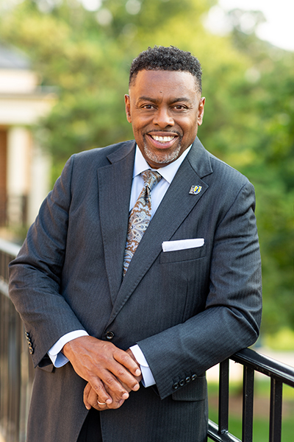
Dr. Franklin D. Gilliam, Jr. Chancellor
Chancellor's Update

Slide 17
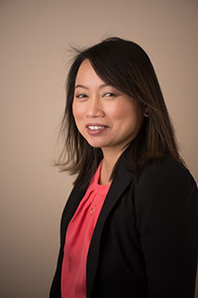
Waiyi Tse Chief of Staff, Office of the Chancellor
Chancellor's Update

Slide 18
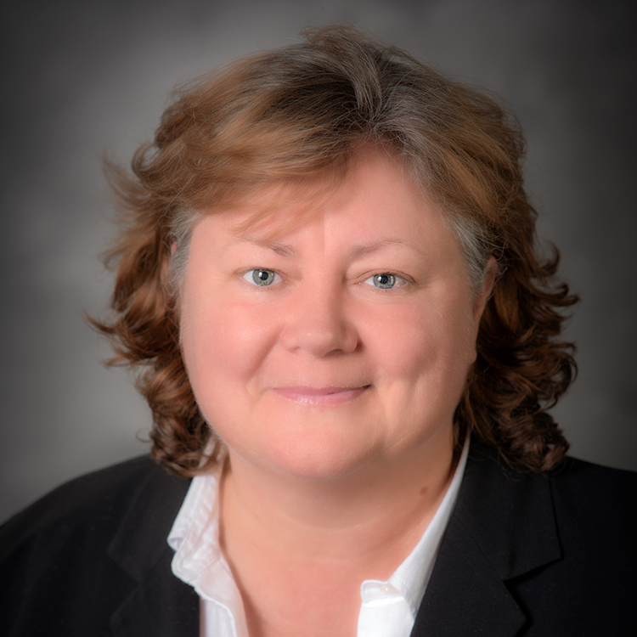
Information Technology Service Update
Technology Initiatives
Workshops
Donna Heath
Vice Chancellor, Information Technology Services

Slide 19
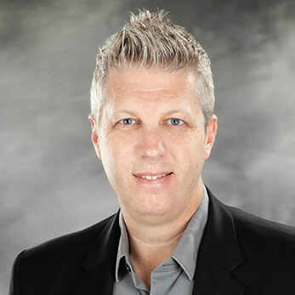
Information Technology Service Update
Technology Initiatives
Workshops
Todd Sutton
Associate Vice Chancellor for Learning Technology and Customer Success

Slide 20
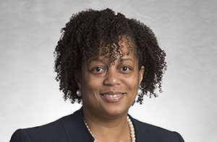
Human Resources Update
UNCG Human Resources website
Patricia Lynch Director of ER and EEO/AA
Human Resources Officer

Slide 21
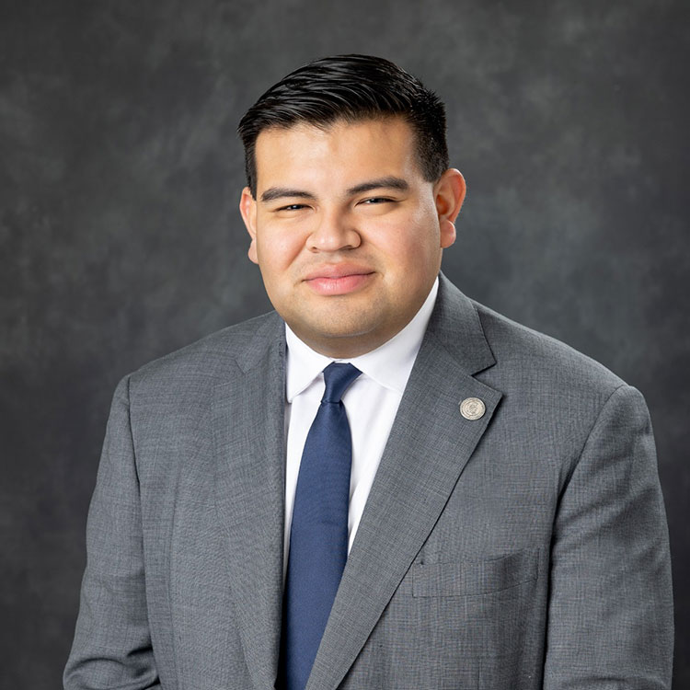
Juan Pleitez Director of External Affairs Strategy and Policy
Legislative Update

Slide 22
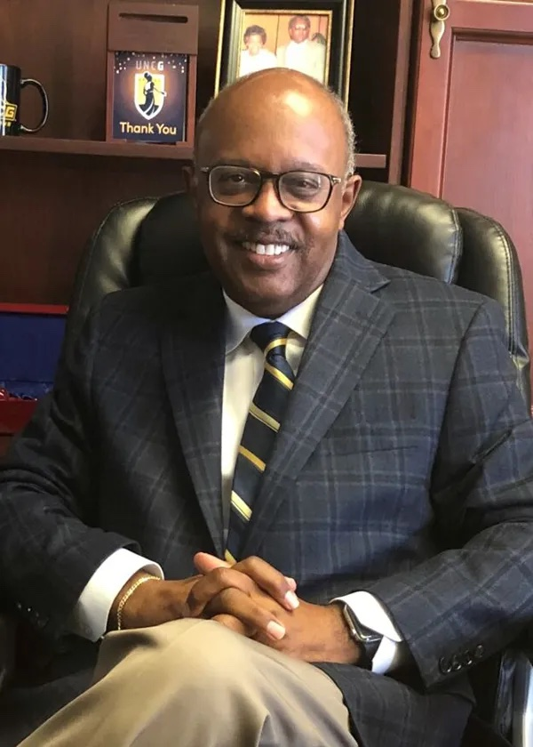
Jerry Blakemore Vice Chancellor, Institutional Integrity & General Counsel
Equality Policy
Notes:
Jerry D. Blakemore serves as the Vice Chancellor for Institutional Integrity and General Counsel for UNC Greensboro.
He has more than 30 years of experience in higher education administration, policy development and the providing of legal services, 19 of which as General Counsel for major institutions of higher education.

Slide 23
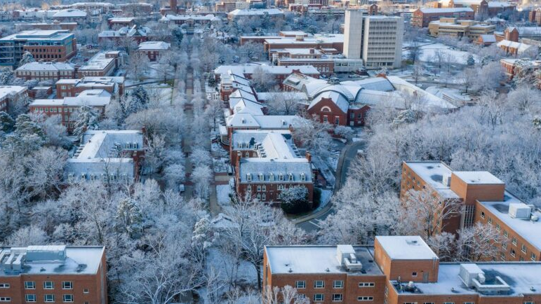

UNCG Surplus Services
Ross Rick, Assistant Director for Facilities Support Services
Erik Schuman, Warehouse Manager
Jeremy Murray, Warehouse Associate

Slide 24

UNCG Surplus
UNCG Facilities Operations
Material Disposition Experts
NC DOA-Surplus
Purchasing
Fixed Assets
ITS
Tenants of Surplus
Reduce, Reuse, Repurpose, Recycle
Diversion Rate 35% FY 25’

Slide 25
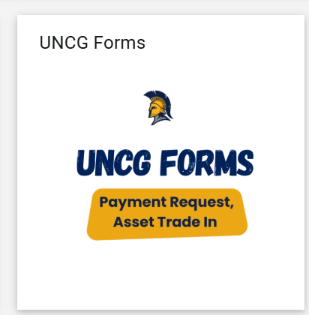
Surplus-Reducing our footprint
Reduce
Reduce campus materials
ITS Professional Services
Service Request
Pick Up Request
Repurpose Tech Store
Office upfitting
Purchasing furniture
Material trade-in request
Spartanmart-UNCG Forms

Slide 26
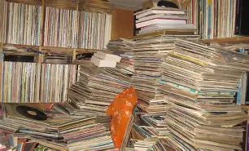
Surplus-Reuse Opportunities
Reuse
Office Upfitting
Pick-up surplus material
Material on site
Re-sale
N.C. G.S. 143.article 3A
N.C. State Surplus Web-based
Renovations, dorm upfitting
Move Request
Internal Moves & External Moves
Surplus Warehouse Moving SOP

Slide 27
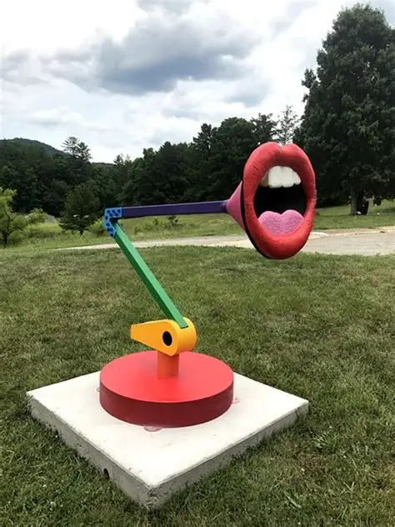
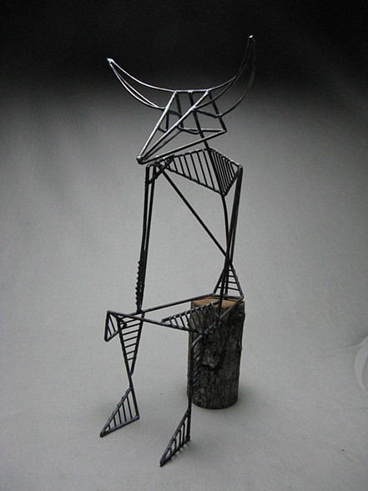
Surplus-Repurpose
Repurpose-Upcycling
Partner with Academics
Foundry
Woodshops
Theatre
Interior Architecture
Transferring of Assets
Internally and Externally
Furniture
Kitchen Equipment

Slide 28
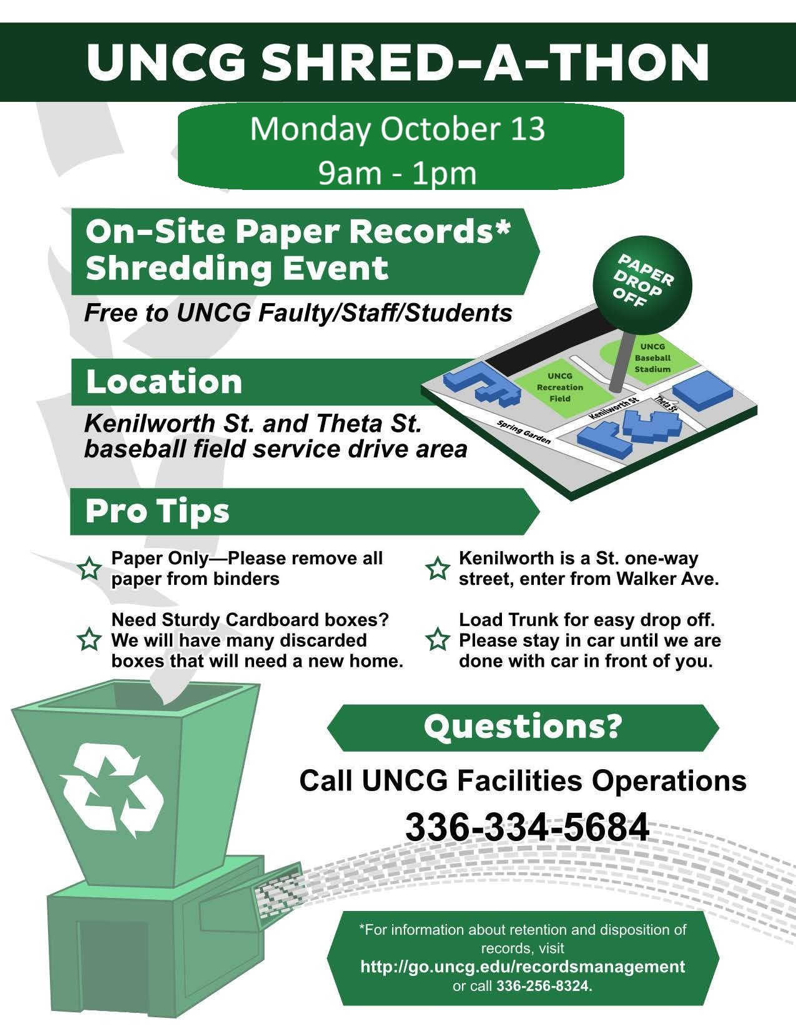
Surplus-Recycle
Recycling
Electronic Waste
Catalogue disposal
Metal Waste
Bulky, unsellable material
Moving Boxes
Campus Moves
Partner with OWRR
Office Clean Out
Shred-a-thon –Fall break

Slide 29


Surplus Warehouse Summary
Avenue of Diversion
200 tons of material annually
Reduce
ITS equipment swap
Trade in request
Reuse
Surplus Pick up & Redistribution
Web Auctions
Move Request
Repurpose
Partnering Across Campus
Transfer of property & assets
Recycle
Submit pick up request
Office Clean outs

Slide 30
Associated Links
Work Request or Move
fowork@uncg.edu
https://fac.uncg.edu/fm/wo/
Surplus-Compliance-SOP-D-26-01.pdf
Office-Furniture-Moving-SOP-D-27-02.pdf
ITS Professional Services
Knowledge - CHiP: Tech Recovery
Request for Repurpose or Surplus - 6-TECH: The UNCG Self Service Portal
Fixed Assets
Forms | Fixed Assets
NC DOA-Surplus
NC DOA State Surplus Property Agency - Government Auctions & Retail Surplus Sales
Chapter 143 - Article 3A

Slide 31
Ross Rick
Support Services Division
R_rick@uncg.edu

Slide 32
Project/Committee Reports

Slide 33
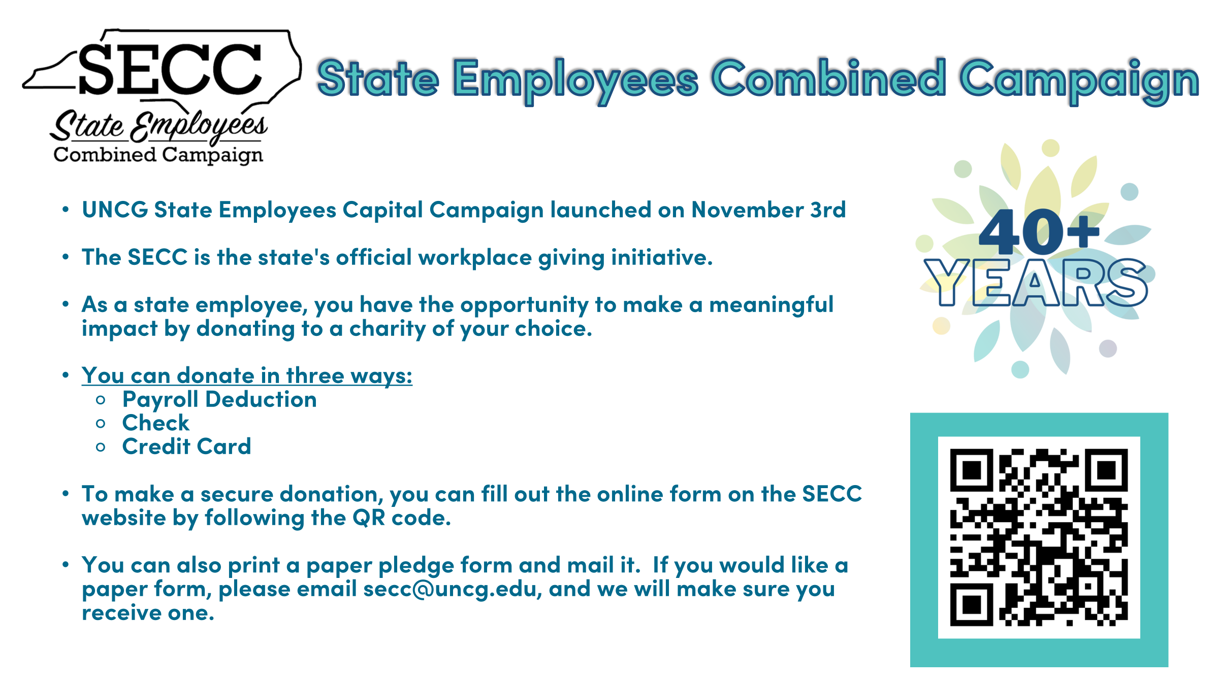
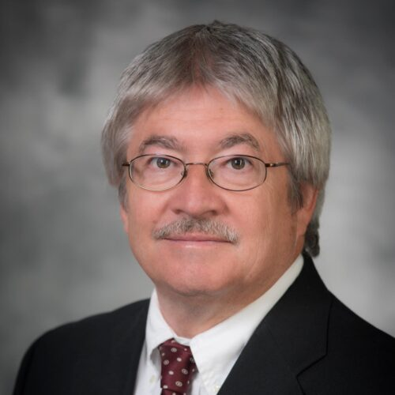
Faculty Senate
Faculty Senate website
Chuck Bolton Faculty Senate Chair

Slide 34

Outreach Committee
Congratulations to our newest Staff Stars
Staff Star
Space left blank
More to come!
Next month

Slide 35

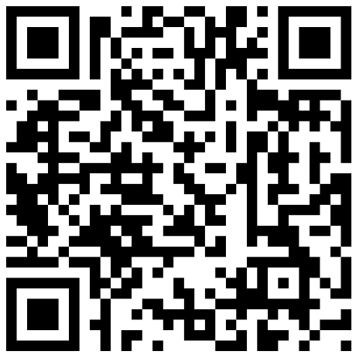
Outreach Committee
Celebrate Exceptional Acts of Care at UNCG
Nominate a Staff Star: go.uncg.edu/staffstar
Devotion to Duty
Innovation
Service
Human Relations
Other Outstanding Achievements
Recipients recognized at Full Body Staff Senate Meetings

Slide 36
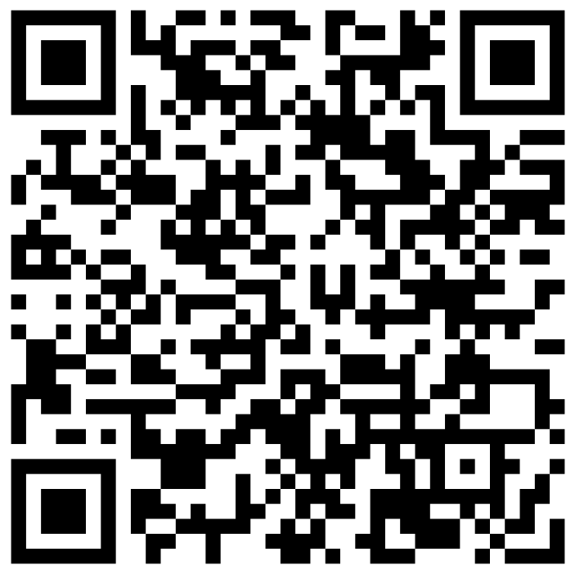
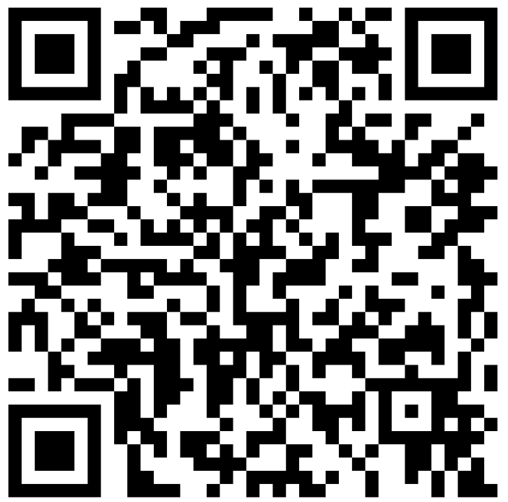
Excellence Awards
Staff Excellence Award
Ezekiel Robinson Staff Emeritus Award
Recognizes outstanding SHRA and EHRA Non‑faculty employees who make exceptional contributions to our campus.
Up to two recipients will be selected to receive $1,000 each
Submit: go.uncg.edu/staffexcellenceaward
Deadline: March 1, 2026
An honor conferred to recognize staff whose careers reflect distinguished and meritorious service to the university.
Submit: go.uncg.edu/staffemeritus
Deadline: March 1, 2026

Slide 37
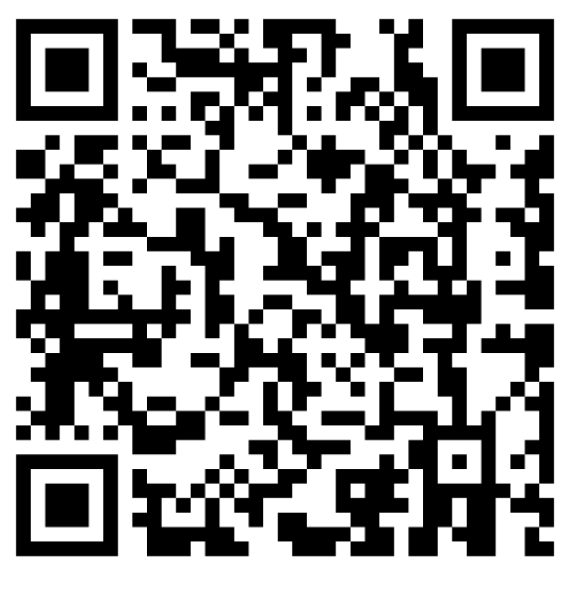
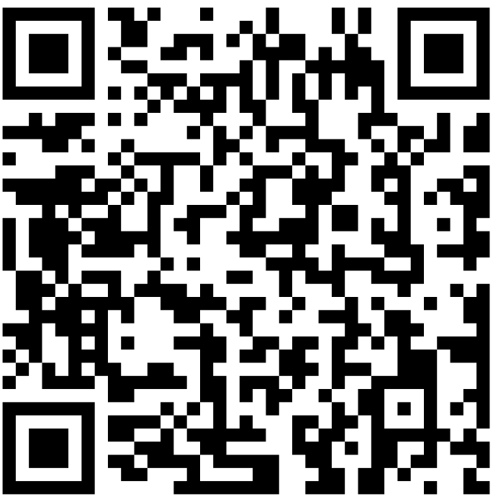
Fundraising
UNCG Staff Senate Endowed Scholarship
Please donate to the UNCG Staff Senate Endowed Scholarship.
Please use QR CODE below
Your support would be greatly appreciated.
Dates are March 3-4th
How Your Support Makes a Difference:
Professional Growth: Fund opportunities that promote career development and leadership for staff members.
Community Building: Enable programs and activities that strengthen connections across campus.
Scholarship Application Opening Soon
*Deadline: March 25, 20206
Donate
Apply
Make a difference today-donate to the Staff Senate and help us shape the future of our community.
Notes:
The Staff Senate Scholarship is designed to support the educational goals of UNCG staff and their families.
If you or a dependent, spouse, or domestic partner meet the eligibility criteria referred on the application, we encourage you to apply and take advantage of this opportunity to further your academic journey.

Slide 38
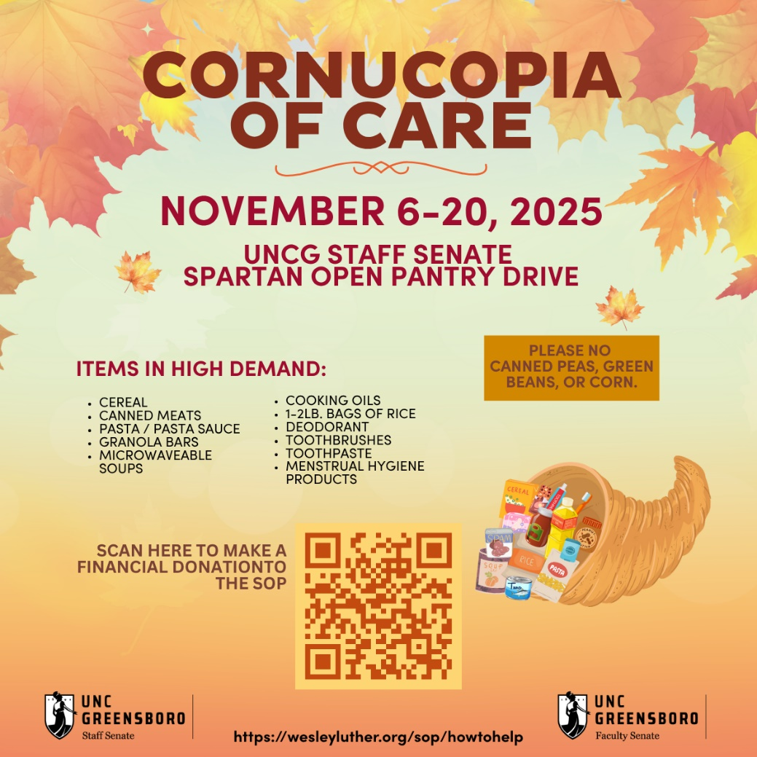
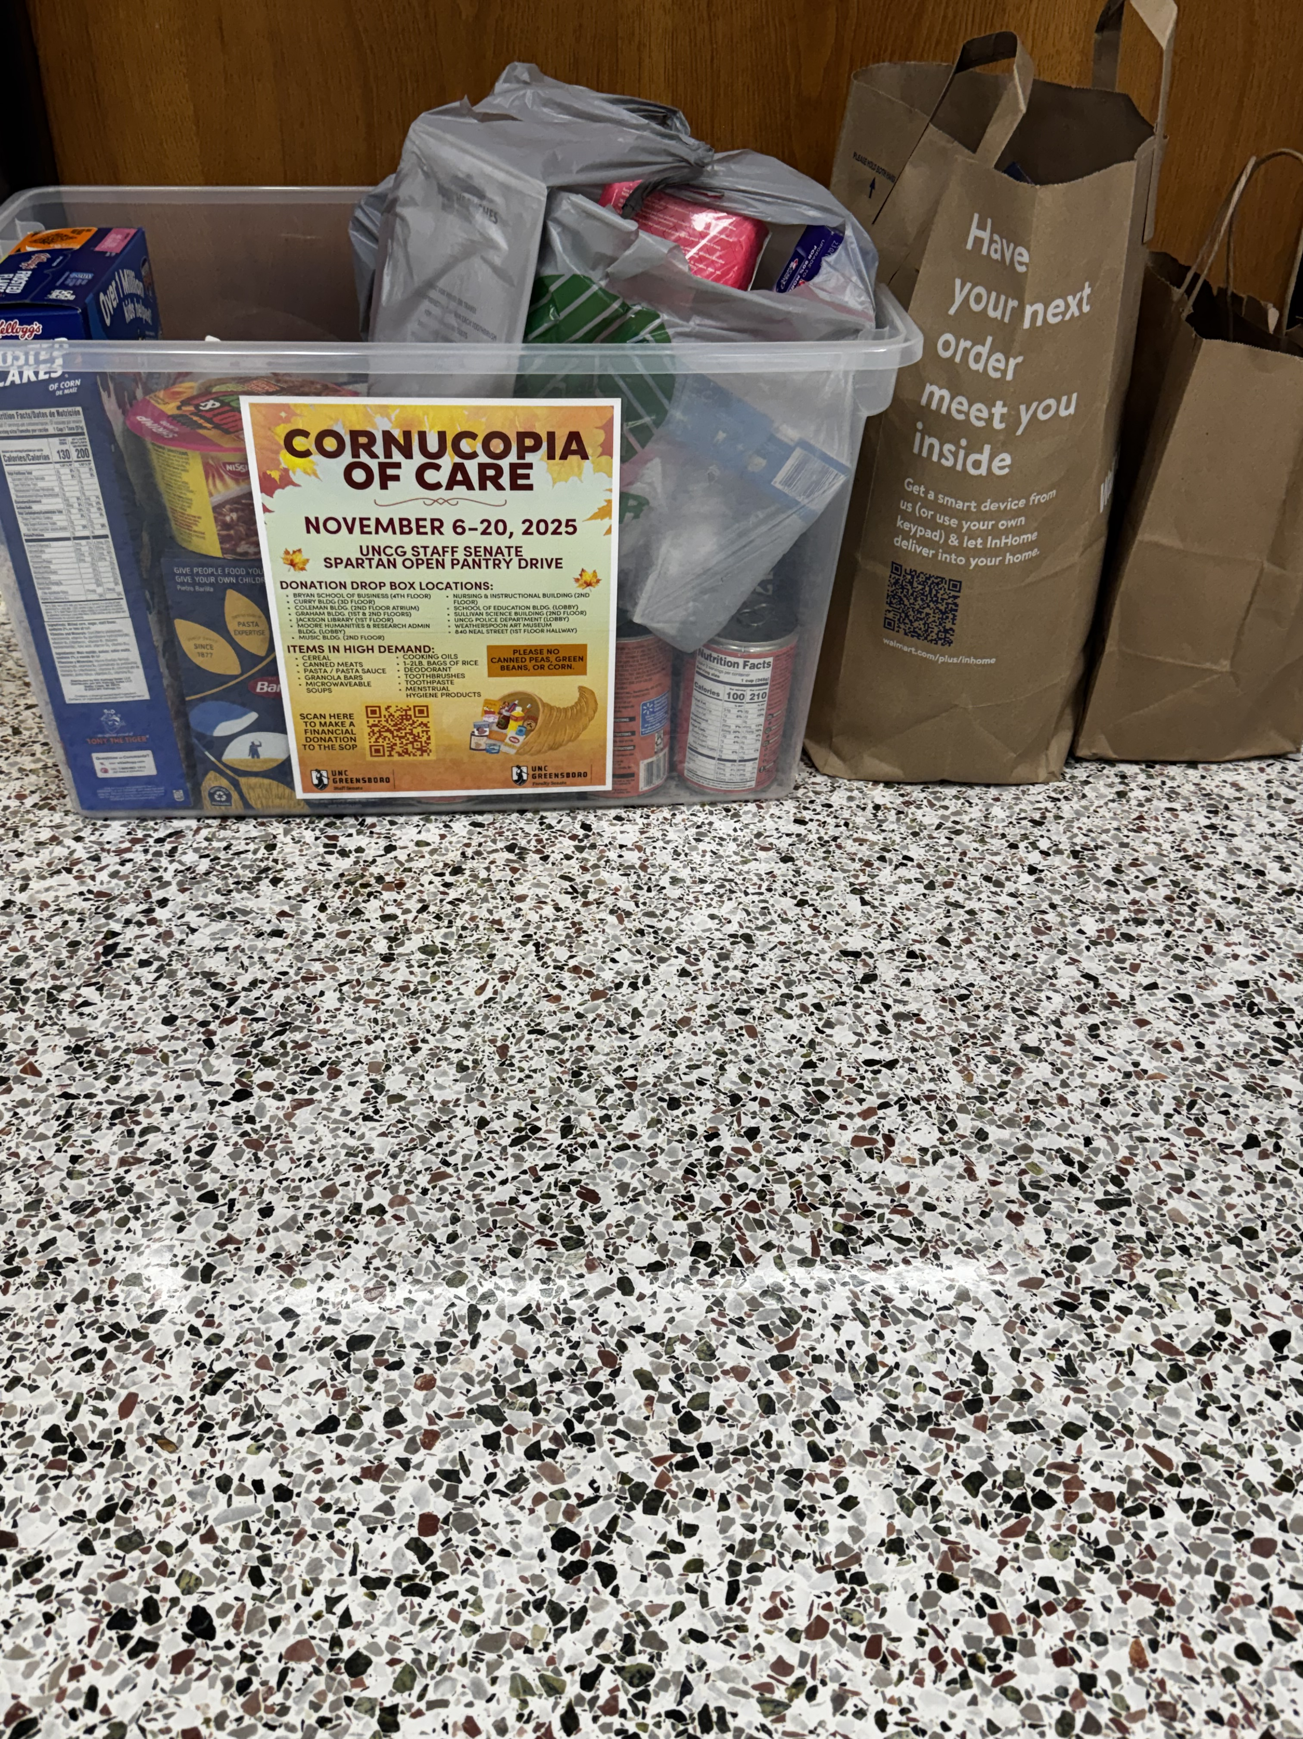
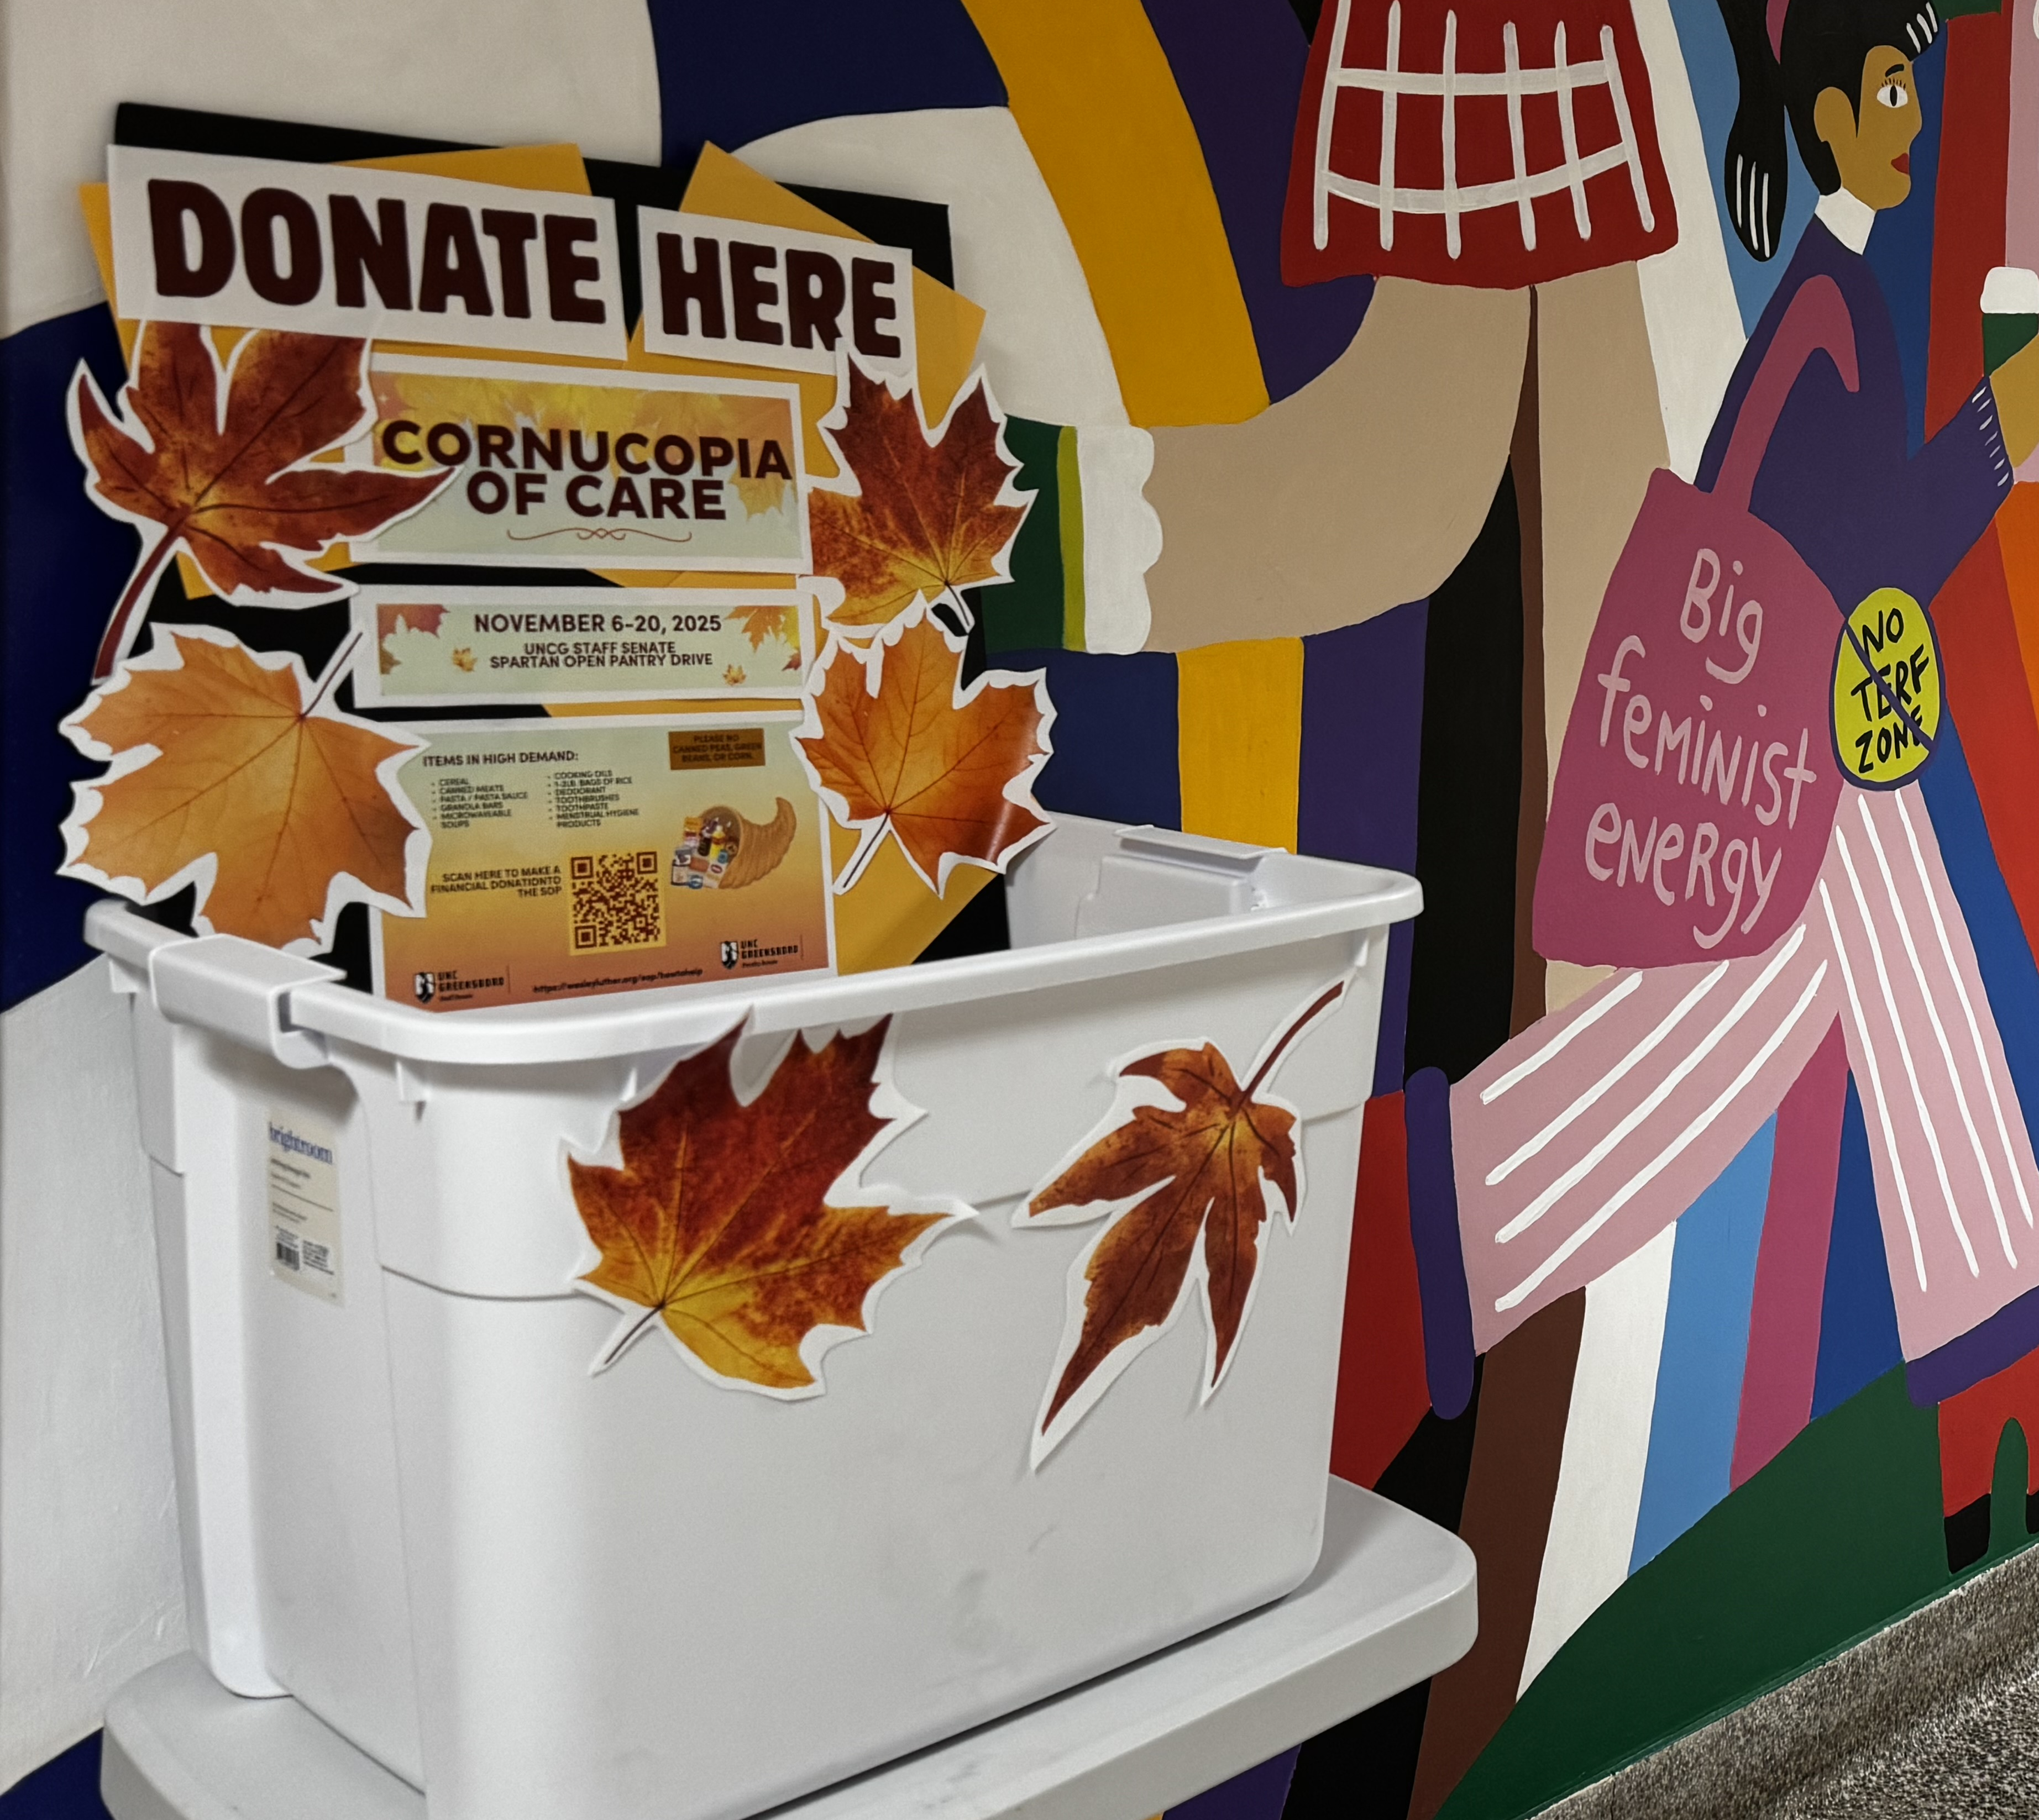
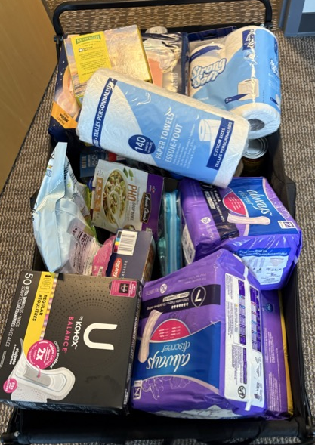
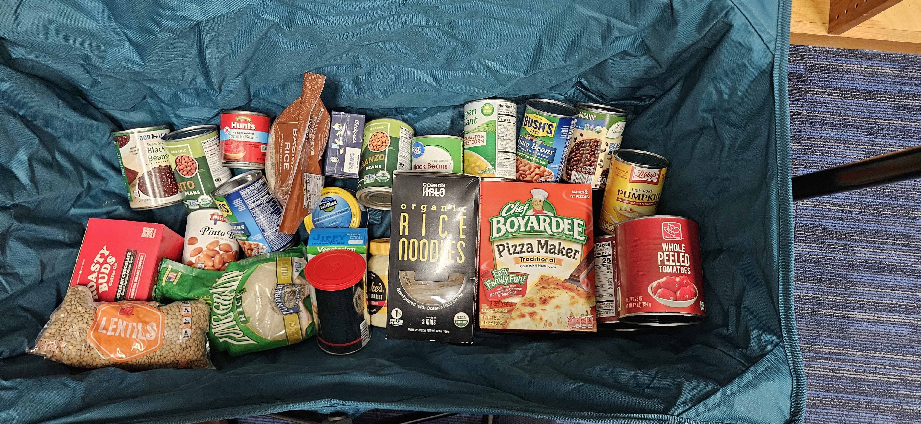
Spartan Open Pantry
Campus Community in Action
Staff Senate 🤝 Faculty Senate
Total locations: 17 locations across campus
Total Pounds collected: 1202.73
Estimated Monetary Donations: $2525

Slide 39
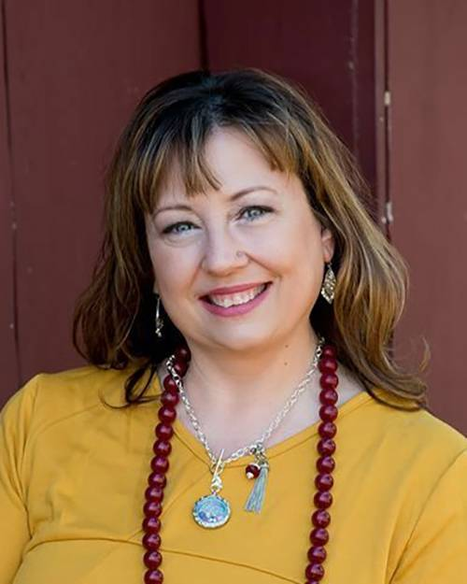
Kimberly Mozingo Parlimenatarian & Past Co-Chair
Elections
Total=46
Return=15
Open=31

Slide 40

Elections

Slide 41
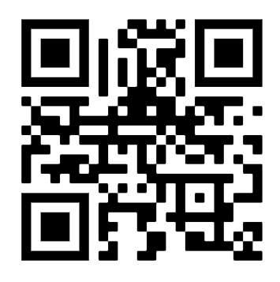
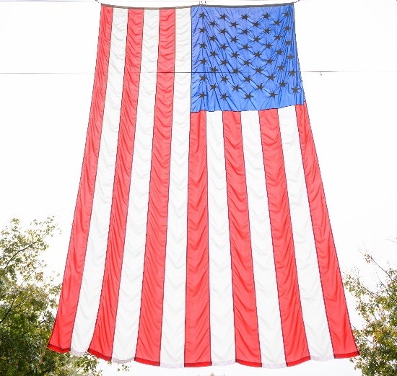
Honoring Veterans & Armed Services
November 11th
Two Events, Morning and Afternoon
Morning-EUC
10:00 AM – 1:00 PM
Card Signing and Pin Give Away
Afternoon-Military Affiliated Services
2:00 PM – 4:00 PM
Dessert Social
Veterans Only
VOLUNTEER SIGN UP

Slide 42
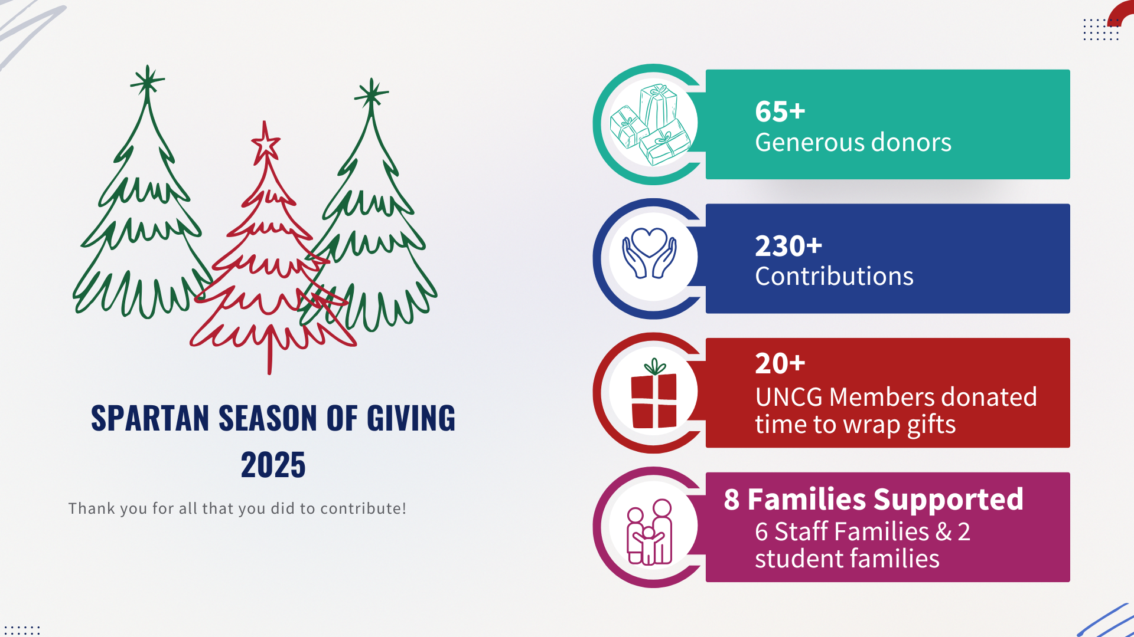
Spartan Season of Giving

Slide 43
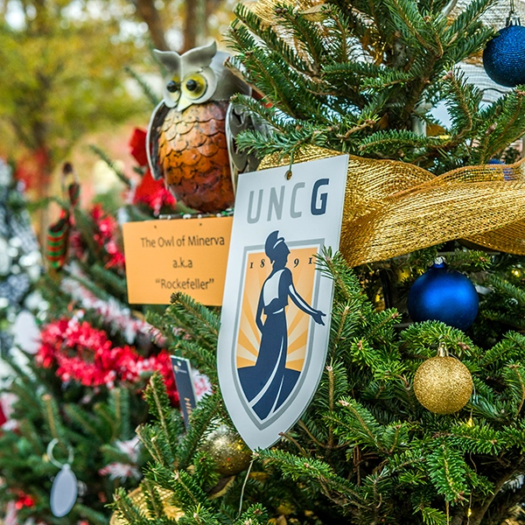
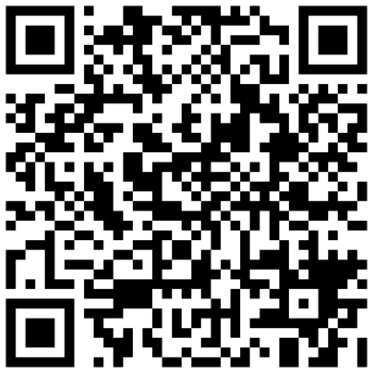
Spartan Season of Giving
November 4
November 6
December 10
December 15
Nominations were due
Selected nominees will be notified
November 14
Amazon Wish Lists will go live
Gift delivery deadline
Wrapping Party
For more information use the QR code on this slide or visit go.uncg.edu/SpartanSeasonofGiving.
Notes:
Every holiday season, the Staff Senate sponsors a Spartan Season of Giving to bring joy and support to individuals and families on our campus. Through the generosity of our staff, we collect and distribute gifts to those in need.
Nominations were due and submitted by November 4.
Families will be selected and notified on November 6.
Amazon Wish Lists will go live November 14.
All gifts need to be delivered by December 10.
The Staff Senate Wrapping Party will be December 15th and we are excited to see you all there! Refreshments will be provided.
For more information on Spartan Season of Giving, and to find the Amazon Wish Lists on November 14, use the QR code on this slide or visit go.uncg.edu/SpartanSeasonofGiving.

Slide 44
Upcoming Reminders

Slide 45

UNC System Staff Assembly
SAVE the DATE
Monday & Tuesday, March 9 & 10, 2026, at North Carolina Central University
Hear updates from the UNC System Office’s Human Resources

Slide 46
Adjournment

Slide 47


