Slide 1
UNCG
2025-2026
STAFF SENATE
Full Body Meeting
January 8, 2025
Notes:
Kimberly

Slide 2
Agenda
10:00am | Call to Order | Carla Wilson, Staff Senate Chair
10:05am | Roll Call | Scott Wilkens, Staff Senate Secretary
10:10am | Approval of Minutes
10:15am | Ex-Officio Reports
10:30am | Guest Speaker – Stefani Milroy & Dr. Mike Perko: 500 Fist Bumps @ UNCG Initiative
10:45am | Project/Committee Reports
10:50am | Upcoming Reminders
11:00am | Adjournment | Carla Wilson, Staff Senate Chair
Notes:
Kimberly

Slide 3
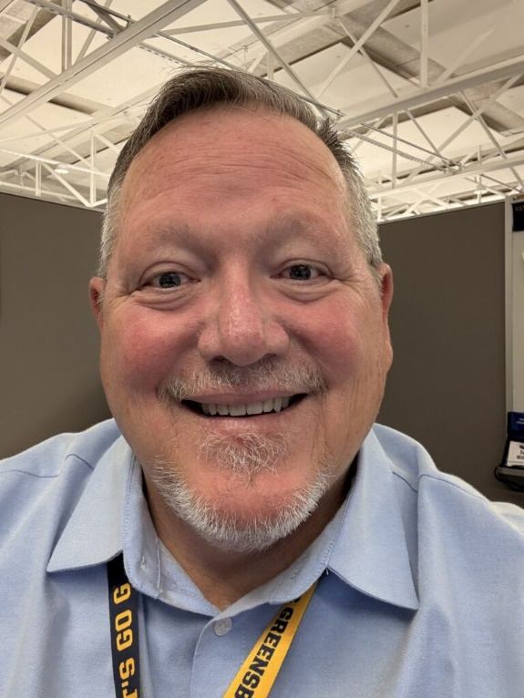
Scott Wilkens
Secretary
Roll Call
Senators attending online please let us know through the Q&A.

Slide 4
Roll Call
Senators attending online please let us know through the Q&A.

Slide 5
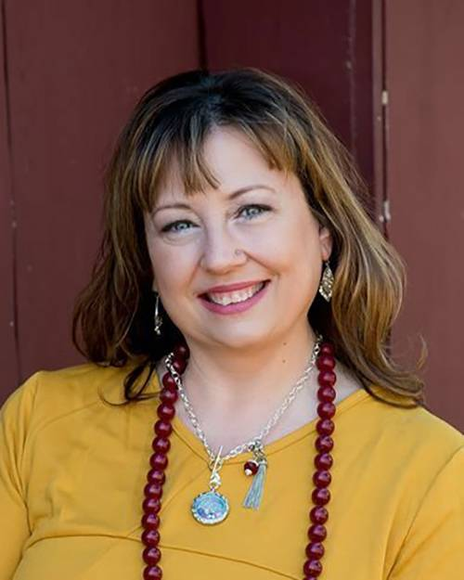
Kimberly Mozingo
Parlimenatarian &
Past Co-Chair
Approval of Meeting Minutes
November 2025

Slide 6
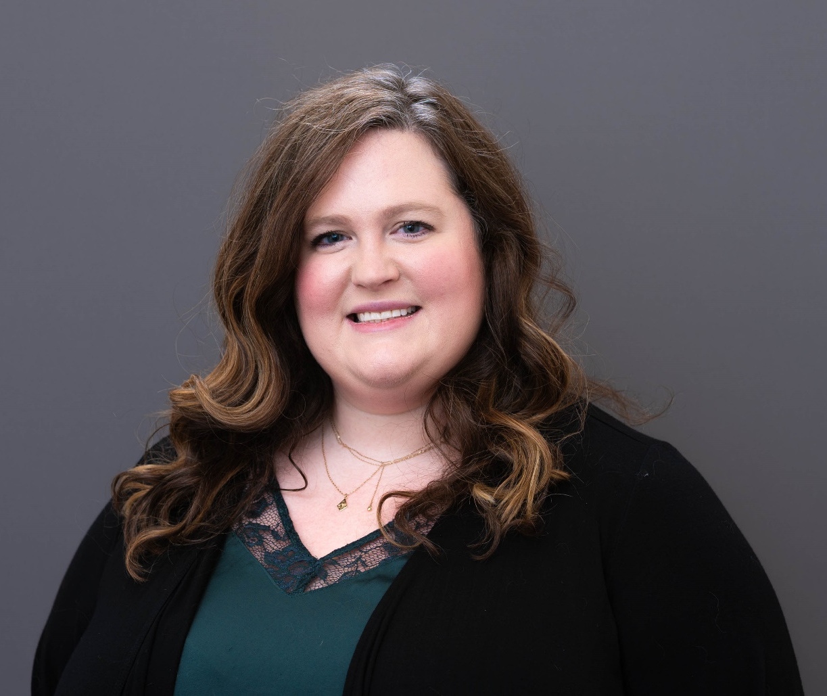
Brynne Pulver
Vice Chair
Approval of Meeting Minutes
November 2025

Slide 7
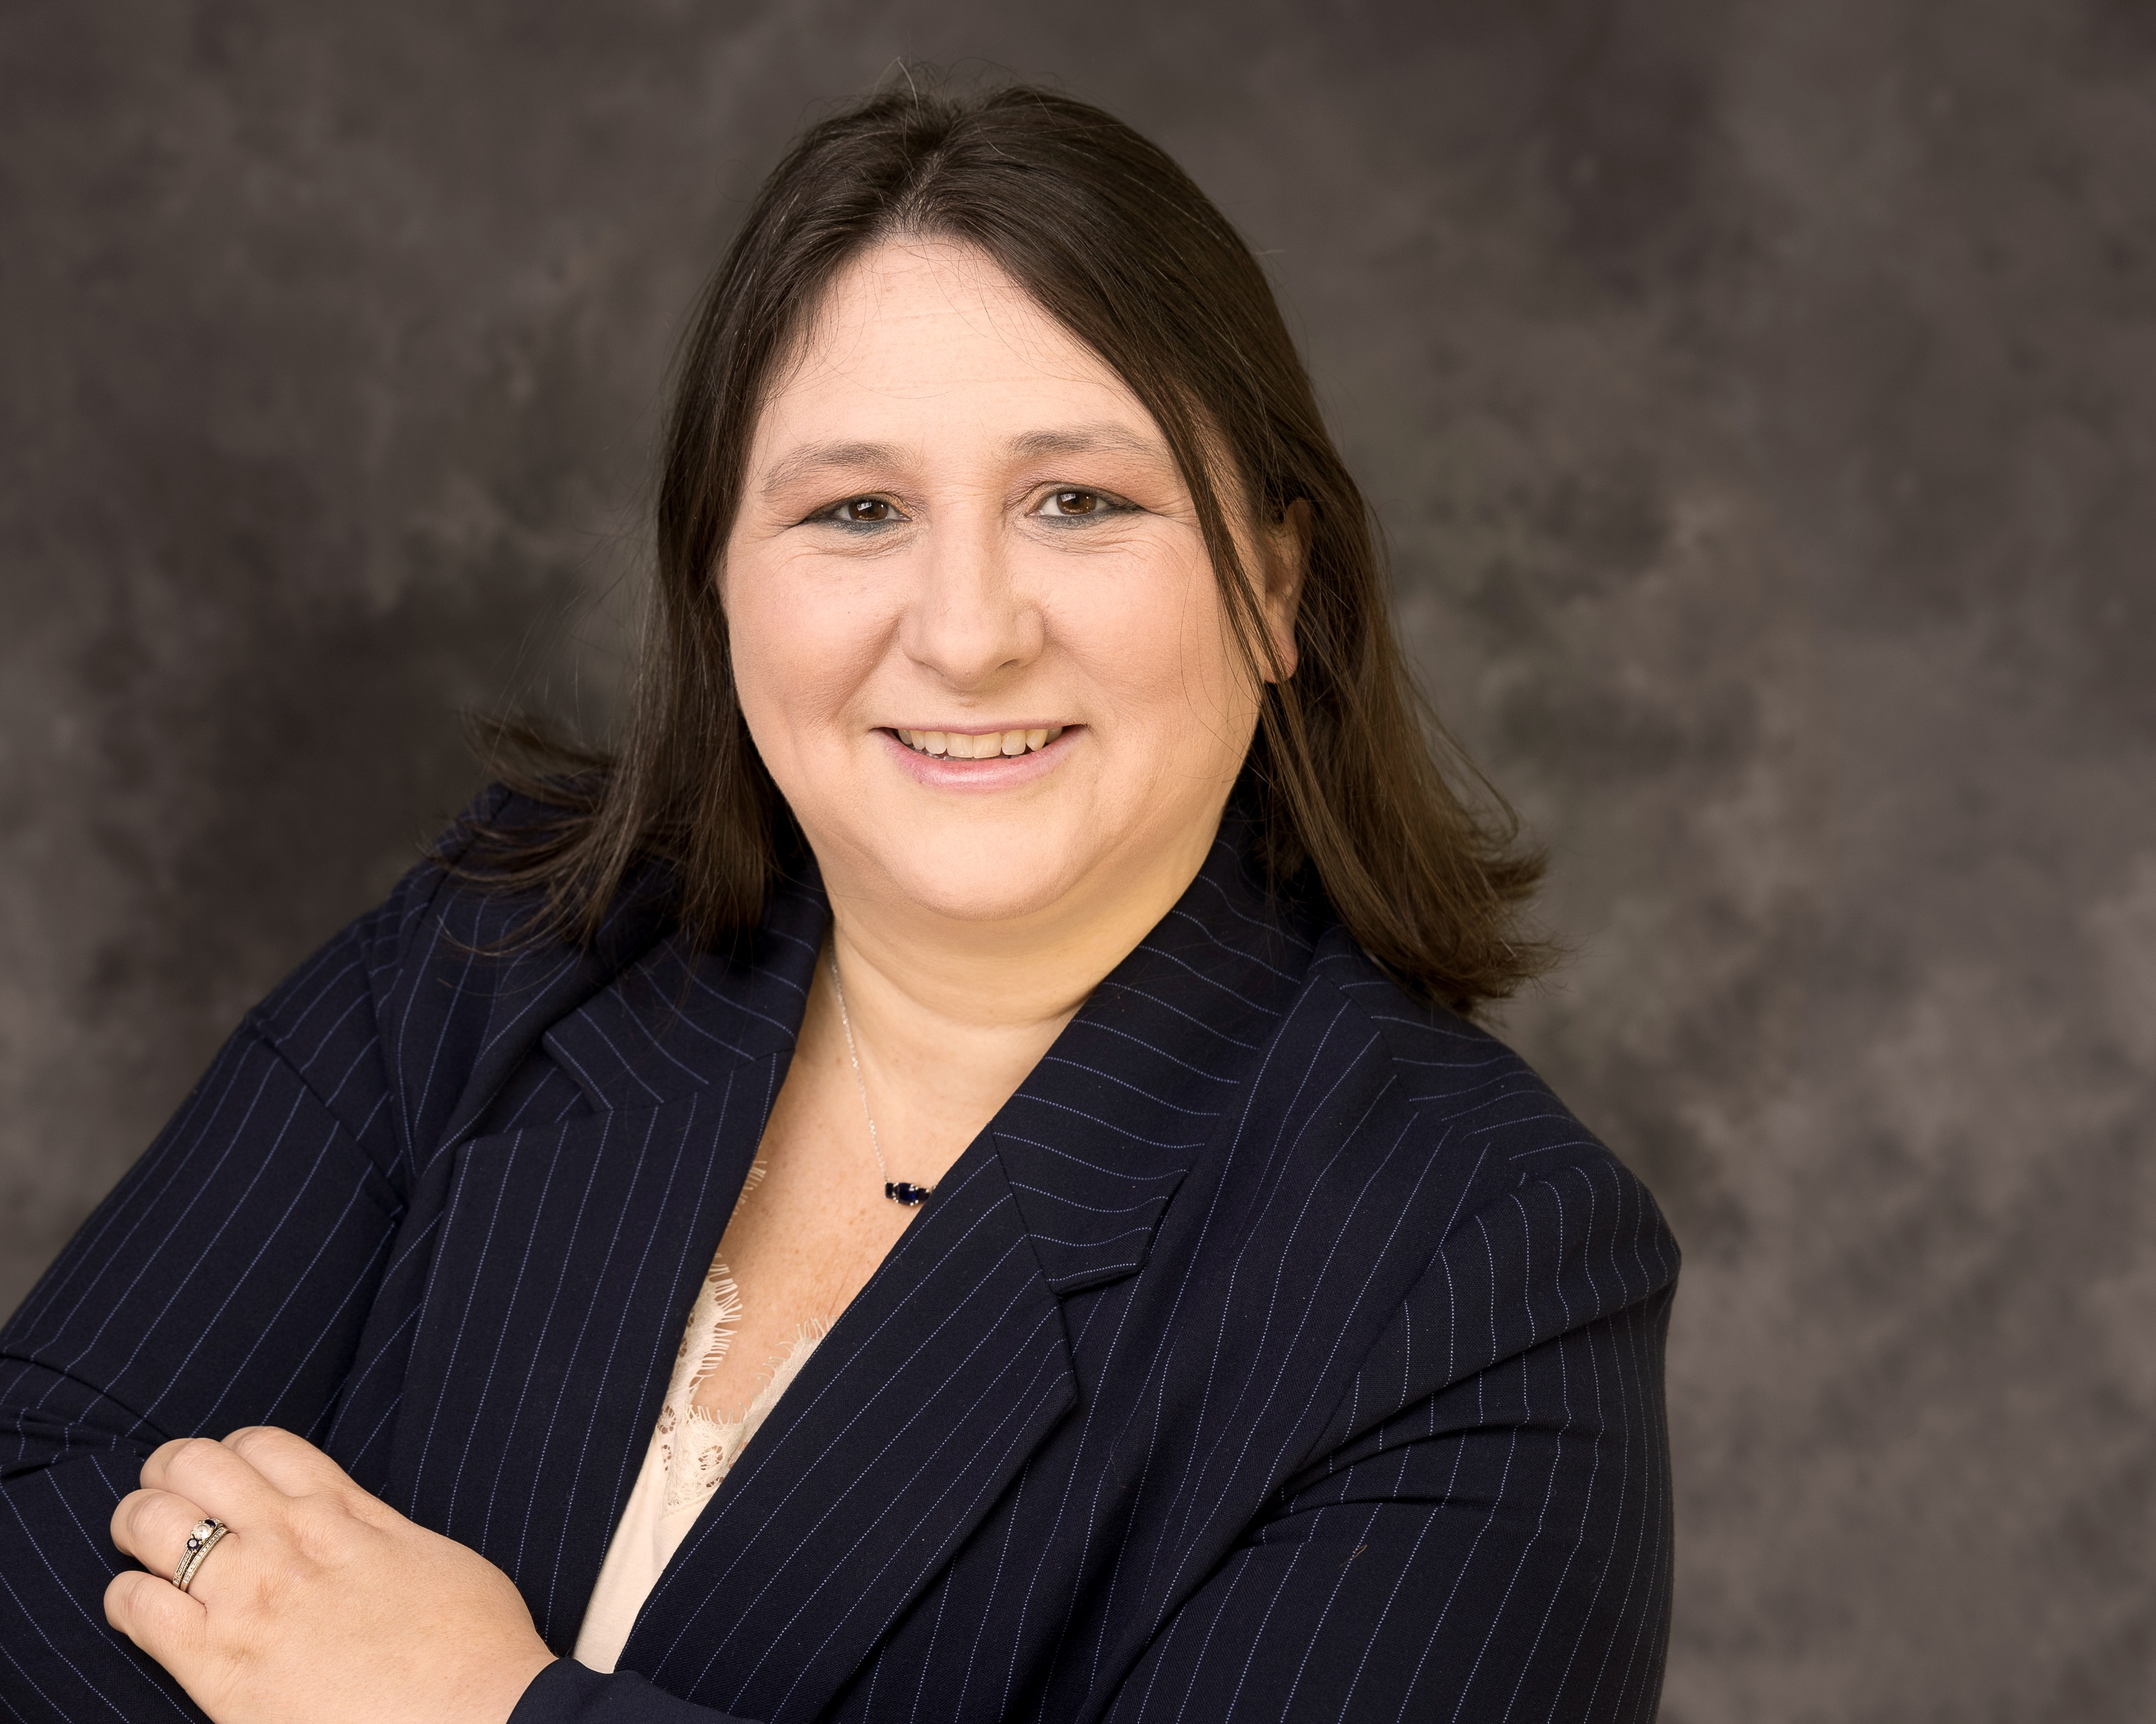
Carla Wilson
Chair
Approval of Meeting Minutes

Slide 8
Ex Officio Reports/Updates

Slide 9
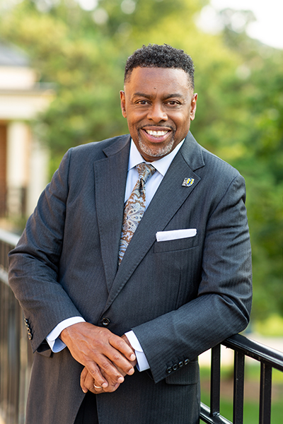
Dr. Franklin D. Gilliam, Jr.
Chancellor
Chancellor's Update

Slide 10
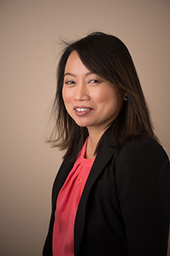
Waiyi Tse
Chief of Staff,
Office of the Chancellor
Chancellor's Update

Slide 11

Information Technology Service Update
Technology Initiatives
Workshops
Todd Sutton
Associate Vice Chancellor for Learning Technology and Customer Success

Slide 12
Information Technology Service Update
Technology Initiatives
Workshops

Slide 13
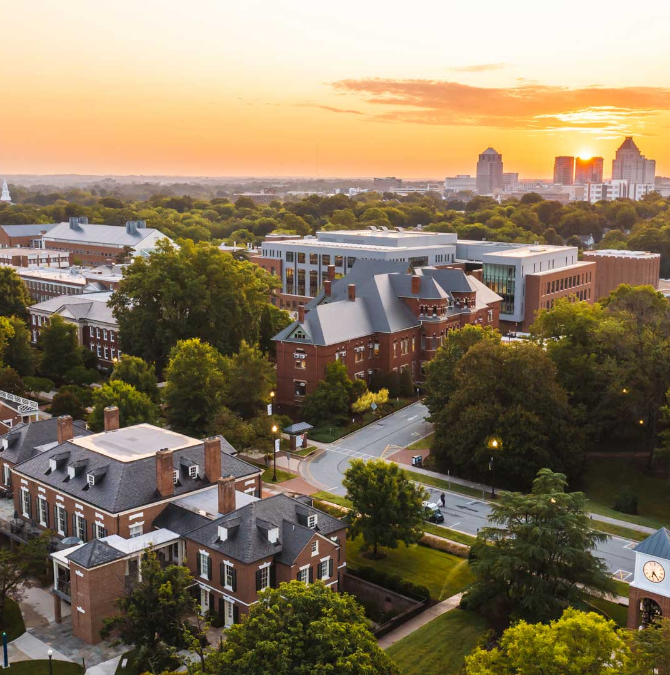
JANUARY 2026 UPDATES
TECHNOLOGY
INITIATIVES
Todd Sutton
Associate Vice Chancellor for Learning Technology and Customer Success

Slide 14
Managed Print Services (MPS) Program
Purpose: Streamline print operations, reduce costs, improve efficiency, and support sustainability through centralized printer management
Features
Secure, shared multifunction printers
Follow-Me billing & usage reports
Centralized billing, no P-Card use
Placement & Access
Common areas only, no office printers
Shared access across departments
Student printers placed by need
Policies
ITS approval for all printers & supplies
MPS covers toner & standard paper
Return unapproved or legacy printers
Special Cases & Compliance
E-fax replaces physical faxing
Specialty printers need approval
Escalating penalties for violations
https://go.uncg.edu/mps

Slide 15
CHiP Initiative
Purpose: Centralize all UNCG technology purchases through ITS to ensure compliance, improve security, standardize support, and reduce costs. ​​
Scope:
  All UNCG tech purchases go through ITS​
  Standardized, secure, supported services
  $1Mil+ annual savings projects
Two Facets:
  Leasing: Tier 1 or Tier 2 Mac/PC for faculty & staff (4-year lifecycle)
  Purchases: Peripherals, tablets, & other non-leased technology (research equipment, Tier 3 exceptions, etc.)
https://its.uncg.edu/tech-initiatives/chip-initiative/

Slide 16
IT Assessment
Purpose: Evaluate how IT services are organized and delivered across campus. ​​
Goal: Identify strengths, gaps, and design a model tailored to UNCG
Process: Transparent, phased, and shaped by input from faculty, staff, and students
Job Security: Not designed to cut positions; changes will be thoughtful & gradual
Your Role: Share IT support experiences, understand that this is about sustainability, and watch for updates.
Town Hall Details:
  Date: Monday, Jan. 12, 2026
  Time: 2:00–3:30 p.m.
  Location: Elliott University Center Auditorium
https://tech-assessment.uncg.edu/

Slide 17
Identity and Access Management Initiative
Purpose: UNCG is developing a strategic plan to modernize how we manage sign-ins and system access—improving security, user experience, and efficiency across campus.
Update:
Planning for IAM platform procurement and implementation project
https://its.uncg.edu/tech-initiatives/identity-and-access-management

Slide 18
Banner Web Time Entry
Purpose: Streamline and improve our current time and leave entry process
Reminders for Exempt Leave-Earning Employees using Leave Reports:
Submit on your last working day of the month—once approved, the leave report is final, and leave is deducted; any changes must go through HR or FPS.
Visit https://hrs.uncg.edu/hr-operations/banner-hr/ for 2026 deadlines and WTE documentation.
Campus Go Live:
  Date TBD: Hourly Student and Temp employees will begin using Banner Web Time Entry timesheets
  Date TBD: Non-Exempt and Non-Exempt LEO employees will begin using Banner Web Time Entry timesheets
https://its.uncg.edu/tech-initiatives/banner-web-time-entry/

Slide 19
Academic-Link
Purpose: Strengthen indoor wireless connectivity at UNCG, ensuring fast, reliable Wi-Fi where it’s needed most
Update:
November 2025: Network closet assessment complete
TBD: Remediation
https://its.uncg.edu/tech-initiatives/academic-link/

Slide 20
ITS Project Status Dashboard
https://its.uncg.edu/project-status-dashboard/
Notes:
ITS Project Status Dashboard view provides all active projects status across all three technology portfolios (AAF/EM, F&A, and ITS)

Slide 21
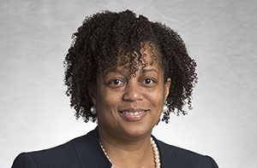
Human Resources Update
UNCG Human Resources website
Patricia Lynch
Director of ER and EEO/AA
Human Resources Officer

Slide 22
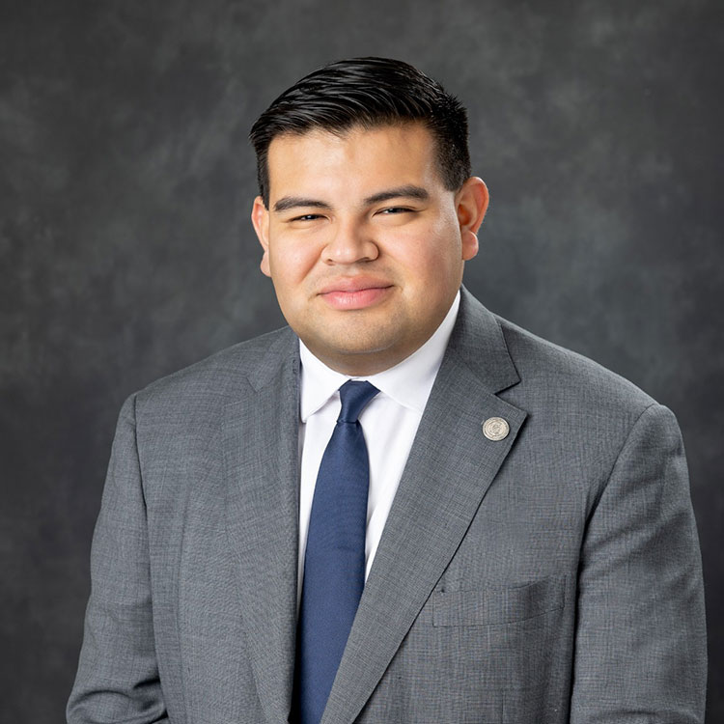
Juan Pleitez
Director of External Affairs
Strategy and Policy
Legislative Update

Slide 23
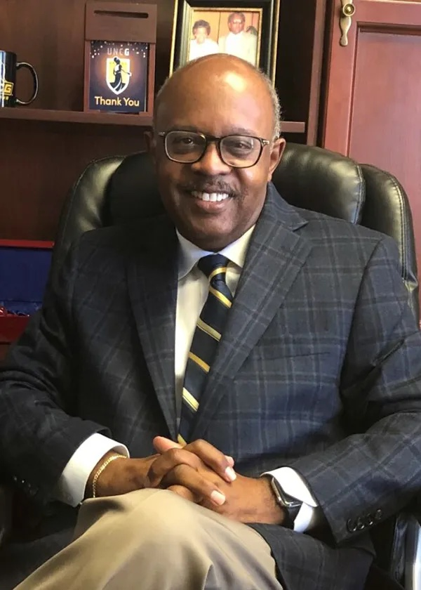
Jerry Blakemore
Vice Chancellor,
Institutional Integrity & General Counsel
Equality Policy
Notes:
Jerry D. Blakemore serves as the Vice Chancellor for Institutional Integrity and General Counsel for UNC Greensboro.
He has more than 30 years of experience in higher education administration, policy development and the providing of legal services, 19 of which as General Counsel for major institutions of higher education.

Slide 24
Guest Speaker

Slide 25







Workplace Edition
You BELONG here!
You BELONG Here
Building Connection and Belonging:
500 Fist Bumps Info Session

Slide 26





YThink back to someone in your life who made an positive impact on who you are today.
How did they make you feel?

Slide 27
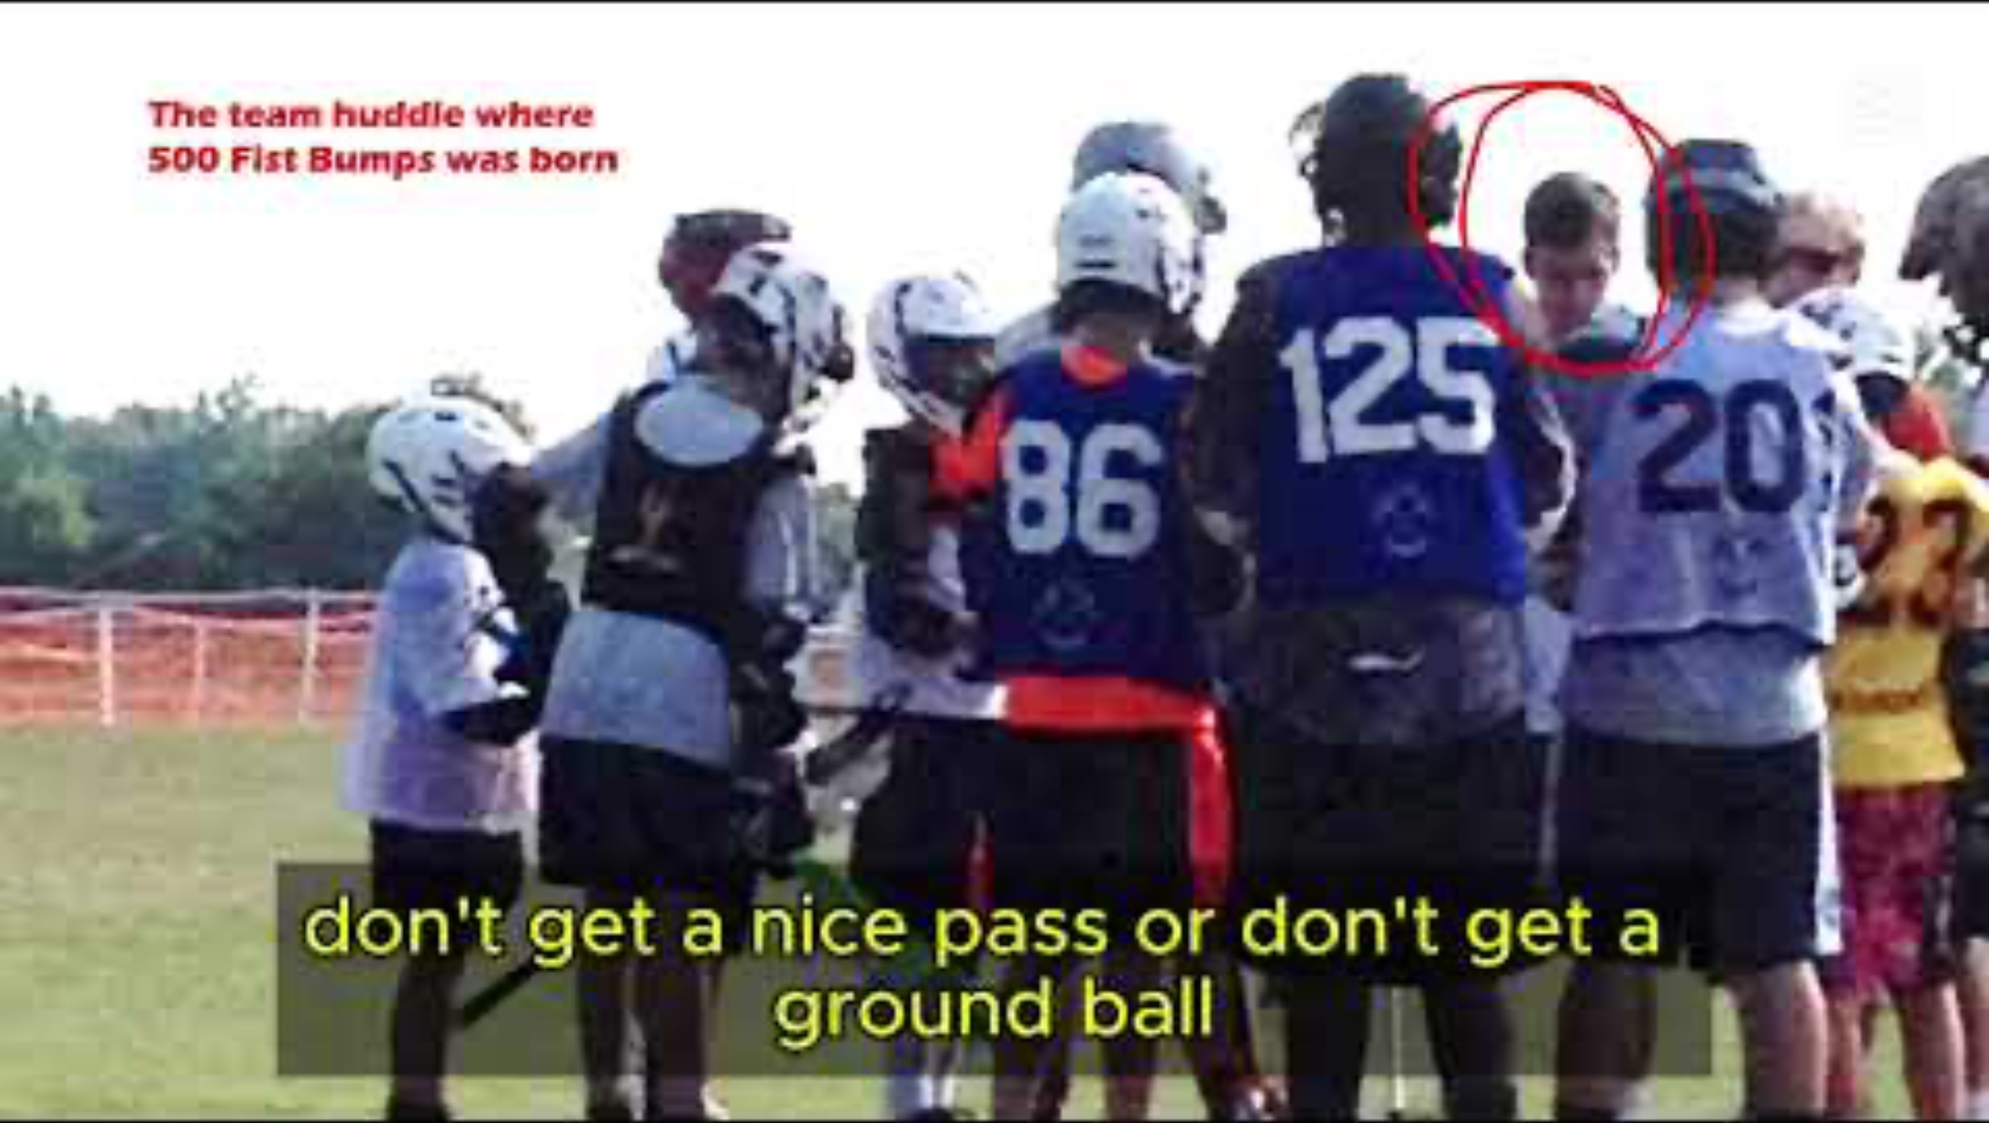
What is 500 Fist Bumps?

Slide 28


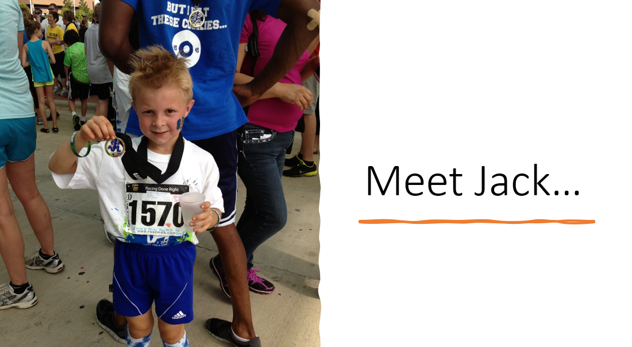



Slide 29


Slide 30
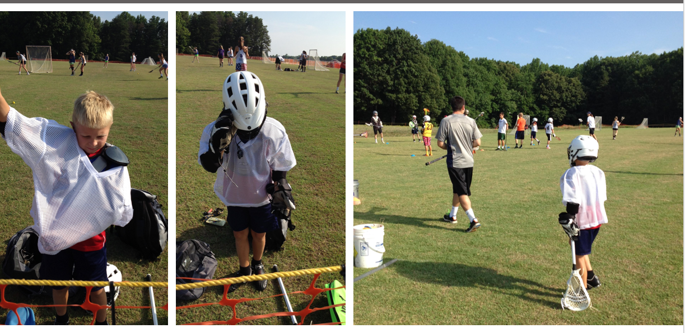

Slide 31
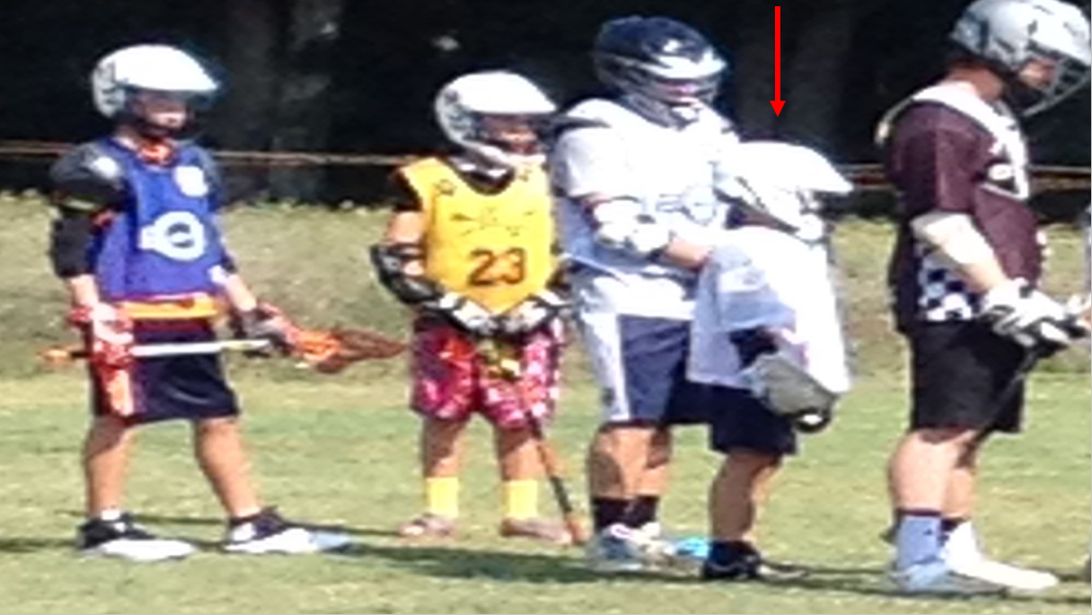

Slide 32
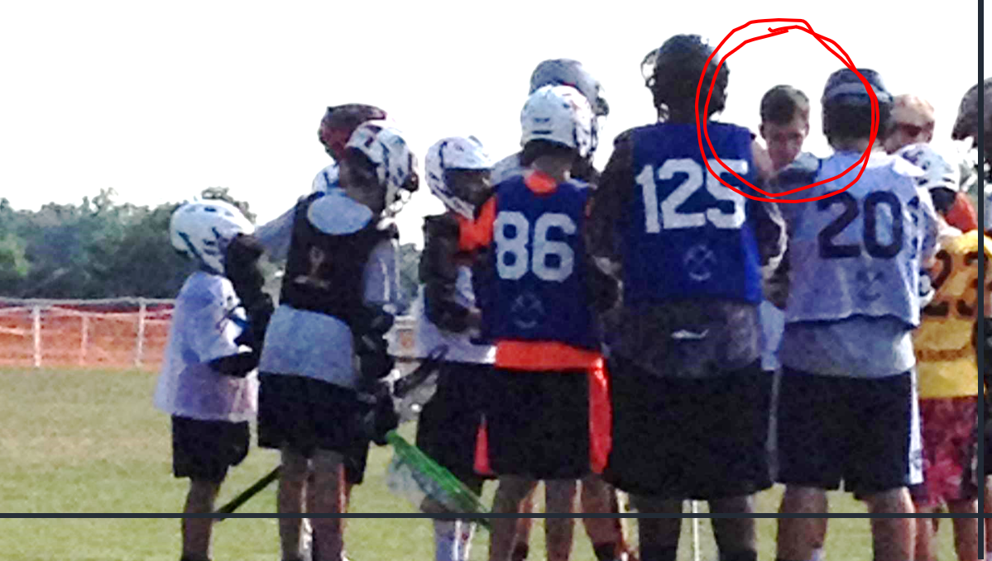

Slide 33
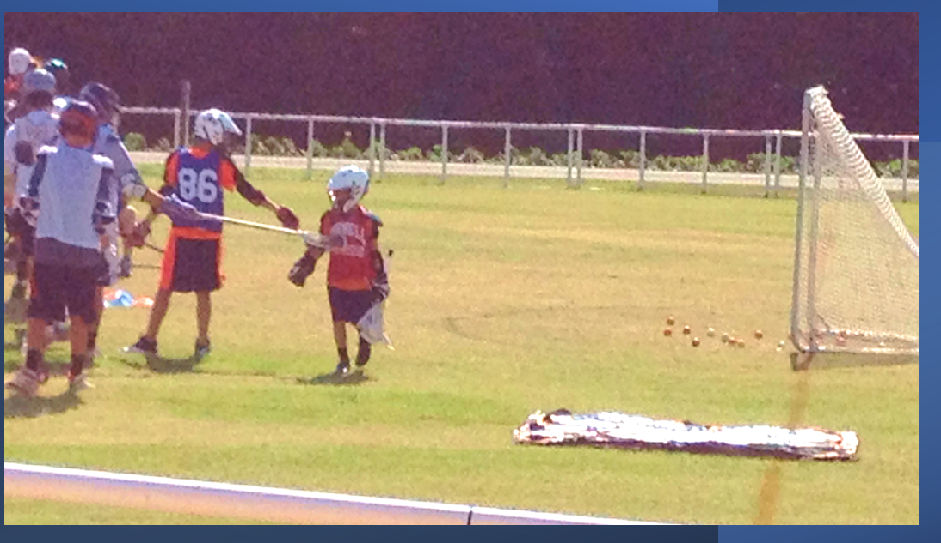

Slide 34
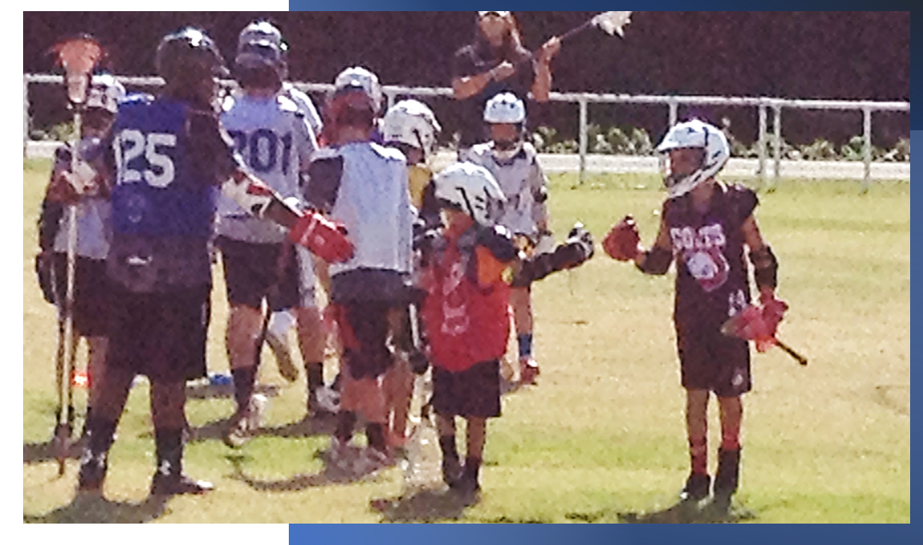

Slide 35
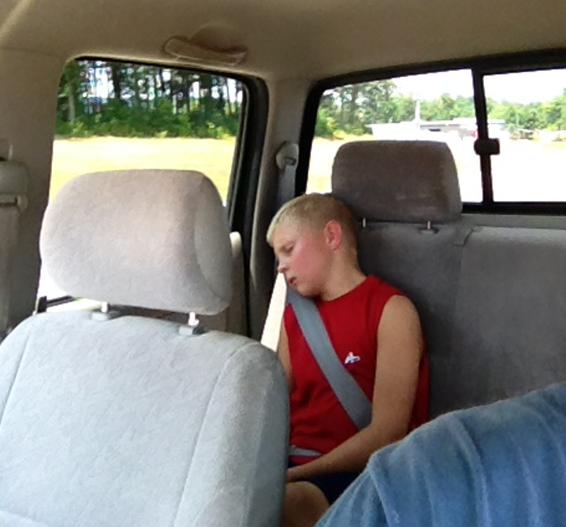
Best day ever!

Slide 36
For 30 years I have been asked one question:
How do we create a culture that supports being healthier?
You BELONG here!

Slide 37
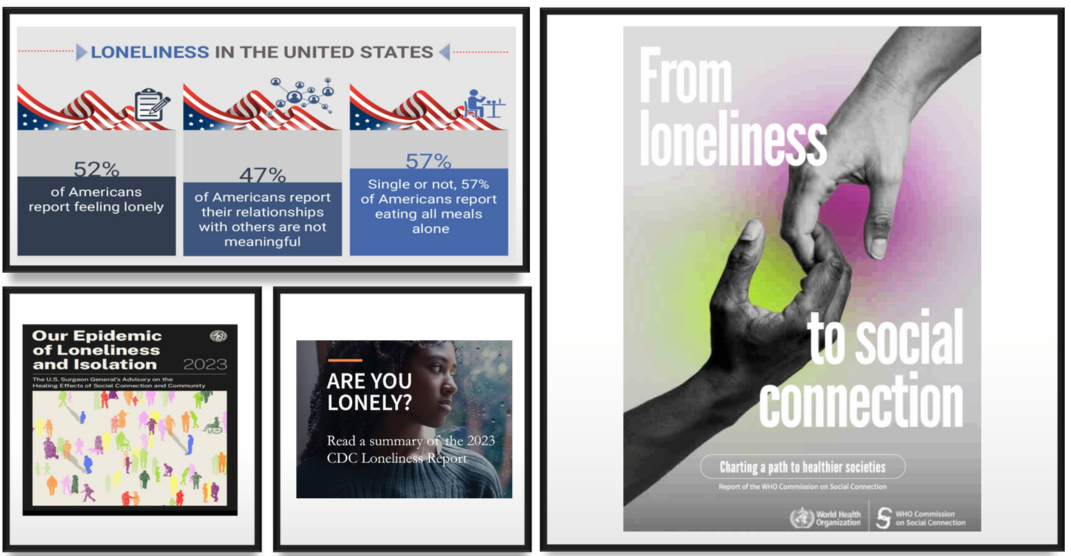

“There is no community without connection.”
Human connection is a social determinant of health and is no longer a program level issue; it’s now a mandate for institutional commitment.
Notes:
Create or find graphs make visually appealing

Slide 38

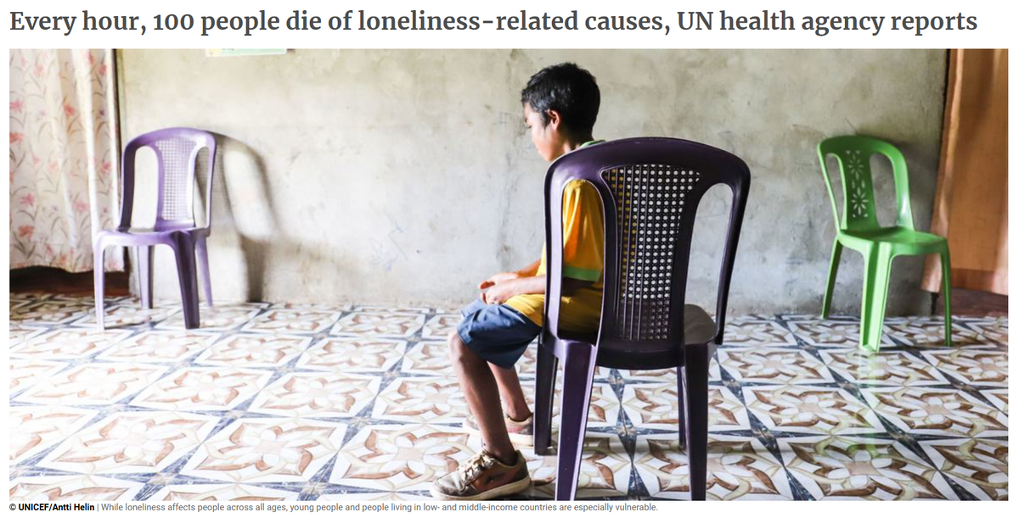

The Effect of Loneliness & Health
Social isolation and loneliness can increase a person's risk for:
  Heart disease and stroke.
  Type 2 diabetes.
  Depression and anxiety.
  Suicidality and self-harm.
  Dementia.
  Earlier death.
26% higher mortality rate

Slide 39

Why 500 fist bumps? ​
​
After 5 fist bumps: Receptors in the skin release oxytocin, the hormone that helps decrease anxiety and the discomfort felt from everyday stressors.​
​
After 50 fist bumps: Feelings of loneliness are reduced, and an increased level of bonding and empathy are created.​
​
After 150 fist bumps: The hormones dopamine and serotonin are released; these help to create feelings of safety and security and a greater sense of coping.​
​
After 300 Fist Bumps: Stress hormone cortisol reduced, Heart rate slows, blood pressure lowered, perceived risk of fear, danger, and threat reduced.​
​
After 500 fist bumps: The brain's insular cortex engaged; this is a part of the brain that activates feelings of happiness, trust, and cooperation in social situations. Literally creates a sense of community.​

Slide 40


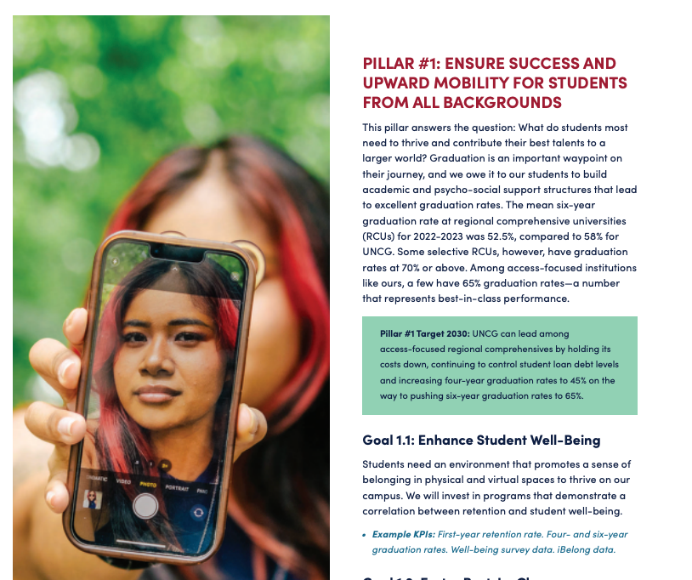



“YOU BELONG HERE”

Slide 41
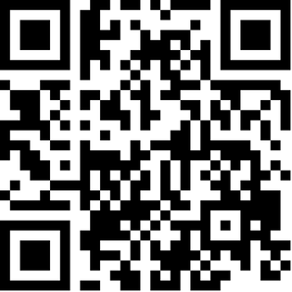
Connection Coin Challenge
You BELONG Here

Slide 42




3 steps to create connection and belonging using the Connection Coins
Step 3: SCAN THE BACK & PASS IT ON...
Step 1. INTENTIONALITY
Step 2: PURPOSE
  Building belonging takes intention. Be deliberate about creating opportunities to connect.
  Connect for many reasons:
support, encouragement,
empathy congratulations, or
to simply say, “I see you.”
  Everyone deserves to be connected - look for every opportunity to connect with others.
With 3 steps, UNCG will build belonging—one fist bump at a time.

Slide 43

Projected Goal for UNCG
You BELONG Here
is a campus-wide effort to connect the UNC Greensboro conmmunity. Rooted in public health principles, we invite our community to engage in deliberate acts of connection.
These "fistbumps" symbolize moments of belonging, recognition, and care—because when we feel seen and supported, we thrive academically, professionally, and personally.
Social connection strengthens our well-being and deepens our shared commitment to inclusive excellence. Together, we’re creating a culture of kindness and collaboration that reflects the best of what UNCG stands for. You BELONG here!

Slide 44
How to become a 500 Fist Bump Dept.
You BELONG Here
  Pre-survey
  Fishbowl (250 coins)
    (25 coins individual)
  Signage
  Stickers
  Weekly Newsletter
  Follow-up
  80% department participation earns “500 Fist Bump Department” designation with plaque and signage, website and socials recognition

Slide 45
Thank You
Belonging = Better YOU and UNCG COMMUNITY

Slide 46
Project/Committee Reports

Slide 47
Spring 2026 FB Meetings
Thursday, February 5
Thursday, March 12
Thursday, April 9
Thursday, June 11 (10-noon) | EOY Wrap-up Celebration
All meetings are from 10-11am in the Alumni House unless otherwise posted.
For more information: staffsenate.uncg.edu
Notes:
Kimberly

Slide 48
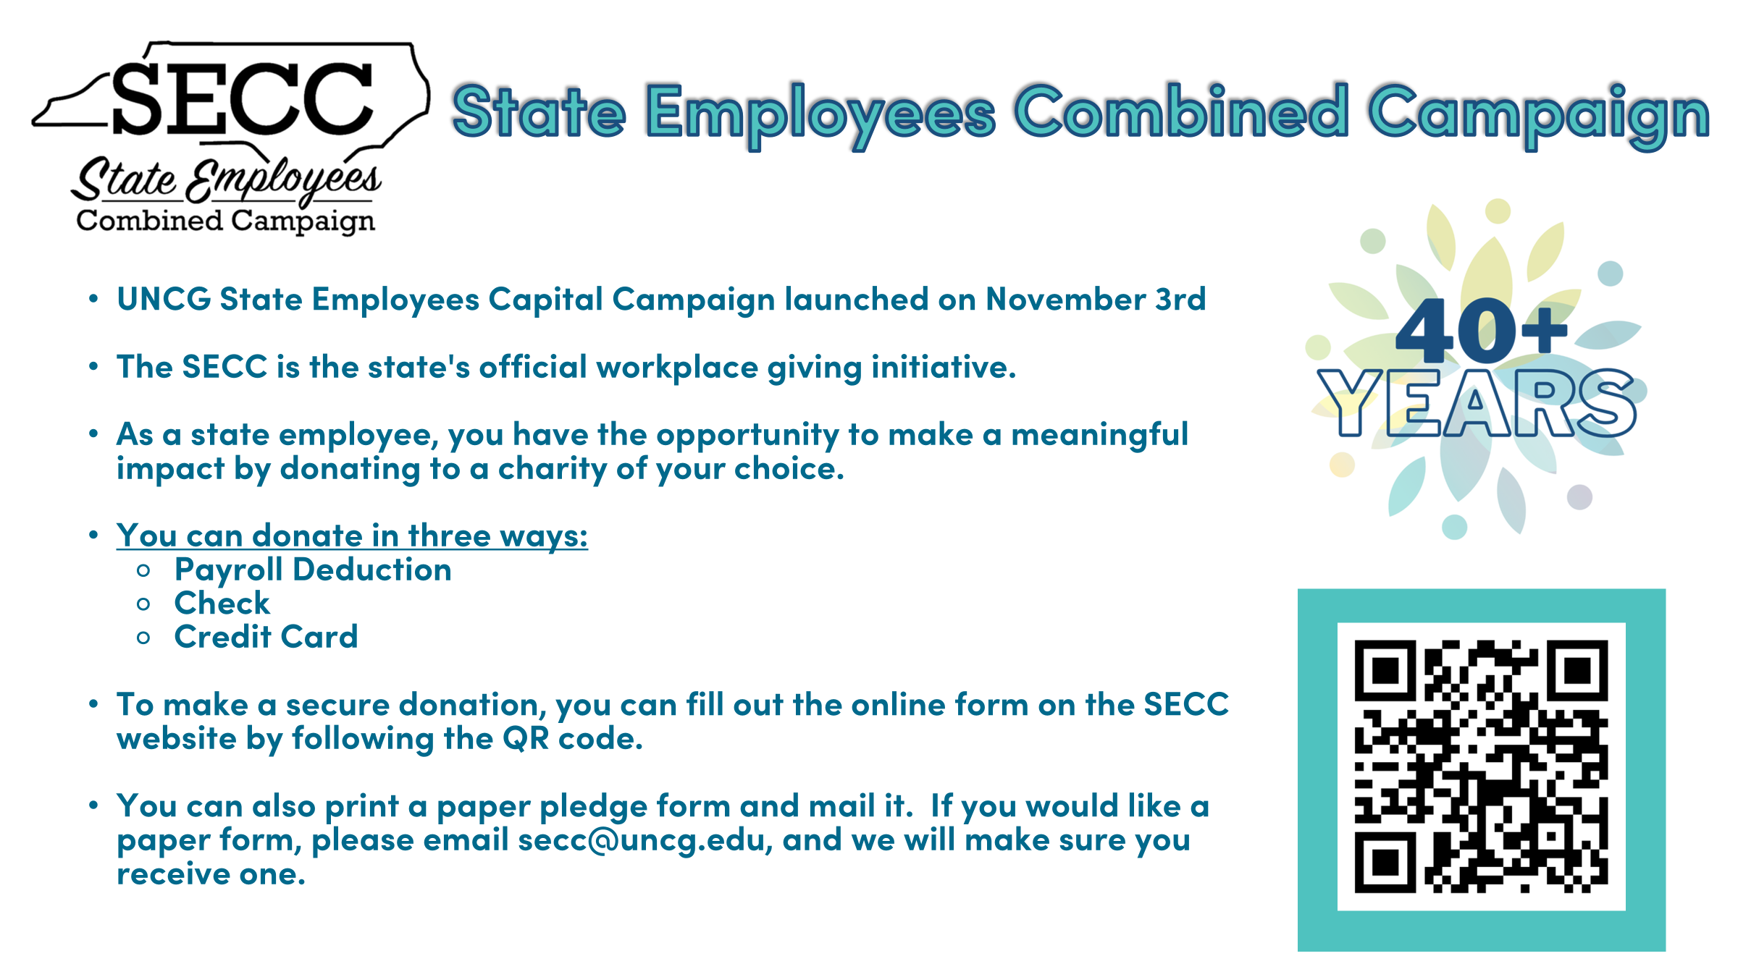
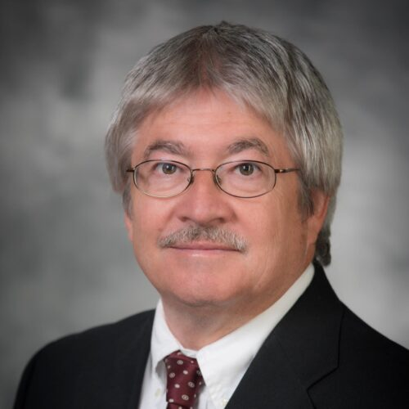
Faculty Senate
Faculty Senate website
Chuck Bolton
Faculty Senate Chair

Slide 49

Outreach Committee
Congratulations to our newest Staff Stars
Donald Gray
Technology Support Analyst
Bryan School & School of Education
Julia Goren
Dean’s Office
Bryan School
Gail Pack
Undergraduate Student Services
Bryan School
Timothy Wilkins
Facility Services
Jessica Quattrucci
Academic Advisor
Bryan Undergraduate Student Services
Academic Advisor
Bryan Undergraduate Student Services
Nancy Trejo- Barcenas
Recruiting & Academic Advising Specialist
Bryan School
Breanna Wallace
Academic Advisor
Bryan Undergraduate Student Services
Alyssa Rose

Slide 50
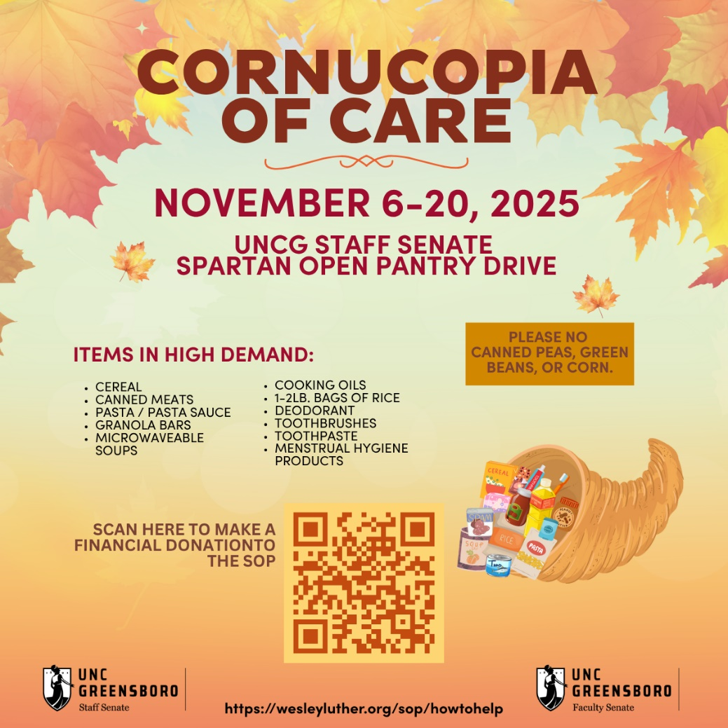
Spartan Open Pantry
Provides free, high-quality foods for needy Spartans
Runs November 6th through November 20th
Location! Location! Location!
NEEDED ITEMS
Cereal
Canned meats
Pasta/pasta sauce
Granola bars
Microwaveable soups
Cooking oils
1- 2 lb. bags of rice
Deodorant
Toothbrushes
Toothpaste
Menstrual hygiene products

Slide 51
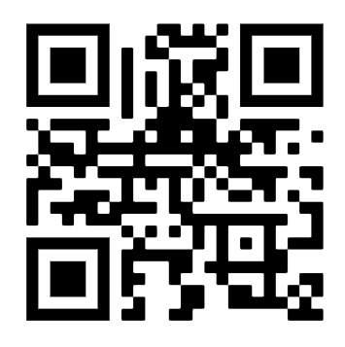
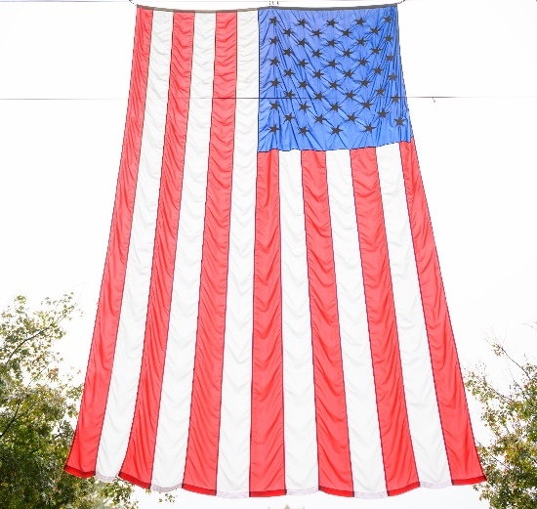
Honoring Veterans & Armed Services
November 11th
  Two Events, Morning and Afternoon
Morning-EUC
  10:00 AM – 1:00 PM
  Card Signing and Pin Give Away
Afternoon-Military Affiliated Services
  2:00 PM – 4:00 PM
  Dessert Social
  Veterans Only
VOLUNTEER SIGN UP

Slide 52
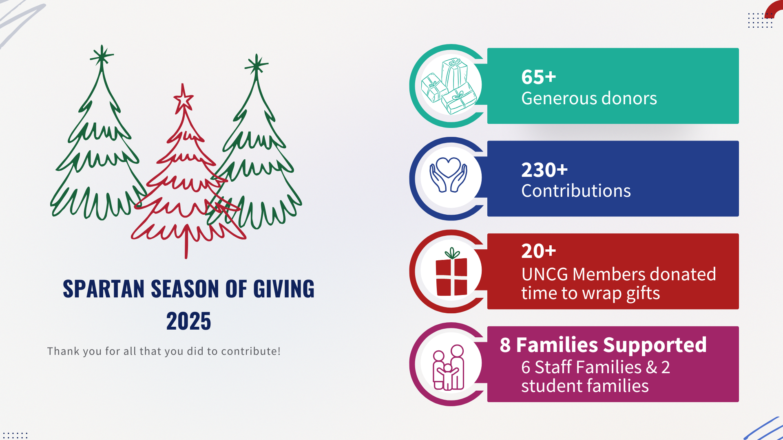
Spartan Season of Giving

Slide 53
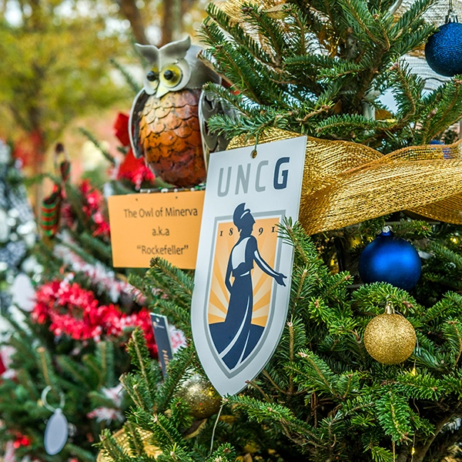
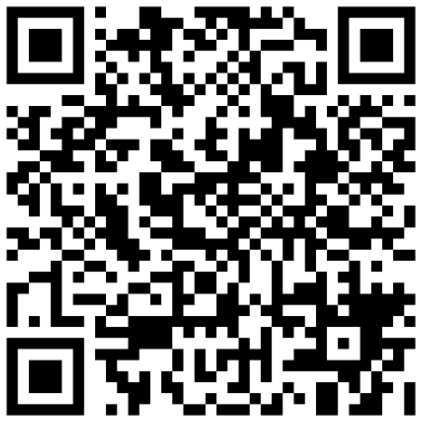
Spartan Season of Giving
November 4
November 6
December 10
December 15
Nominations were due
Selected nominees will be notified
November 14
Amazon Wish Lists will go live
Gift delivery deadline
Wrapping Party
  For more information use the QR code on this slide or visit go.uncg.edu/SpartanSeasonofGiving.
Notes:
Every holiday season, the Staff Senate sponsors a Spartan Season of Giving to bring joy and support to individuals and families on our campus. Through the generosity of our staff, we collect and distribute gifts to those in need.
Nominations were due and submitted by November 4.
Families will be selected and notified on November 6.
Amazon Wish Lists will go live November 14.
All gifts need to be delivered by December 10.
The Staff Senate Wrapping Party will be December 15th and we are excited to see you all there! Refreshments will be provided.
For more information on Spartan Season of Giving, and to find the Amazon Wish Lists on November 14, use the QR code on this slide or visit go.uncg.edu/SpartanSeasonofGiving.

Slide 54
Kimberly Mozingo
Parlimenatarian &
Past Co-Chair
Elections

Slide 55

Elections

Slide 56
Upcoming Reminders

Slide 57

UNC System Staff Assembly
SAVE the DATE
Monday & Tuesday, March 9 & 10, 2026, at North Carolina Central University
Hear updates from the UNC System Office’s Human Resources

Slide 58

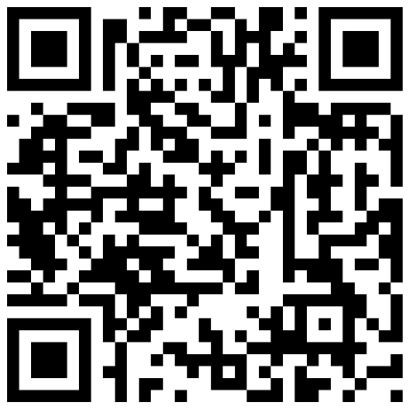
Celebrate Exceptional Acts of Care at UNCG
Nominate a Staff Star: go.uncg.edu/staffstar
  Devotion to Duty
  Innovation
  Service
  Human Relations
  Other Outstanding Achievements
Recipients recognized at a Full Body Staff Senate Meeting

Slide 59
Adjournment

Slide 60


