Slide 1
UNCG
2025-2026
STAFF SENATE
Full Body Meeting
November 6, 2025
Notes:
Kimberly

Slide 2
Agenda
10:00am | Call to Order | Carla Wilson, Staff Senate Chair
10:05am | Roll Call |
10:10am | Approval of Minutes | Kimberly Mozingo, Parliamentarian & Past Co-Chair
10:15am | Ex-Officio Reports
10:30am | State Employees Combined Campaign | Brynne Pulver, Staff Senate Vice Chair
10:35am | Guest Speaker | Vacc Counseling Clinic
10:50am | Upcoming Reminders
11:00am | Adjournment | Carla Wilson, Staff Senate Chair
Notes:
Kimberly

Slide 3
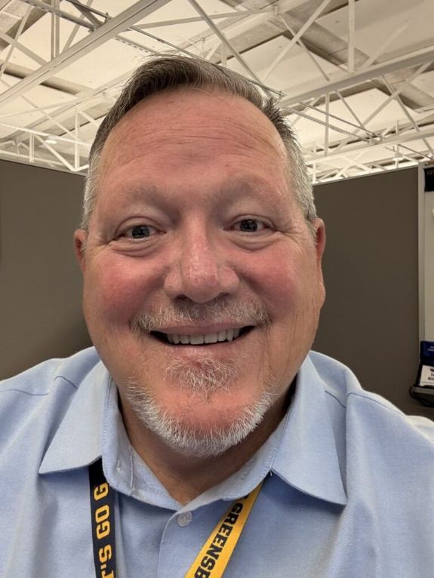
Scott Wilkens
Secretary
Roll Call
Senators attending online please let us know through the Q&A.

Slide 4
Roll Call
Senators attending online please let us know through the Q&A.

Slide 5
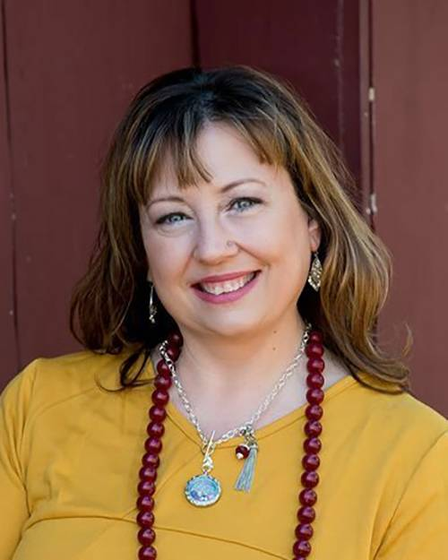
Kimberly Mozingo
Parlimenatarian &
Past Co-Chair
Approval of Meeting Minutes
October 2025

Slide 6
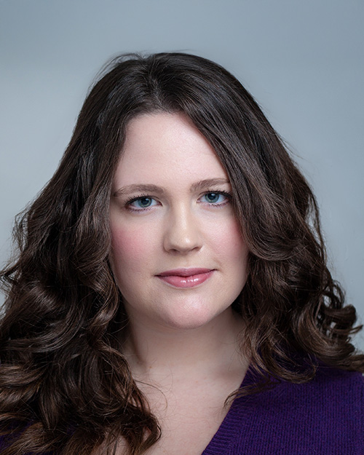
Brynne Pulver
Vice Chair
Approval of Meeting Minutes
September 17, 2025

Slide 7
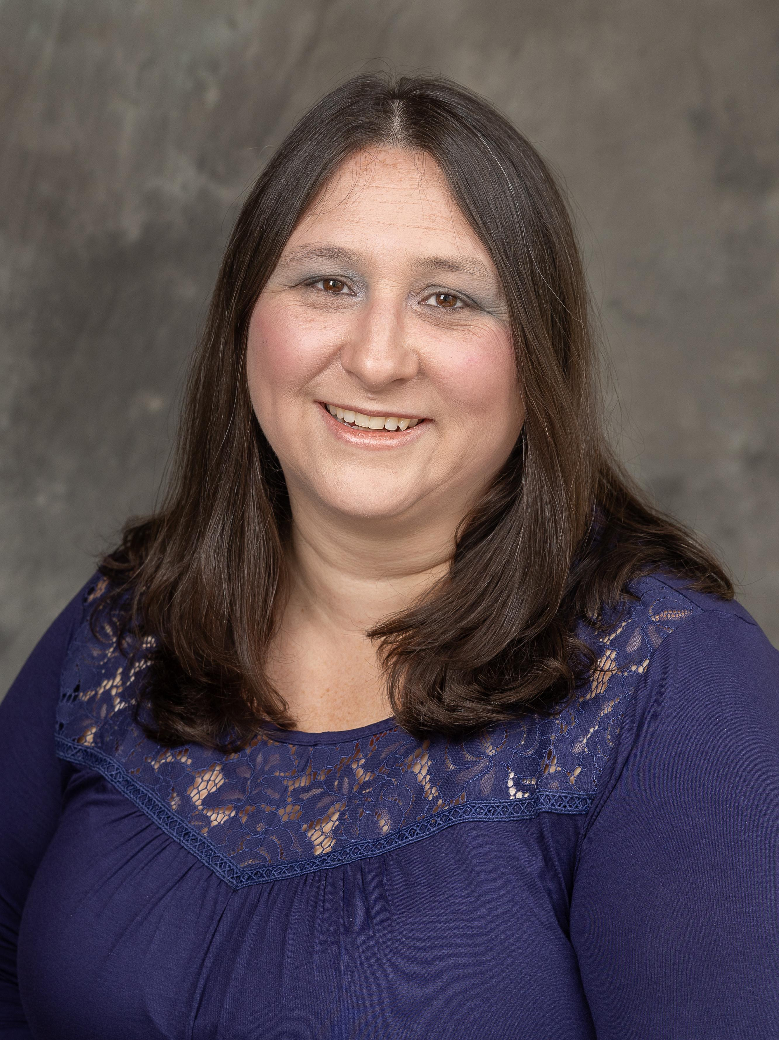
Carla Wilson
Chair
Approval of Meeting Minutes

Slide 8
Ex Officio Reports/Updates

Slide 9
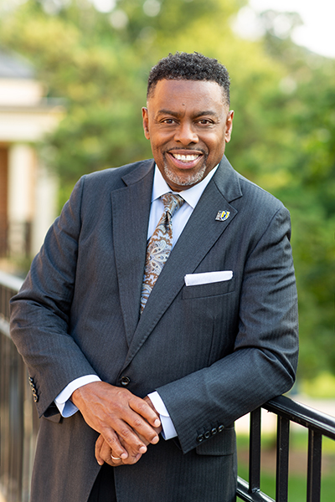
Dr. Franklin D. Gilliam, Jr.
Chancellor
Chancellor's Update

Slide 10
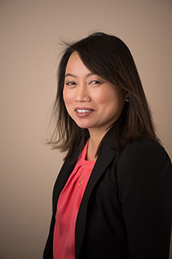
Waiyi Tse
Chief of Staff,
Office of the Chancellor
Chancellor's Update

Slide 11

Information Technology Service Update
Technology Initiatives
Workshops
Todd Sutton
Associate Vice Chancellor for Learning Technology and Customer Success

Slide 12

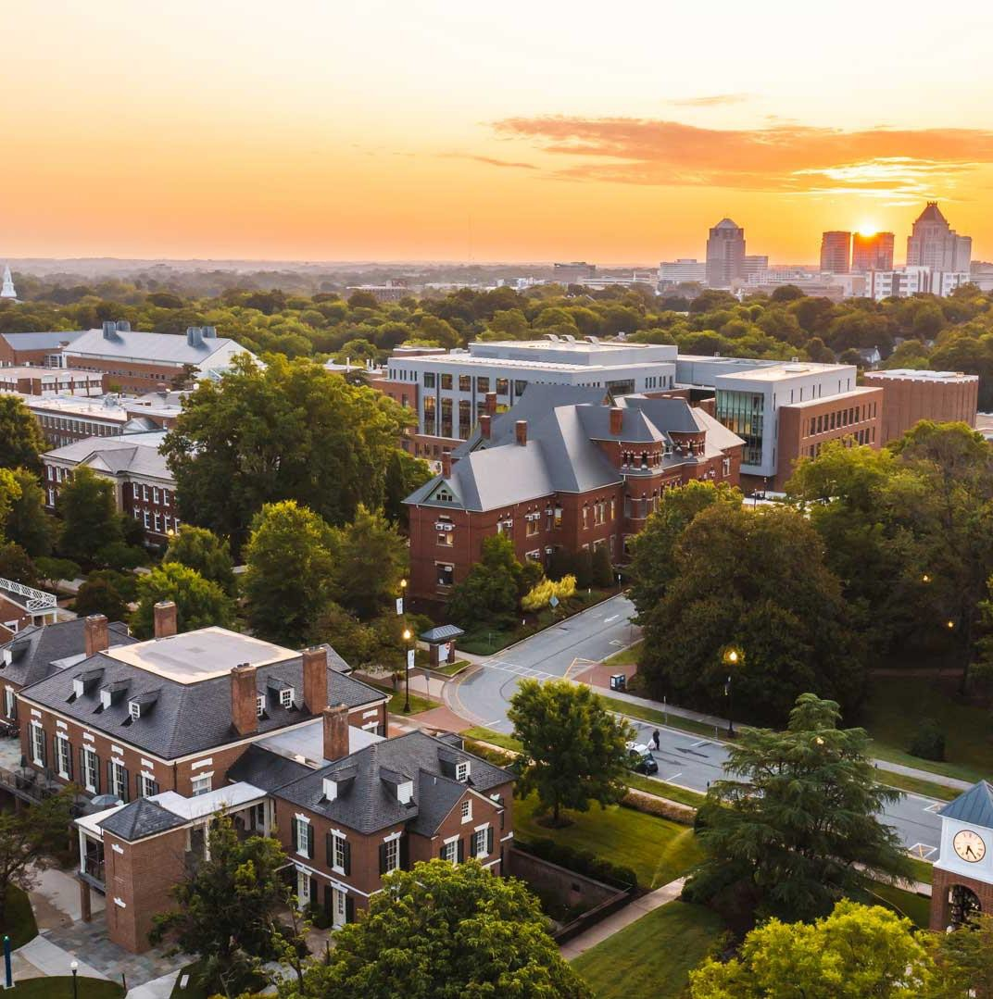

NOVEMBER 2025 UPDATES
TECHNOLOGY INITIATIVES
Todd Sutton
Associate Vice Chancellor for Learning Technology and Customer Success

Slide 13
Managed Print Services (MPS) Program
Purpose: Streamline print operations, reduce costs, improve efficiency, and support sustainability through centralized printer management
Features Policies
Secure, shared multifunction printers
Follow-Me billing & usage reports
Centralized billing, no P-Card use
ITS approval for all printers & supplies
MPS covers toner & standard paper
Return unapproved or legacy printers
Placement & Access
Special Cases & Compliance
Common areas only, no office printers
Shared access across departments
Student printers placed by need
E-fax replaces physical faxing
Specialty printers need approval
Escalating penalties for violations
https://go.uncg.edu/mps

Slide 14
CHiP Initiative
Purpose: Centralize all UNCG technology purchases through ITS to ensure compliance, improve security, standardize support, and reduce costs.
Scope:
  All UNCG tech purchases go through ITS
  Standardized, secure, supported services
  $1Mil+ annual savings projects
Two Facets:
  Leasing: Tier 1 or Tier 2 Mac/PC for faculty & staff (4-year lifecycle)
  Purchases: Peripherals, tablets, & other non-leased technology (research equipment, Tier 3 exceptions, etc.)
https://its.uncg.edu/tech-initiatives/chip-initiative/

Slide 15
IT Assessment
Purpose: Evaluate how IT services are organized and delivered across campus.
Goal: Identify strengths, gaps, and design a model tailored to UNCG
Process: Transparent, phased, and shaped by input from faculty, staff, and students
Job Security: Not designed to cut positions; changes will be thoughtful and
gradual
Your Role: Share IT support experiences, understand that this is about
sustainability, and watch for updates.

Slide 16
Purpose: UNCG is developing a strategic plan to modernize how we manage sign-ins and system access—improving security, user experience, and efficiency across campus.
Identity and Access Management Initiative
Update:
IAM assessment and executive presentation complete
Planning for IAM platform procurement and implementation project
https://its.uncg.edu/tech-initiatives/identity-and-access-management

Slide 17
Purpose: Transition to Box as UNCG's dedicated research data storage platform to ensure secure, compliant, and collaborative management of research data.
Research Data Storage
Update:
September 2, 2025: Non-research data in Box was frozen and set to read-only
October 10-14, 2025: Research Data migration from Google Drive to Box
December 11, 2025: Non-research data will be moved to Trash
https://its.uncg.edu/tech-initiatives/research-storage/

Slide 18
Purpose: Upgrade all University-owned Windows devices to Windows 11 before
support for Windows 10 ends.
Transition to Windows 11
Reminder: As of Oct. 15, 2025, Windows 10 machines are no longer supported by Microsoft.
Starting Nov. 11 Windows 10 machines will no longer be able to connect
to UNCG's GCN network.
https://its.uncg.edu/tech-initiatives/transition-to-windows-11/

Slide 19
Purpose: UNCG will end its use of Panopto at the end of the current contract, streamlining video tools by transitioning to M365 solutions and Canvas Studio.
Panopto Retirement
Update:
Panopto service at UNCG ends 12/31/2025
Simplify tools- use Microsoft 365 (OneDrive, Clipchamp) or Canvas Studio
Download and move desired Panopto videos
Do not use Panopto in the Fall, use Microsoft or Canvas Studio tools
instead
https://its.uncg.edu/tech-initiatives/panopto-retirement/

Slide 20
Banner Web Time Entry
Purpose: Streamline and improve our current time and leave entry process
Reminder for Exempt Leave-Earning Employees using Leave Reports:
Submit on your last working day of the month—once approved, the timesheet is final, and leave is deducted; any changes must go through HR.
Campus Go Live:
  Date TBD: Hourly Student and Temp employees will begin using Banner Web Time Entry timesheets
  Date TBD: Non-Exempt and LEO employees will begin using Banner Web Time Entry timesheets
https://its.uncg.edu/tech-initiatives/banner-web-time-entry/

Slide 21
Purpose: Strengthen indoor wireless connectivity at UNCG, ensuring fast, reliable
Academic-Link
Wi-Fi where it’s needed most
Update:
October 2025: Network closet assessment began
November 2025: Network closet assessment to complete
TBD: Remediation (pending Network closet assessment completion)
https://its.uncg.edu/tech-initiatives/academic-link/

Slide 22
ITS Project Status Dashboard
https://its.uncg.edu/project-status-dashboard/

Slide 23
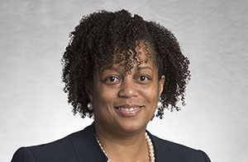
Human Resources Update
UNCG Human Resources website
Patricia Lynch
Director of ER and EEO/AA
Human Resources Officer

Slide 24

Human Resources Update
Emily Foust
Benefits Manager

Slide 25

Human Resources
Find your career here
Thursday, November 6, 2025

Slide 26
Deduction Reminders
It is possible that salaries may be reevaluated in the first 3-4 months of 2026, and premium changes would take place if a member moved to a different salary band (legislative increase).
New health plan deductions will be in the December 22nd paychecks. Health insurance is paid a month ahead.
All other Open Enrollment deductions will take place in the January 30th paychecks (FSA, life, dental, etc.).

Slide 27
State Health Plan – Lantern Surgical Benefit
What is it?
  Lantern is a network of surgeons designed for non-emergent surgeries.
Why should we use it?
  If a surgery is deemed a Lantern-covered surgery by the State Health Plan, it would be free for the member. There will be no cost ($0) for the surgery for members who use a Lantern provider —no deductibles and no copays.
  A Lantern Care Advocate will provide personalized support throughout the surgical journey, handle scheduling and paperwork.

Slide 28
Commonly covered procedure categories for Lantern:
Spine
Orthopedic
Joint
Ear, nose, & throat
Cardiac
Gynecology
General surgery
Gastrointestinal
Spine & ortho injections
Urology
Bariatrics*
*Beginning Jan. 1, 2026, Bariatric surgery will only be covered by the Plan if it is performed by a Lantern surgeon.

Slide 29
State Health Plan – Lantern Surgical
Benefits: Medical Travel
A Lantern Care Advocate will work to match you with a surgeon in the Lantern network as close to your home as possible. When close to home isn’t possible, there is a travel benefit members may utilize (see below for details).
If travel is necessary to receive care from a Lantern provider, some travel costs may be covered. Lantern will send members a prepaid card to use for:
  Daily allowance for meals or other needs (up to $35/day)
  Ground transportation (up to $100)
  Hotel accommodation
  Airfare available if necessary

Slide 30
State Health Plan – Lantern Surgical Benefit
For more information: https://www.shpnc.gov/employee-benefits/lantern-surgery-benefit
Members may call Lantern at 833-916-3826 to determine if a surgery is covered.

Slide 31
MetLife Legal Plan
For $13.66 per month -
The legal plan provides access to a nationwide network of 18,000 attorneys.
The legal plan provides full coverage of attorney fees for common personal legal matters with no additional out-of-pocket costs to employees.
Full coverage for you, your spouse/domestic partner, and eligible dependent children.

Slide 32
MetLife Legal Plan
Assistance for a wide range of legal needs, including financial matters, home and real estate issues, family and personal matters, civil lawsuits, elder care concerns and even minor traffic violations.
A nationwide network of thousands of vetted attorneys.
A library of digital legal resources, including estate planning tools, power of attorney forms and other easy-to-use, self-guided documents.
If you need additional information, please see the website www.legalplans.com or call MetLIFE Legal at 1-800-821-6400.

Slide 33
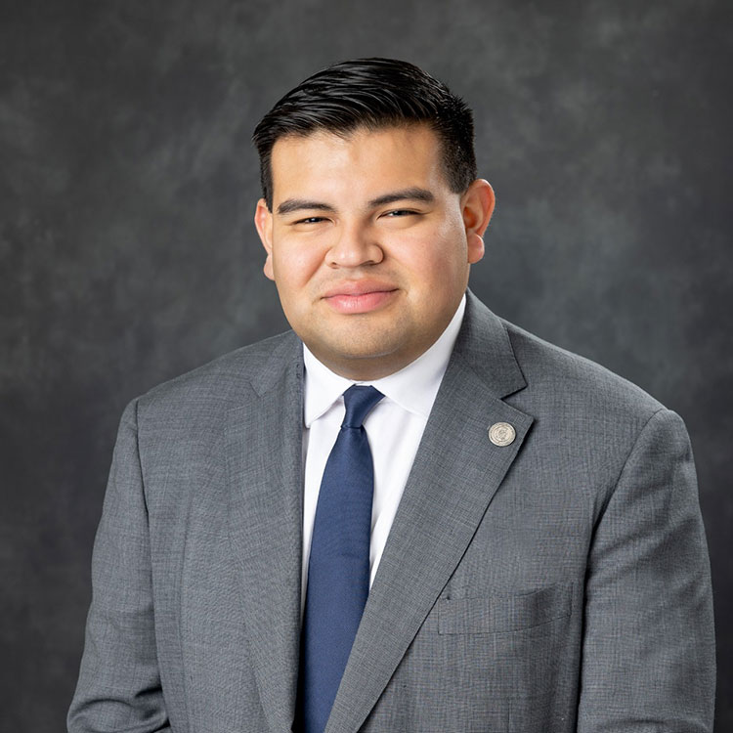
Juan Pleitez
Director of External Affairs
Strategy and Policy
Legislative Update

Slide 34
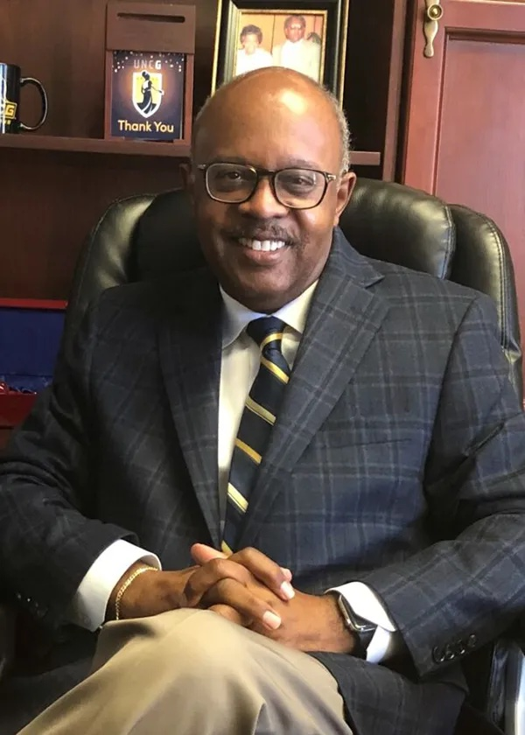
Jerry Blakemore
Vice Chancellor,
Institutional Integrity & General Counsel
Equality Policy
Notes:
Jerry D. Blakemore serves as the Vice Chancellor for Institutional Integrity and General Counsel for UNC Greensboro.
He has more than 30 years of experience in higher education administration, policy development and the providing of legal services, 19 of which as General Counsel for major institutions of higher education.

Slide 35
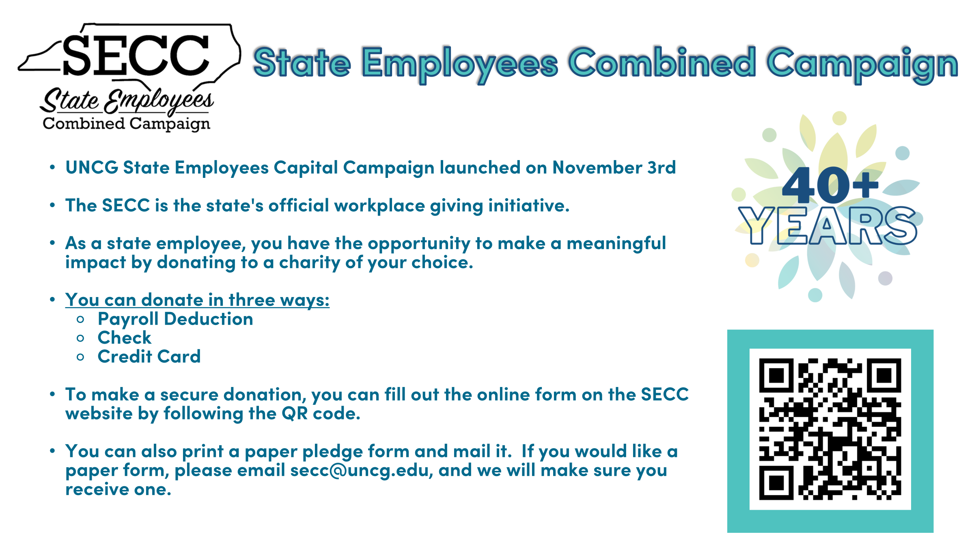
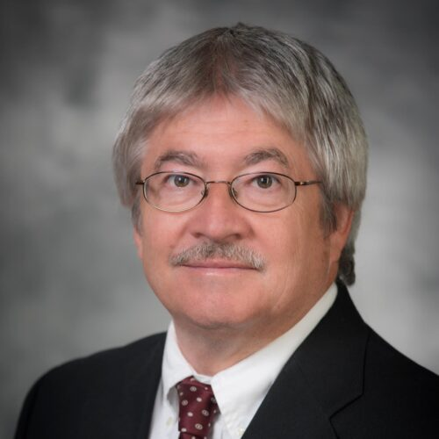
Faculty Senate
Faculty Senate website
Chuck Bolton
Faculty Senate Chair

Slide 36
Guest Speaker

Slide 37


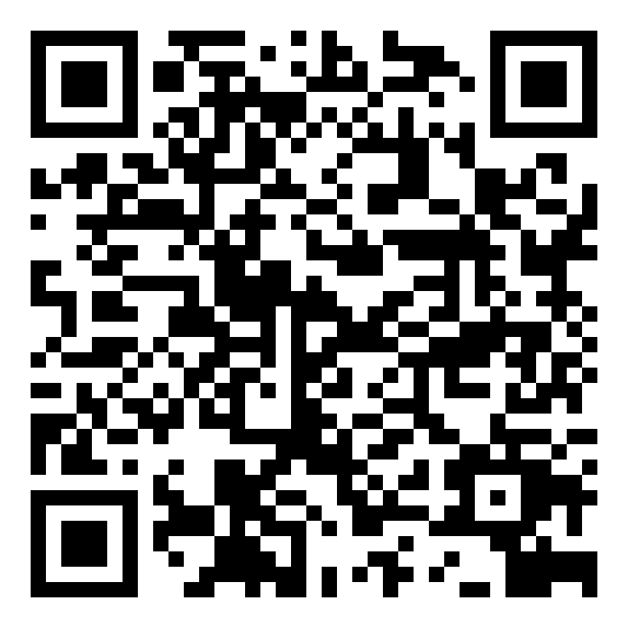
Nicholas A. Vacc
Counseling and Consulting Clinic
Register for services!
Phone: 336-334-5112
Email: cedclini@uncg.edu
Website: https://soe.uncg.edu/ced/vacc-clinic/
Location: Ferguson Building, 2nd Floor
Hours of Operation
Monday – Thursday: 9:00 am to 8:00 pm
Friday: 9:00 am to 5:00 pm

Slide 38
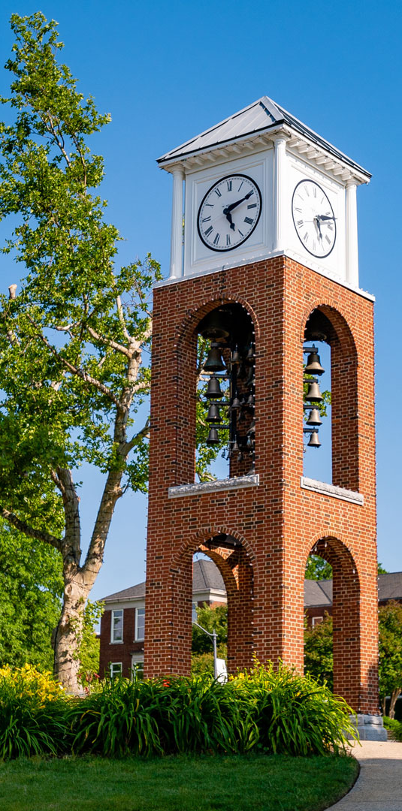
Services and Fees
Individual Counseling (In-Person and Telehealth (ages 10+))
Group Counseling (In-Person Only)
Couples Counseling (In-Person Only)
Family Counseling (In-Person Only)
Psychoeducation Workshops (In-Person and Telehealth)
Fees:
UNCG students and faculty/staff – $5/session
Community Members (ages 5+) –
  Sliding scale for annual household income
  $10-$30/session for individual
  $20-$60/session for couples/family
The clinic does not provide any diagnosis or take insurance.
Cash, check, credit or debit cards are acceptable forms of payment.

Slide 39
Projects & Committee Reports
Old & New Business

Slide 40

Outreach Committee
Congratulations to our newest Staff Stars
Donald Gray
Technology Support Analyst
Bryan School & School of Education
Julia Goren
Dean’s Office
Bryan School
Gail Pack
Undergraduate Student Services
Bryan School
Timothy Wilkins
Facility Services
Jessica Quattrucci
Academic Advisor
Bryan Undergraduate Student Services
Academic Advisor
Bryan Undergraduate Student Services
Nancy Trejo- Barcenas
Recruiting & Academic Advising Specialist
Bryan School
Breanna Wallace
Academic Advisor
Bryan Undergraduate Student Services
Alyssa Rose

Slide 41

Spartan Open Pantry
Provides free, high-quality foods for needy Spartans
Runs November 6th through November 20th
Location! Location! Location!
NEEDED ITEMS
Cereal
Canned meats
Pasta/pasta sauce
Granola bars
Microwaveable soups
Cooking oils
1- 2 lb. bags of rice
Deodorant
Toothbrushes
Toothpaste
Menstrual hygiene products

Slide 42
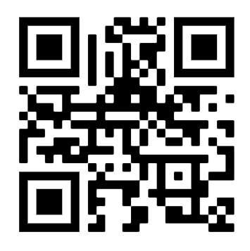

Honoring Veterans & Armed Services
November 11th
  Two Events, Morning and Afternoon
Morning-EUC
  10:00 AM – 1:00 PM
  Card Signing and Pin Give Away
Afternoon-Military Affiliated Services
  2:00 PM – 4:00 PM
  Dessert Social
  Veterans Only
VOLUNTEER SIGN UP

Slide 43

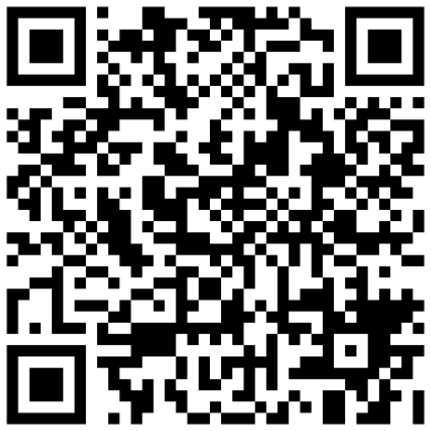
Spartan Season of Giving
November 4
November 6
December 10
December 15
Nominations were due
Selected nominees will be notified
November 14
Amazon Wish Lists will go live
Gift delivery deadline
Wrapping Party
  For more information use the QR code on this slide or visit go.uncg.edu/SpartanSeasonofGiving.
Notes:
Every holiday season, the Staff Senate sponsors a Spartan Season of Giving to bring joy and support to individuals and families on our campus. Through the generosity of our staff, we collect and distribute gifts to those in need.
Nominations were due and submitted by November 4.
Families will be selected and notified on November 6.
Amazon Wish Lists will go live November 14.
All gifts need to be delivered by December 10.
The Staff Senate Wrapping Party will be December 15th and we are excited to see you all there! Refreshments will be provided.
For more information on Spartan Season of Giving, and to find the Amazon Wish Lists on November 14, use the QR code on this slide or visit go.uncg.edu/SpartanSeasonofGiving.

Slide 44
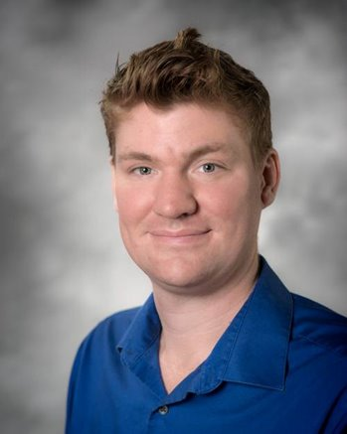
Ryan Milligan
Parlimenatarian &
Past Co-Chair
Elections

Slide 45

UNC System Staff Assembly
Met last month at UNC Pembroke
Our 3 delegates and alternate were able to attend in person
Wonderful opportunity to connect with those across the system
Hear updates from the UNC System Office’s Human Resources

Slide 46
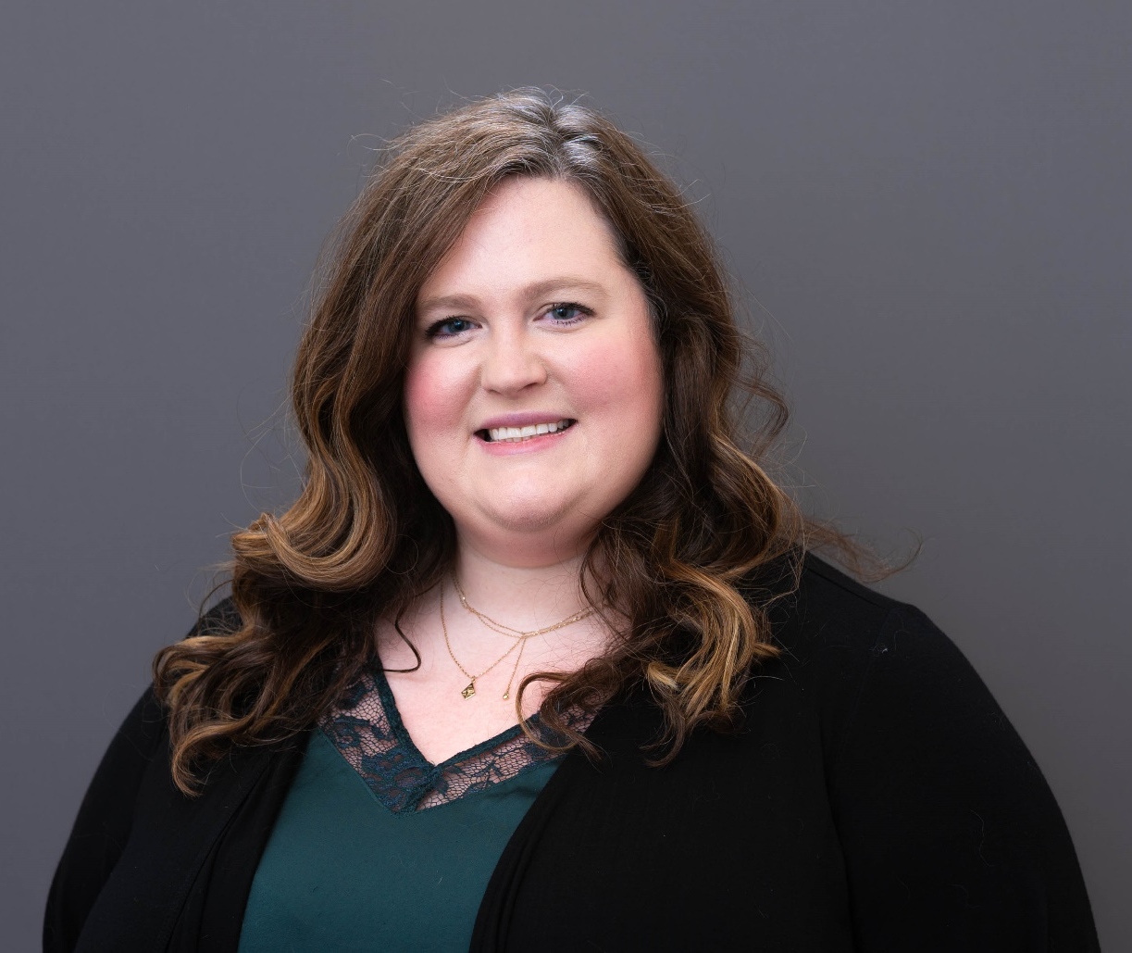
🎉 Congratulations to
Brynne Pulver
We’re proud that Brynne will serve as the newest Secretary of the UNCG Staff Senate.
In this role, she will represent UNCG staff at the UNC System level, helping to strengthen our collective voice and deepen our impact across campuses.

Slide 47
Upcoming Reminders

Slide 48

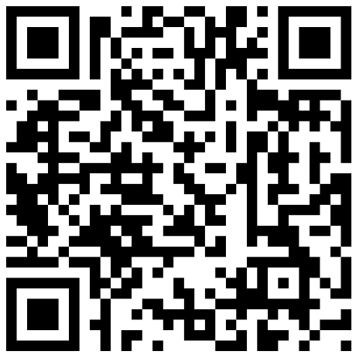
Celebrate Exceptional Acts of Care at UNCG
Nominate a Staff Star: go.uncg.edu/staffstar
  Devotion to Duty
  Innovation
  Service
  Human Relations
  Other Outstanding Achievements
Recipients recognized at a Full Body Staff Senate Meeting

Slide 49
Adjournment

Slide 50


