Slide 1
UNCG
2025-2026
STAFF SENATE
Full Body Meeting
October 9, 2025
Notes:
Kimberly

Slide 2
Agenda
10:00am | Call to Order | Carla Wilson, Staff Senate Chair
10:05am | Roll Call | Scott Wilkens, Staff Senate Secretary
10:10am | Approval of Minutes | Brynne Pulver, Staff Senate Vice Chair
10:15am | Ex-Officio Reports
10:30am | UNCG AI Governance & Strategy
10:50am | Upcoming Reminders
11:00am | Adjournment| Carla Wilson, Staff Senate Chair
Notes:
Kimberly

Slide 3
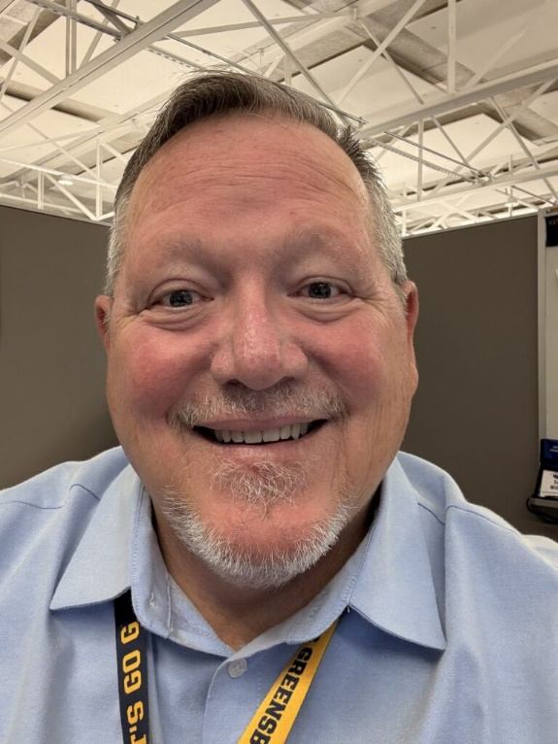
Scott Wilkens
Secretary
Roll Call
Senators attending online please let us know through the Q&A.

Slide 4

Kimberly Mozingo
Parlimenatarian &
Past Co-Chair
Approval of Meeting Minutes
August 7, 2025

Slide 5

Brynne Pulver
Vice Chair
Approval of Meeting Minutes
September 17, 2025

Slide 6
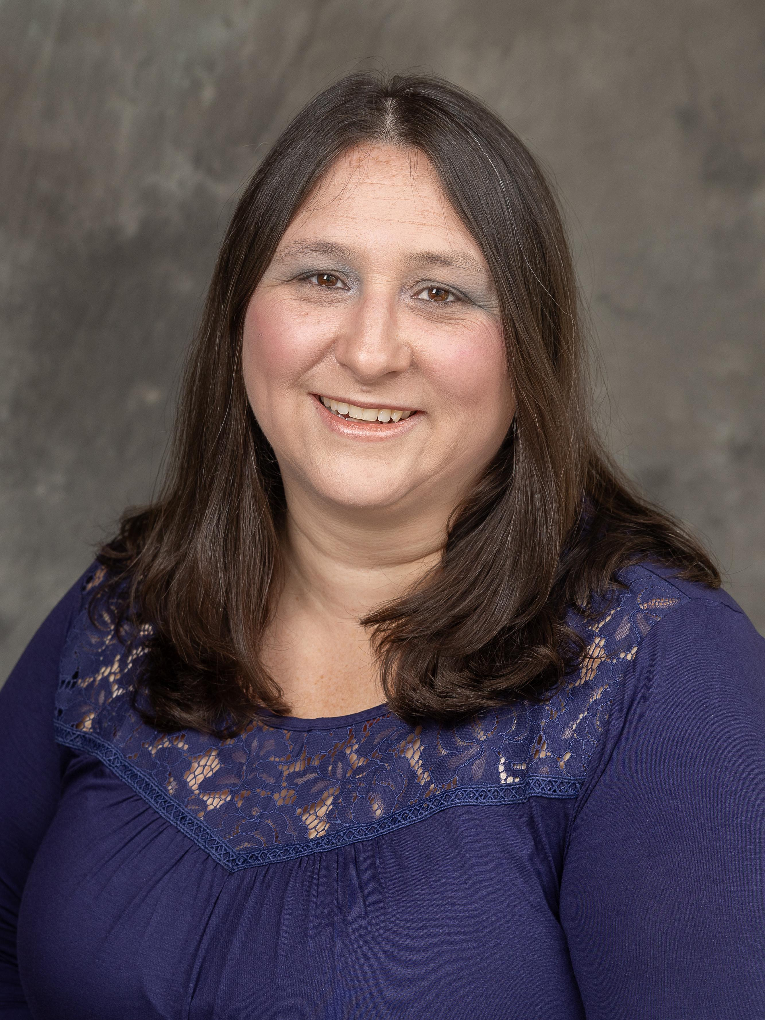
Carla Wilson
Chair
Approval of Meeting Minutes

Slide 7
Ex Officio Reports/Updates

Slide 8
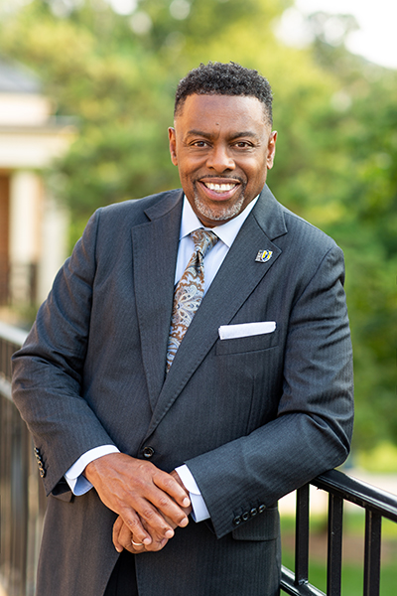
Dr. Franklin D. Gilliam, Jr.
Chancellor
Chancellor's Update

Slide 9
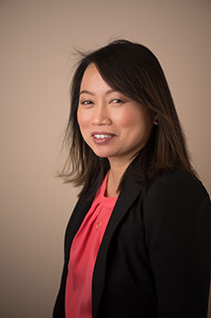
Waiyi Tse
Chief of Staff,
Office of the Chancellor
Chancellor's Update

Slide 10

Information Technology Service Update
Technology Initiatives
Workshops
Todd Sutton
Associate Vice Chancellor for Learning Technology and Customer Success

Slide 11
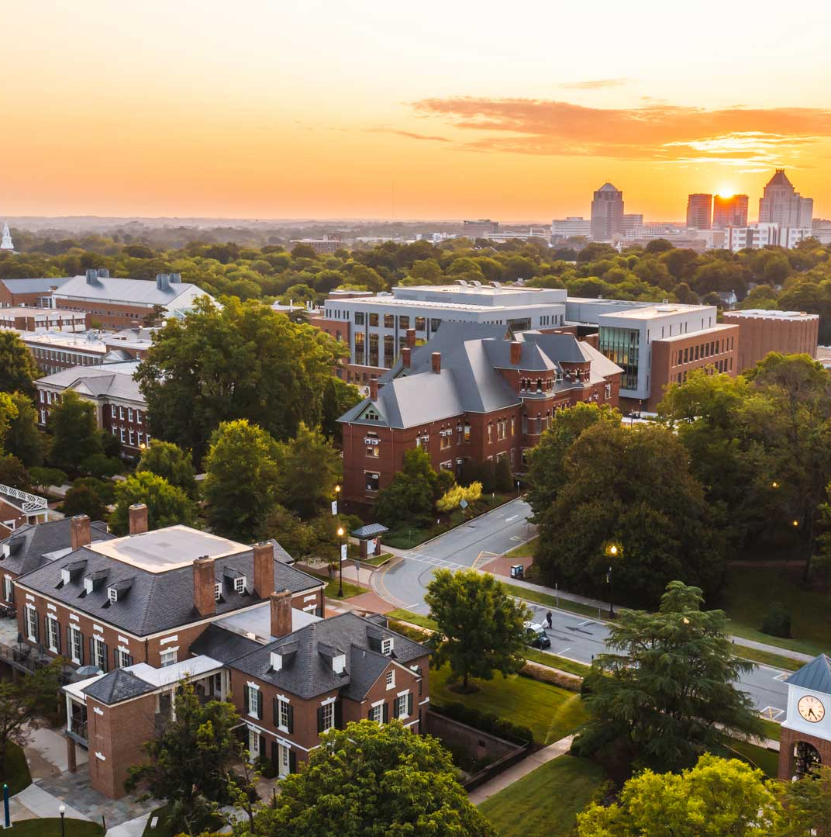
OCTOBER UPDATES
TECHNOLOGY
INITIATIVES
Staff Senate
Todd Sutton
Associate Vice Chancellor for Learning Technology and Customer Success

Slide 12
Managed Print Services (MPS) Program
Purpose: Streamline print operations, reduce costs, improve efficiency, and support sustainability through centralized printer management
Features
Secure, shared multifunction printers
Follow-Me billing & usage reports
Centralized billing, no P-Card use
Placement & Access
Common areas only, no office printers
Shared access across departments
Student printers placed by need
Policies
ITS approval for all printers & supplies
MPS covers toner & standard paper
Return unapproved or legacy printers
Special Cases & Compliance
E-fax replaces physical faxing
Specialty printers need approval
Escalating penalties for violations
https://go.uncg.edu/mps

Slide 13
CHiP Initiative
Purpose: Centralize all UNCG technology purchases through ITS to ensure compliance, improve security, standardize support, and reduce costs. ​​
Scope:
  All UNCG tech purchases go through ITS​
  Standardized, secure, supported services
  $1Mil+ annual savings projects
Two Facets:
  Leasing: Tier 1 or Tier 2 Mac/PC for faculty & staff (4-year lifecycle)
  Purchases: Peripherals, tablets, and other non-leased technology (research equipment, Tier 3 exceptions, etc.)
https://its.uncg.edu/tech-initiatives/chip-initiative/

Slide 14
IT Assessment
Purpose: Evaluate how IT services are organized and delivered across campus. ​​
Goal: Identify strengths, gaps, and design a model tailored to UNCG
Process: Transparent, phased, and shaped by input from faculty, staff, and students
Job Security: Not designed to cut positions; changes will be thoughtful and gradual
Your Role: Share IT support experiences, understand that this is about sustainability, and watch for updates.

Slide 15
ITS Project Status Dashboard
https://its.uncg.edu/project-status-dashboard/

Slide 16
Identity and Access Management Initiative
Purpose: UNCG is developing a strategic plan to modernize how we manage sign-ins and system access—improving security, user experience, and efficiency across campus.
Update:
Executive Presentation (pushed to October 14, 2025)
Planning for deployment project
https://its.uncg.edu/tech-initiatives/identity-and-access-management

Slide 17
Research Data Storage
Purpose: Transition to Box as UNCG's dedicated research data storage platform to ensure secure, compliant, and collaborative management of research data.
Update:
September 2, 2025: Non-research data in Box was frozen and set to read-only
October 10-14, 2025: Research Data migration from Google Drive to Box
December 11, 2025: Non-research data will be moved to Trash
https://its.uncg.edu/tech-initiatives/research-storage/

Slide 18
Transition to Windows 11
Purpose: Upgrade all University-owned Windows devices to Windows 11 before support for Windows 10 ends.
Reminder: October 15, 2025, Windows 10 machines will no longer be able to connect to UNCG's GCN network.
https://its.uncg.edu/tech-initiatives/transition-to-windows-11/

Slide 19
Panopto Retirement
Purpose: UNCG will end its use of Panopto at the end of the current contract, streamlining video tools by transitioning to M365 solutions and Canvas Studio.
Update:
Panopto service at UNCG ends 12/31/2025
Simplify tools- use Microsoft 365 (OneDrive, Clipchamp) or Canvas Studio
Download and move desired Panopto videos
Do not use Panopto in the Fall, use Microsoft or Canvas Studio tools instead
https://its.uncg.edu/tech-initiatives/panopto-retirement/

Slide 20
Banner Web Time Entry
Purpose: Streamline and improve our current time and leave entry process
Reminder for Exempt Leave-Earning Employees using Leave Reports:
Submit on your last working day of the month—once approved, the timesheet is final, and leave is deducted; any changes must go through HR.
Campus Go Live:
  Date TBD: Hourly Student and Temp employees will begin using Banner Web Time Entry timesheets
  Date TBD: Non-Exempt and LEO employees will begin using Banner Web Time Entry timesheets
https://its.uncg.edu/tech-initiatives/banner-web-time-entry/

Slide 21
Academic-Link
Purpose: Strengthen indoor wireless connectivity at UNCG, ensuring fast, reliable Wi-Fi where it’s needed most
Update:
Will coordinate professional services to:
  Add 606 new access points
  Replace 533 older access points with newer models
  Move 301 access points to new locations for better coverage
https://its.uncg.edu/tech-initiatives/academic-link/

Slide 22





Join UNCG’s Information Security team this month for workshops and Q&A
at 1:00 p.m. on Fridays starting on October 10th.
October 10 @ 1PM
October 17 @ 1PM
Responsible AI
and Security
Best Practices
Protect UNCG Data and Yourself
October 24 @ 1PM
October 31 @ 1PM
Data Loss Prevention
at UNCG
Safeguarding AI and Staying Safe with Encryption
WORKSHOPS.UNCG.EDU

Slide 23
OCTOBER WORKSHOP SCHEDULE
Oct. 7 – Advanced Qualtrics Survey Workshop
Oct. 7 – Instructional Video Production in Microsoft Clipchamp
Oct. 8 – Prompt Writing – A Conversation with Technology
Oct. 10 – Responsible AI and Security Best Practices
Oct. 17 – Protect UNCG Data and Yourself
Oct. 21 – Copilot Productivity Powerup
Oct. 22 – CTRL+ALT+Access: Creating Accessible Canvas Content
Oct. 24 – Data Loss Prevention at UNCG
Oct. 31 – Safeguarding AI and Staying Safe with Encryption
WORKSHOPS.UNCG.EDU

Slide 24
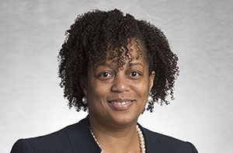
Human Resources Update
UNCG Human Resources website
Patricia Lynch
Director of ER and EEO/AA
Human Resources Officer

Slide 25
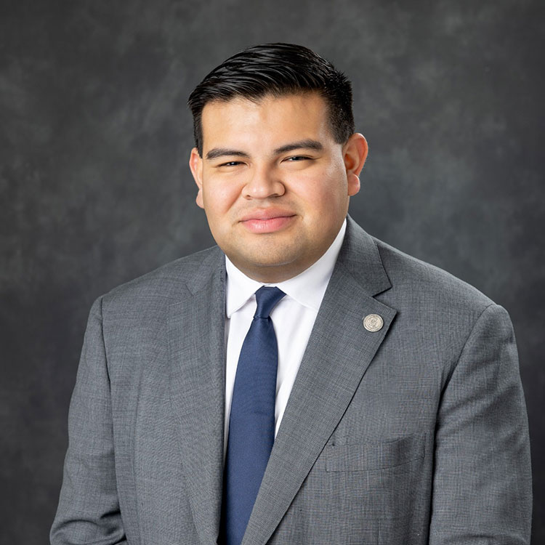
Juan Pleitez
Director of External Affairs
Strategy and Policy
Legislative Update

Slide 26
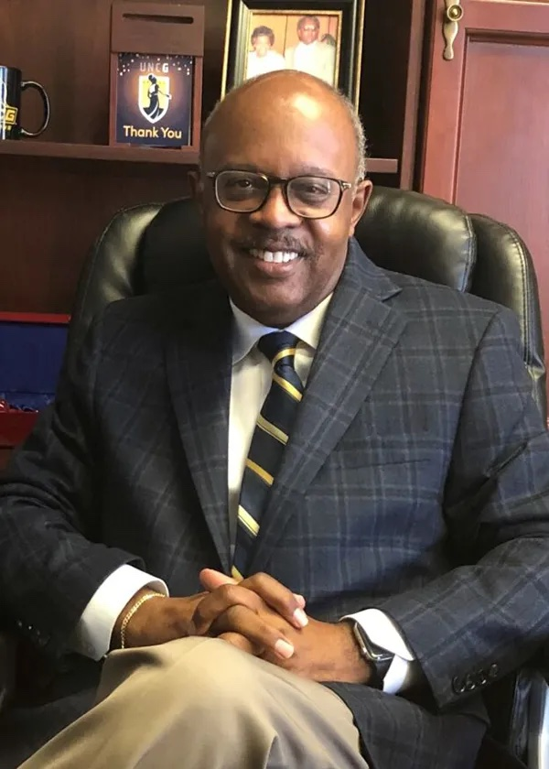
Jerry Blakemore
Vice Chancellor,
Institutional Integrity & General Counsel
Equality Policy
Notes:
Jerry D. Blakemore serves as the Vice Chancellor for Institutional Integrity and General Counsel for UNC Greensboro.
He has more than 30 years of experience in higher education administration, policy development and the providing of legal services, 19 of which as General Counsel for major institutions of higher education.

Slide 27

Faculty Senate
Faculty Senate website
Chuck Bolton
Faculty Senate Chair

Slide 28
Guest Speaker

Slide 29

UNCG
ARTIFICIAL
INTELLIGENCE
Responsible Governance & Strategy
Staff Senate | October 9, 2025 | 10:00AM
Casey J. Forrest, Ph.D.
Associate Vice Chancellor for Enterprise Technology Infrastructure & Chief Technology Officer

Slide 30

UNCG AI GOVERNANCE & STRATEGY
Agenda
AI Governance & Strategy
AI 2025 Roadmap
Approved AI Tools
AI Resources & Training
Q & A

Slide 31
UNCG AI GOVERNANCE & STRATEGY
AI Oversight Committee - Membership
FY2026
Committee Member | University Affiliation
Casey Forrest, Chair | Information Technology Services
Sean Farrell | Human Resources
Dominic Lombardi | Advancement
Janet Imrick | University Communications
Wade Maki | Chancellor’s Office
Enyonam Williams | Institutional Integrity and General Counsel
Denise Archetto | Intercollegiate Athletics
FY2024-25 and FY2025-26
Committee Member | University Affiliation
Travis Hauer | Enrollment Management
Zach Smith | Finance & Administration
Melissa Skillings | Office of Research and Engagement
Brett Carter | Student Affairs
Laura Pipe | Academic Affairs
David Kirkland | Information Technology Services

Slide 32
UNCG AI GOVERNANCE & STRATEGY
AI Oversight Committee - Charter
Purpose
The Artificial Intelligence (AI) Oversight Committee was commissioned by UNCG’s Chancellor and UNCG’s Vice Chancellor for Information Technology Services in February 2025. The AI Oversight Committee is charged with providing strategic guidance and oversight for how UNCG will responsibly embrace, engage, and empower AI use across the university in its approach to learning, academic integrity, professional development, and operational efficiency.
Discover and evaluate opportunities for innovation and efficiency improvements.
Field and provide recommendations for potential security risks and data privacy issues.
Advocate and Promote committee initiatives in respective campus divisions.

Slide 33
UNCG AI GOVERNANCE & STRATEGY
AI Oversight Committee - Goals
Provide guidance on managing AI’s impact on university interests.
Recommend best practices, training, and support for AI use.
Identify necessary policy updates, including ethical and legal considerations.
Assist faculty in incorporating AI into teaching and research.
Promote academic integrity in the use of generative AI.
Ensure ethical and transparent business use of AI tools.
Improve administrative efficiency with AI resources.
Gather community input to inform AI investments and support.

Slide 34
UNCG AI OVERSIGHT COMMITTEE
AI 2025 Roadmap
Responsible AI Principles
AI Digital Trust Guidelines
Academic Integrity Policy Addendum
AI Use Statement (AUP and Data Integrity)
Central AI Hub Website
Campus-wide AI Use Case Inventory

Slide 35
UNCG AI OVERSIGHT COMMITTEE
AI 2025 Roadmap
Develop Responsible AI Principles to guide university procurement, development, implementation, and monitoring of AI within its provision of academic and business services (Accuracy, Dependability, Privacy and Security, and Accountability).
Responsible AI Principles
AI Digital Trust Guidelines
Academic Integrity Policy Addendum
AI Use Statement (AUP and Data Integrity)
Central AI Hub Website
Campus-wide AI Use Case Inventory

Slide 36
UNCG AI OVERSIGHT COMMITTEE
AI 2025 Roadmap
Develop AI Digital Trust Guidelines to foster confident, responsible exploration of the AI landscape to ensure your own privacy and the privacy of students, faculty and staff.
Responsible AI Principles
AI Digital Trust Guidelines
Academic Integrity Policy Addendum
AI Use Statement (AUP and Data Integrity)
Central AI Hub Website
Campus-wide AI Use Case Inventory

Slide 37
UNCG AI OVERSIGHT COMMITTEE
AI 2025 Roadmap
Finalize supplementary guidelines on academic integrity, which address the use of generative artificial intelligence (GAI) tools for completing class assessments and assignments, as an extension to the existing Academic Integrity Policy at UNCG
Responsible AI Principles
AI Digital Trust Guidelines
Academic Integrity Policy Addendum
AI Use Statement (AUP and Data Integrity)
Central AI Hub Website
Campus-wide AI Use Case Inventory

Slide 38
UNCG AI OVERSIGHT COMMITTEE
AI 2025 Roadmap
Primary Objectives: 1) express restrictions on the use of AI with University data; 2) mandate any purchase or use of AI products or services that handle university data above public L2 classification is evaluated by ITS
Responsible AI Principles
AI Digital Trust Guidelines
Academic Integrity Policy Addendum
AI Use Statement (AUP and Data Integrity)
Central AI Hub Website
Campus-wide AI Use Case Inventory

Slide 39
UNCG AI OVERSIGHT COMMITTEE
AI 2025 Roadmap
Responsible AI Principles
AI Digital Trust Guidelines
Academic Integrity Policy Addendum
AI Use Statement (AUP and Data Integrity)
Central AI Hub Website
Campus-wide AI Use Case Inventory

Slide 40
UNCG AI OVERSIGHT COMMITTEE
AI 2025 Roadmap
Responsible AI Principles
AI Digital Trust Guidelines
Academic Integrity Policy Addendum
AI Use Statement (AUP and Data Integrity)
Central AI Hub Website
Campus-wide AI Use Case Inventory
In support of UNCG Acceptable Use Policy, IT Procurement Policy, and Information Security Policy, request campus departments/units to identify and/or provide inventory of any AI deployed and operating in support of university missions.

Slide 41
UNCG AI OVERSIGHT COMMITTEE
AI 2025 Roadmap
Responsible AI Principles
AI Digital Trust Guidelines
Academic Integrity Policy Addendum
AI Use Statement (AUP and Data Integrity)
Central AI Hub Website
Campus-wide AI Use Case Inventory
Launch a UNCG central AI Hub website as a platform to access detailed information about UNCG’s Artificial Intelligence (AI) initiatives, guidelines, resources, news and events, and related links from across the University.

Slide 42
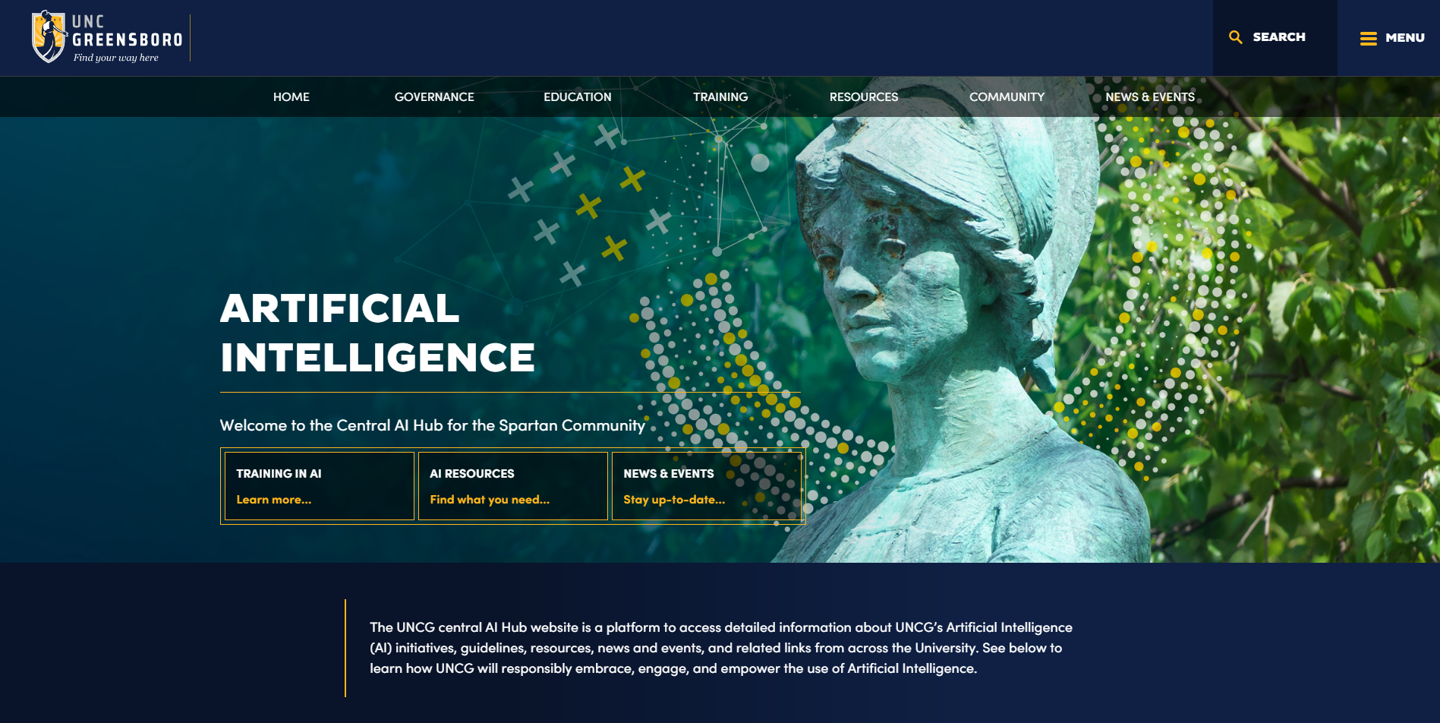

Slide 43
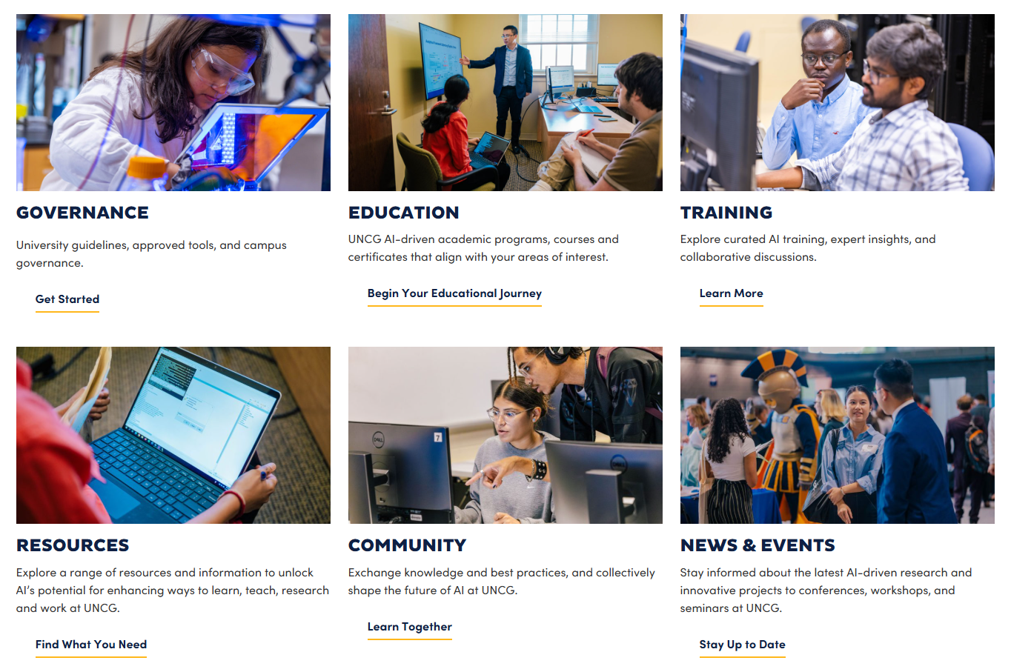

Slide 44
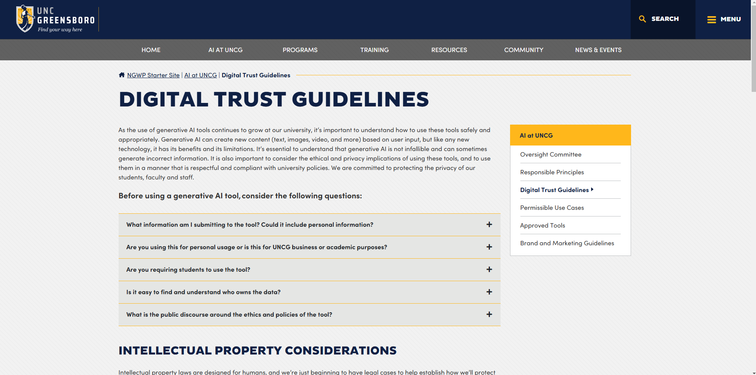

Slide 45
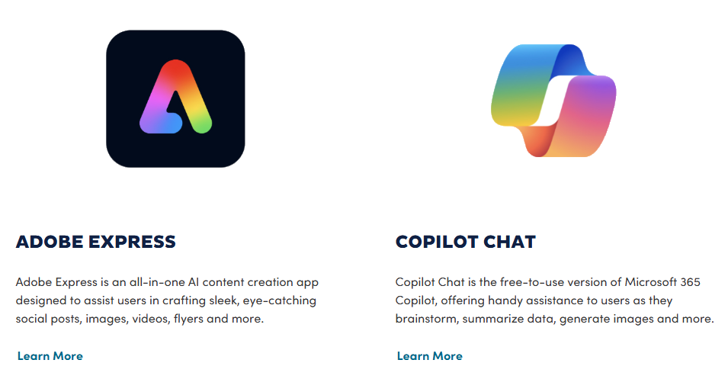
AI RESOURCES & TRAINING
Approved Tools

Slide 46


AI RESOURCES & TRAINING
Approved Tools
Copilot for Microsoft 365
Microsoft Teams Premium
This paid add-on integrates deeply with your Microsoft 365 apps, drawing on your company's data (via Microsoft Graph) to provide intelligent assistance directly in Word, Excel, Outlook, Teams, and other applications.
Microsoft Teams Premium is an add-on license that enhances the standard Microsoft Teams experience by providing AI-powered meeting features like intelligent meeting recaps, AI-generated notes, personalized highlights, and branded meeting experiences.

Slide 47


AI RESOURCES & TRAINING
Approved Tools
ChatGPT Business
Claude pro
ChatGPT Business provides a secure team workspace, access to advanced models, team management features like an admin console, and ensures user data is not used for training OpenAI's models.
Claude is an advanced AI assistant and large language model developed by Anthropic that excels at tasks requiring complex reasoning, coding, writing, and vision analysis, and ensures user data is not used for training OpenAI's models.

Slide 48
AI RESOURCES & TRAINING
Allowable Use by Data Classification
Free Generative AI Tools: Approved for use with Level 1 data classification.
Microsoft Free CoPilot integrated within the Windows 11 OS : Approved for use with Level 1 and Level 2 data classification.
Microsoft Enterprise CoPilot for Microsoft 365: Approved for use with Level 1 and Level 2 data classification.
ChatGPT Business Plan: Approved for use with Level 1 and Level 2 data classification.
Claude Pro Plan: Approved for use with Level 1 and Level 2 data classification.
Adobe Firefly: Approved for use with Level 1 and Level 2 data classification.

Slide 49
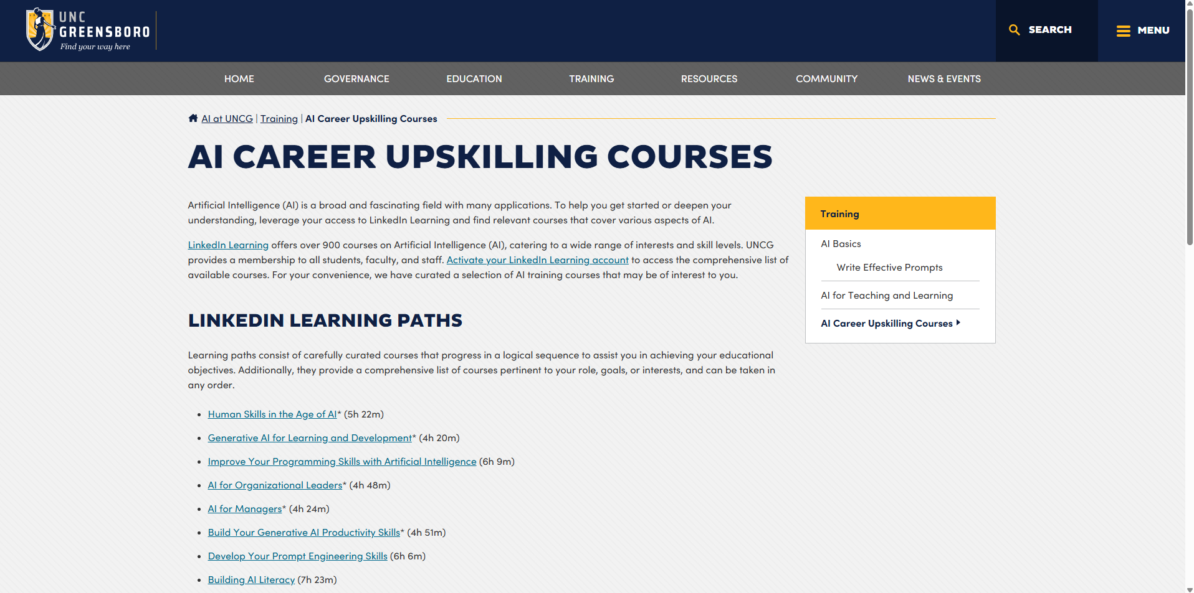

Slide 50
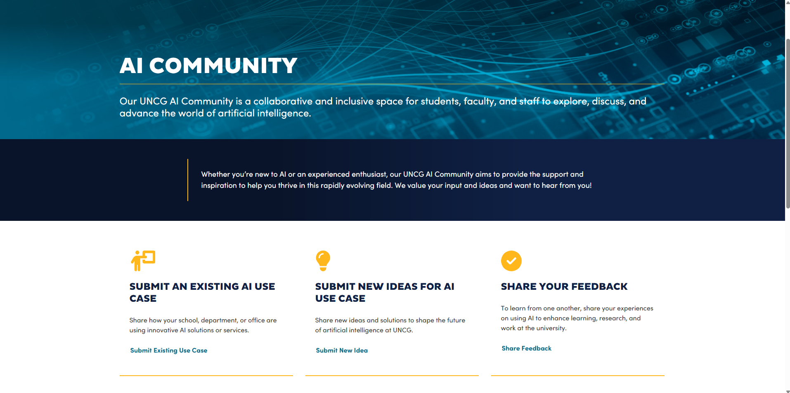

Slide 51

UNCG
ARTIFICIAL
INTELLIGENCE
Responsible Governance & Strategy
QUESTIONS?

Slide 52
Projects & Committee Reports
Old Business, & New Business

Slide 53

Ryan Milligan
Parlimenatarian &
Past Co-Chair
Elections

Slide 54
Staff Engagement

Slide 55
Upcoming Reminders

Slide 56

Celebrate Exceptional Acts of Care at UNCG
Staff Star nominations opening soon!
  Devotion to Duty
  Innovation
  Service
  Human Relations
  Other Outstanding Achievements
Recipients recognized at a Full Body Staff Senate Meeting

Slide 57

Employee Wellness Day
Tuesday, October 14
6 AM to 6 PM
Kaplan Center
Free Parking!
Lot 49 Neal St (with Spartan ID)

Slide 58

Breast Cancer Awareness Walk
Saturday, October 18
Homecoming Weekend
8 a.m. - 10 a.m.

Slide 59
Engagement & Service Opportunities
Staff Senate Facilitated
November
  Spartan Open Pantry drive
  Honoring UNCG Veterans & Armed Service Members
  Nominations for Spartan Season of Giving recipients
December
  Spartan Season of Giving wrapping party

Slide 60
Adjournment

Slide 61


