Slide 1
UNCG
2025-2026
STAFF SENATE
Full Body Meeting
August 7, 2025
Notes:
Kimberly

Slide 2
Agenda
10:00am | Call to Order | Carla Wilson, Staff Senate Chair
10:05am | Roll Call | Scott Wilkens, Staff Senate Secretary
10:10am | Approval of Minutes | Kimberly Mozingo, Past Co-Chair
10:15am | Ex-Officio Reports
10:30am | Weatherspoon Museum | Mei Mendez, Assistant Director for Strategic Engagement
10:50am | Upcoming Reminders
11:00am | Adjournment| Carla Wilson, Staff Senate Chair
Notes:
Kimberly

Slide 3
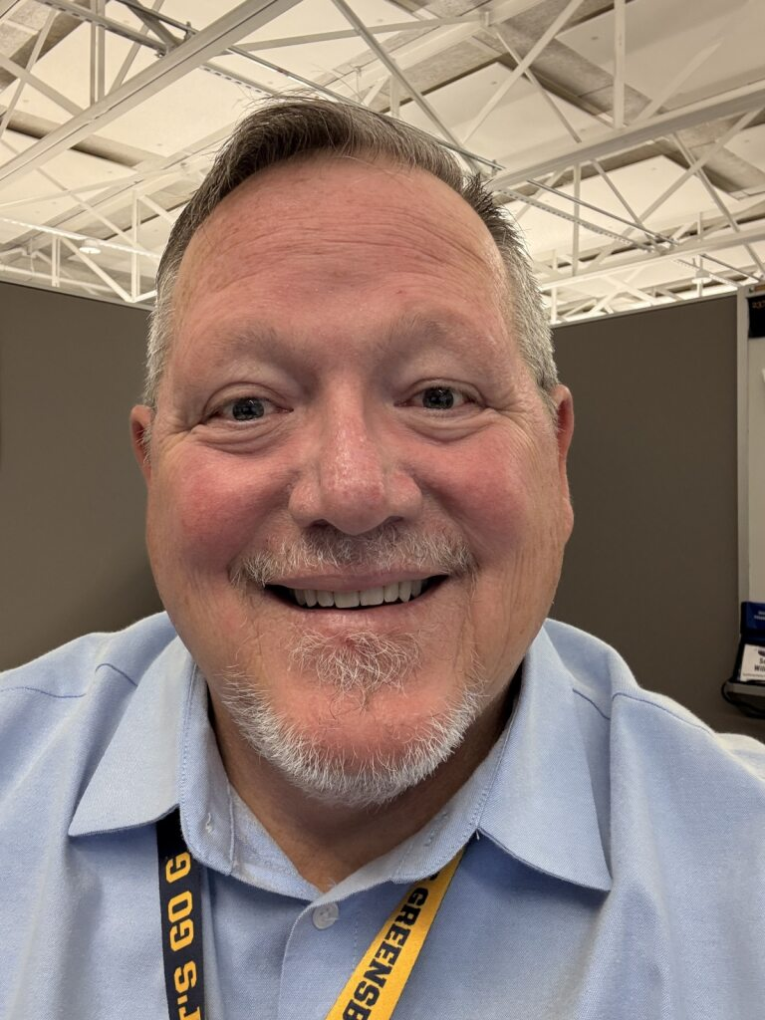
Scott Wilkens
Secretary
Roll Call
Senators attending online please let us know through the Q&A.

Slide 4
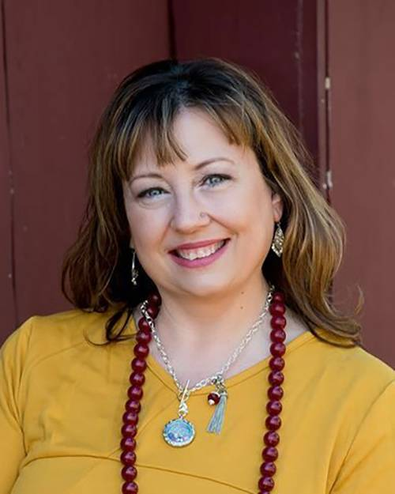
Kimberly Mozingo
Parlimenatarian &
Past Co-Chair
Approval of Meeting Minutes
June 12, 2025

Slide 5
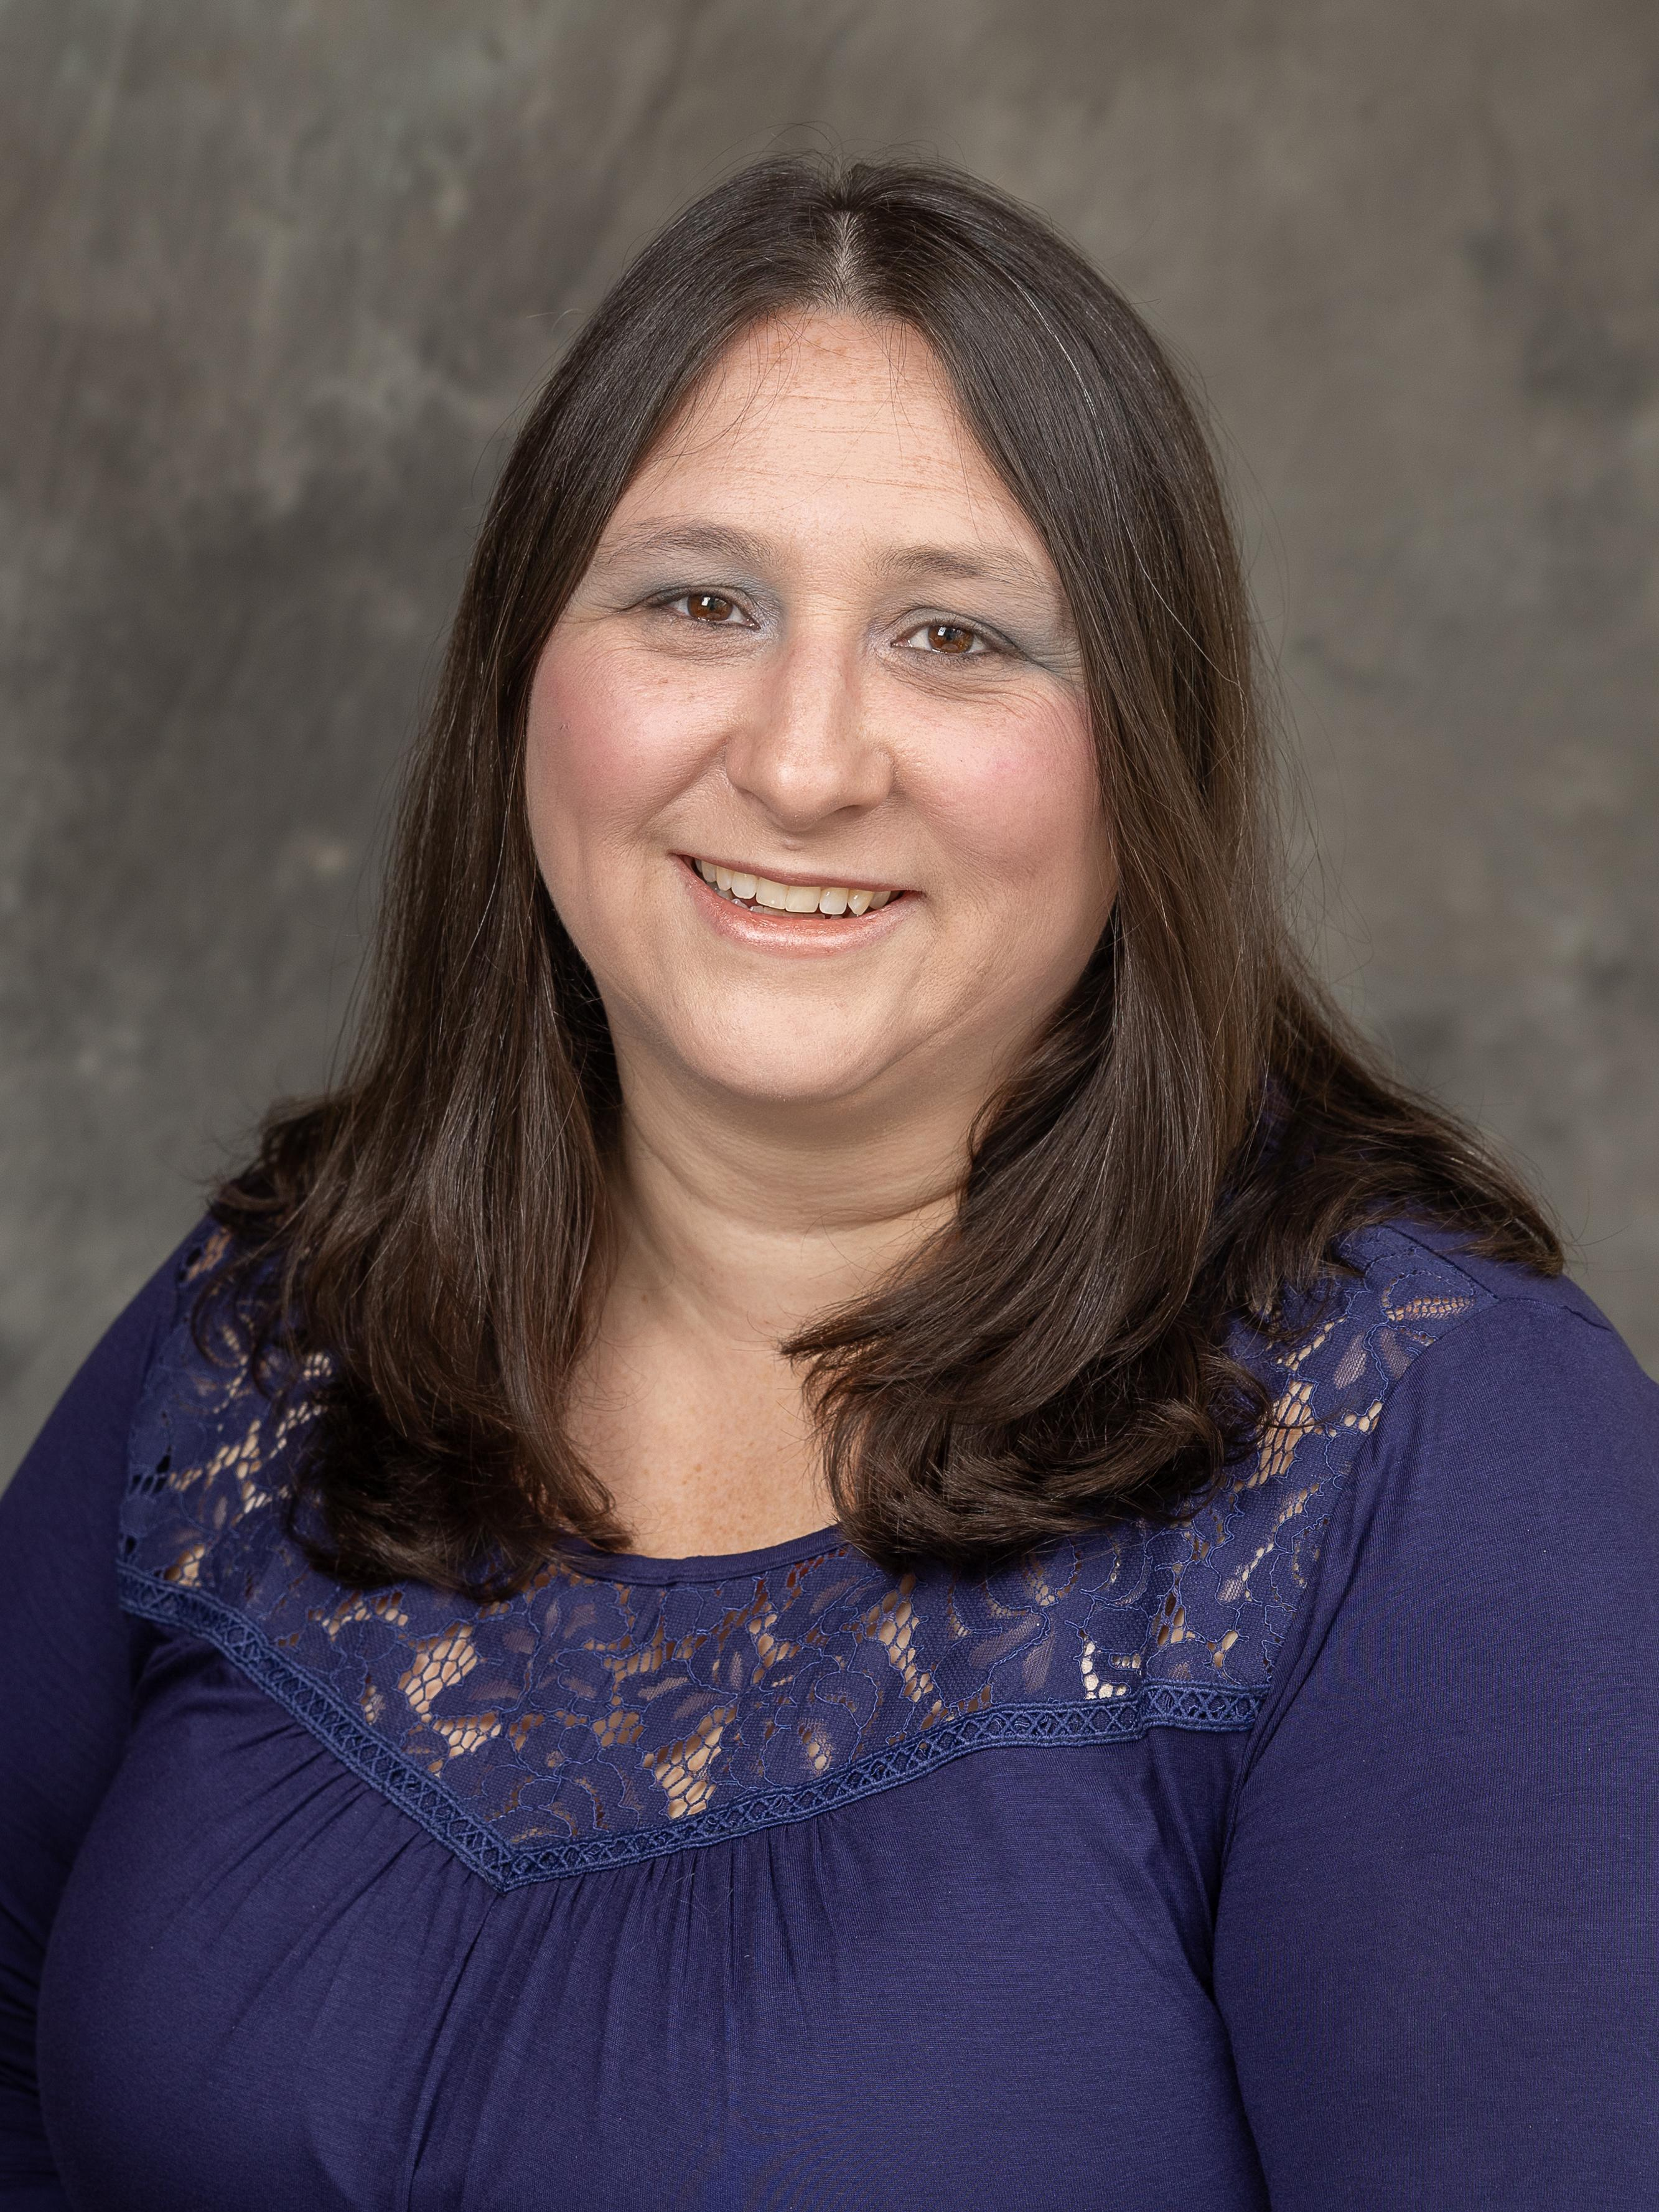
Carla Wilson
Chair
Approval of Meeting Minutes

Slide 6
Ex Officio Reports/Updates

Slide 7
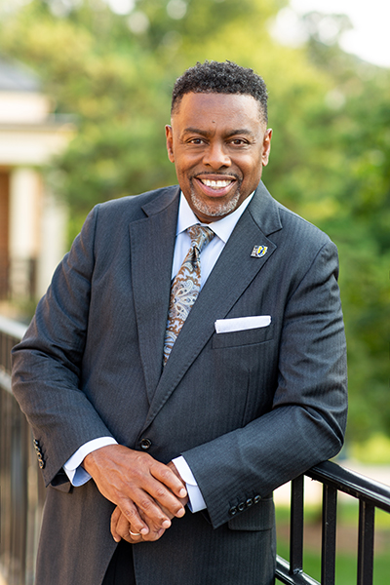
Dr. Franklin D. Gilliam, Jr.
Chancellor
Chancellor's Update

Slide 8
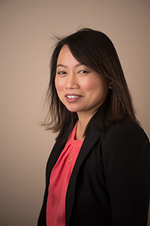
Waiyi Tse
Chief of Staff,
Office of the Chancellor
Chancellor's Update

Slide 9
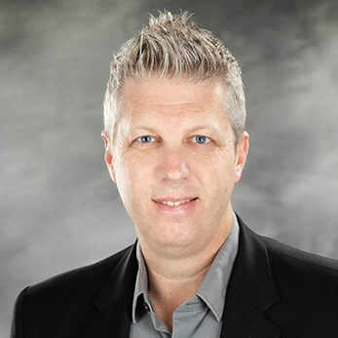
Information Technology Service Update
Technology Initiatives
Workshops
Todd Sutton
Associate Vice Chancellor for Learning Technology and Customer Success

Slide 10
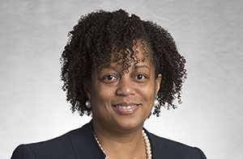
Human Resources Update
UNCG Human Resources website
Patricia Lynch
Director of ER and EEO/AA
Human Resources Officer

Slide 11
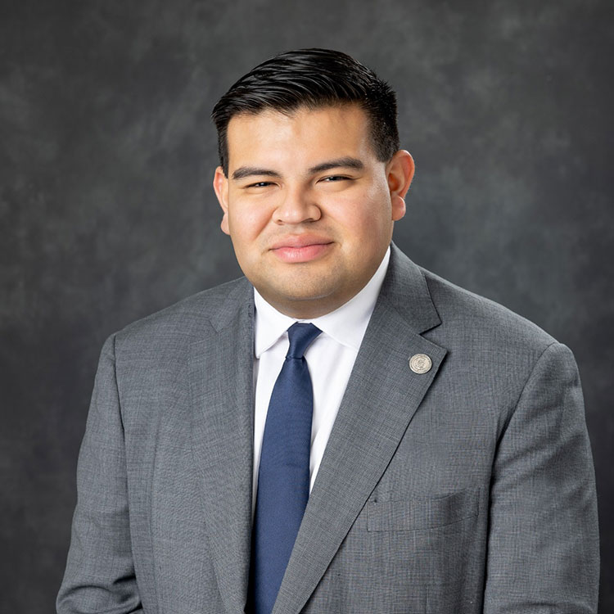
Juan Pleitez
Director of External Affairs
Strategy and Policy
Legislative Update

Slide 12
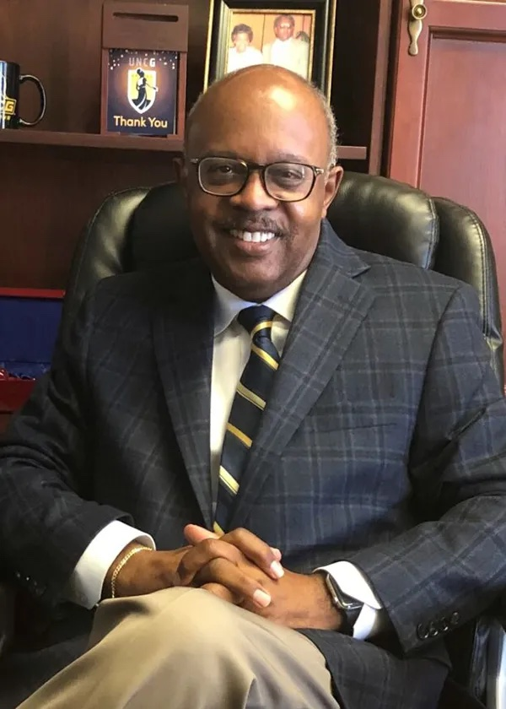
Jerry Blakemore
Vice Chancellor,
Institutional Integrity & General Counsel
Equality Policy
Notes:
Jerry D. Blakemore serves as the Vice Chancellor for Institutional Integrity and General Counsel for UNC Greensboro.
He has more than 30 years of experience in higher education administration, policy development and the providing of legal services, 19 of which as General Counsel for major institutions of higher education.

Slide 13
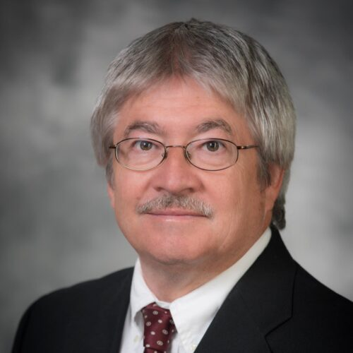
Faculty Senate
Faculty Senate website
Chuck Bolton
Faculty Senate Chair

Slide 14
Guest Speaker

Slide 15
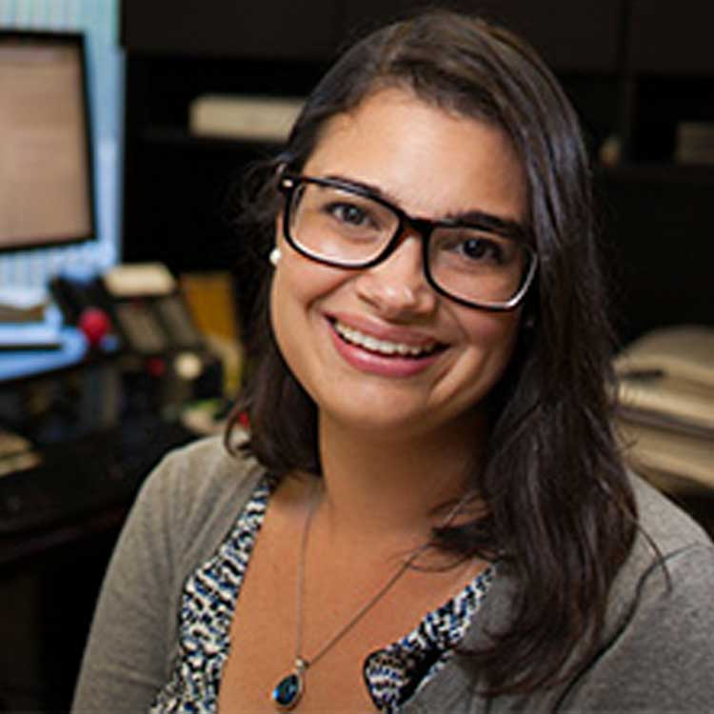
Mei Méndez
Assistant Director for Strategic Engagement

Slide 16
UNCG Staff Senate
August 7, 2025

Slide 17
Museum Information
Free and open to the public
Free parking for visitors with museum permit
Free membership – contact Mei for details (m_mendez3@uncg.edu)
  Members receive:
    Monthly e-blast with exhibition and program information
    First notice of registration-only events
    Print and electronic quarterly newsletters and posters
Hours:
  Tuesday, Wednesday, Friday, and Saturday: 10am-5pm
  Thursday: 10am-8pm

Slide 18
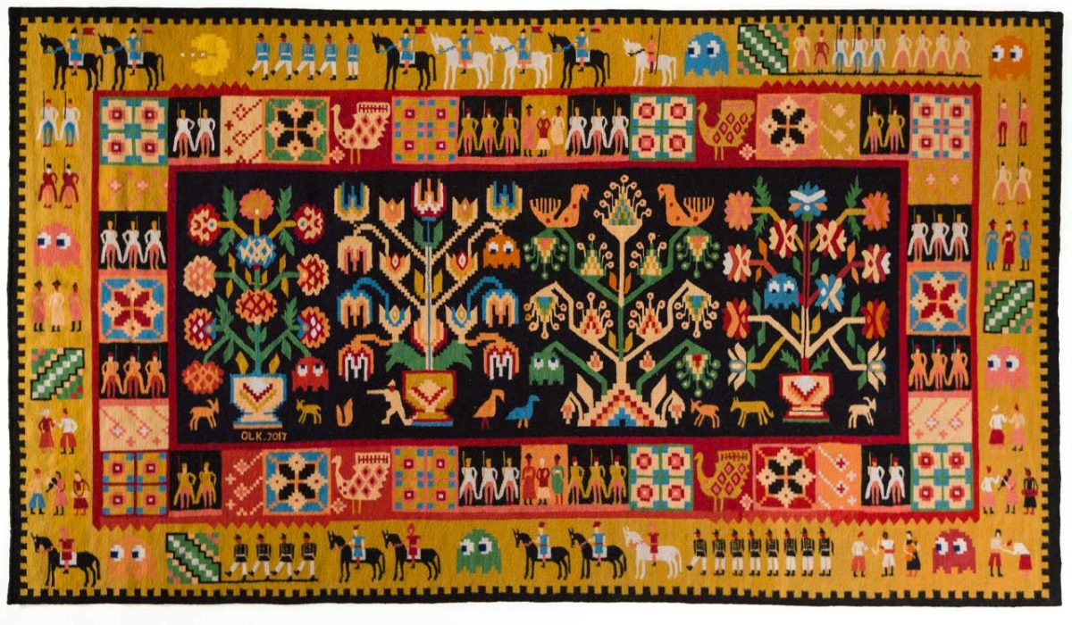
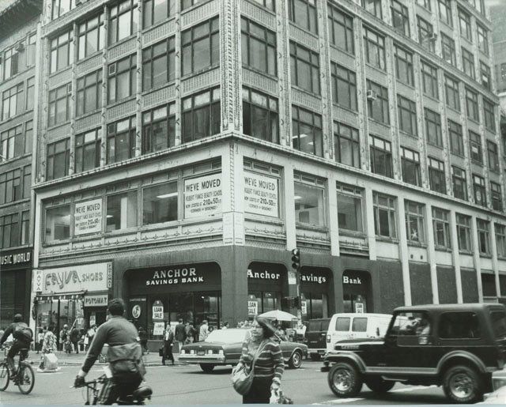
Summer Exhibitions
Oksana Levchenya, Pac-Man and Cossacks, 2022
Andy Warhol, People on the Street, 20th century
RugLife​
May 24–August 9, 2025
Pattern Recognition
June 7, 2025–January 10, 2026

Slide 19
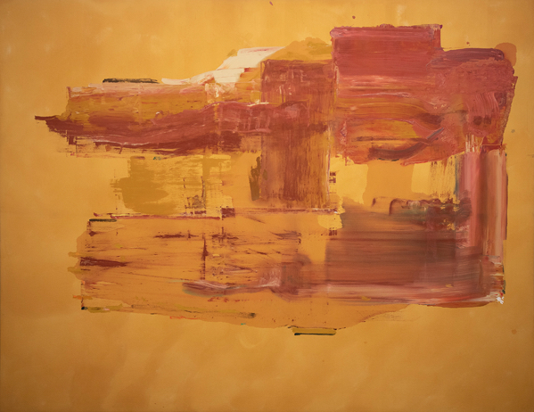

Making Connections: Art, Place, and Relationships
July – December 2025
Helen Frankenthaler
Houdini, 1976
Acrylic on canvas
82 x 108 in.
Gift of Linda and Tom Sloan, 2022
Al Held
Giza Gate I, 1976
Acrylic on canvas
48 x 48 in.
Gift of Maryann and Stuart Abrahams, 2010

Slide 20
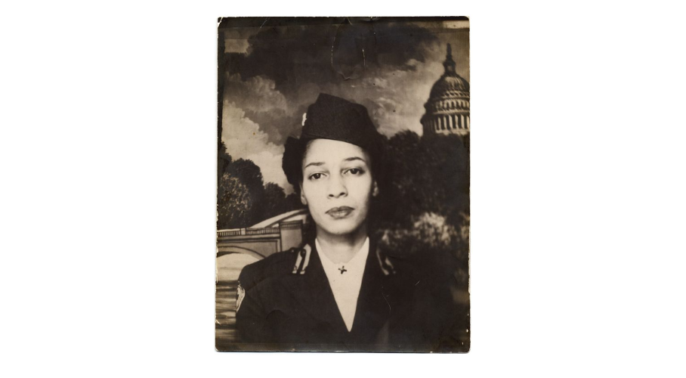
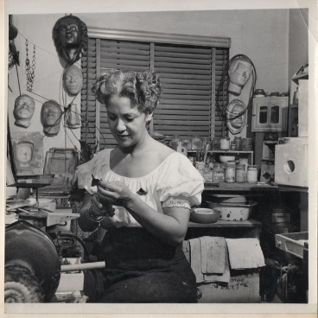
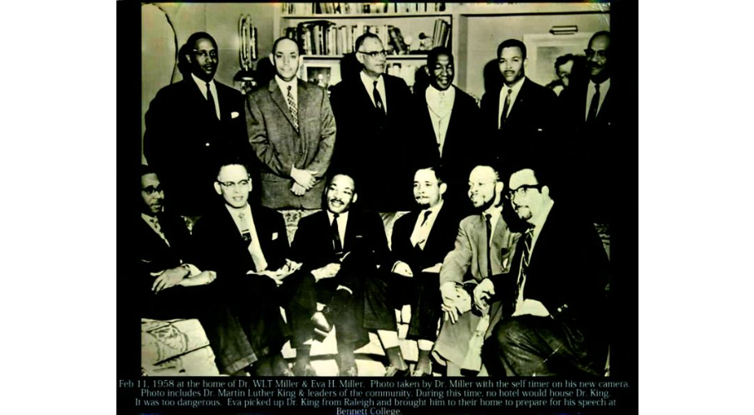
Conversations in Black
August 9, 2025–January 10, 2026
Eva Hamlin Miller in her studio, no date
Family Collection of Dr. William Lloyd Tevis Miller and Eva Hamlin Millier
Dr. Martin Luther King, Jr and [Greensboro] Community Leaders, 1958
Family Collection of Dr. William Lloyd Tevis Miller and Eva Hamlin Millier
Portrait of Jean M. Bright, ca. 1944
Jean M. Bright Collection, UNCG University Libraries

Slide 21


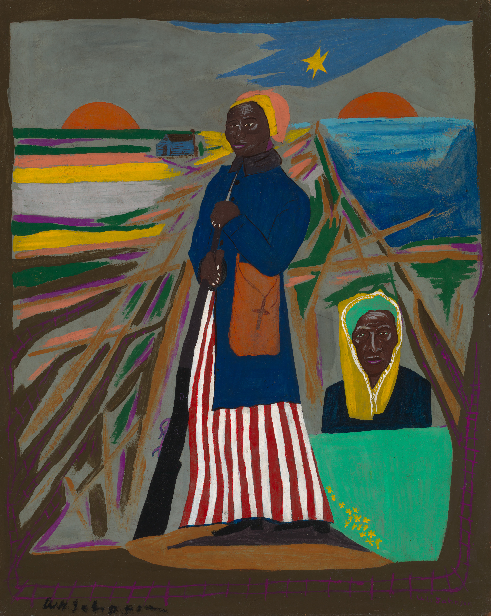
Fighters for Freedom
William H. Johnson, Picturing Justice
September 6–November 29, 2025
Harriet Tubman
about 1945
Oil on paperboard
Booker T. Washington Legend
about 1944–45
Oil on plywood
Marian Anderson
about 1945
Oil on paperboard

Slide 22
September Events & Programs
August 28th: The Art of Gaming, presentation by UNCG Professor and WAM Benjamin Fellow Dr. John Borchert, 6-7pm followed by refreshments
September 4th: Tomorrow, and Tomorrow, and Tomorrow Community Collection Study Session, 5:30-6:30pm followed by refreshments – registration required
September 11th: Curators' Talk: Virginia Mecklenburg on Fighters for Freedom, 5:30-6:30pm followed by refreshments
September 19th: Gallery Talk: WAM Curator Elaine Gustafson and UNCG Art Historian Dr. Claire Ittner in conversation about the work of William H. Johnson, 12-1pm
September 25th: WAM Fall Open House! Music and refreshments to celebrate our exhibition openings, 5-7pm
More at weatherspoonart.org

Slide 23
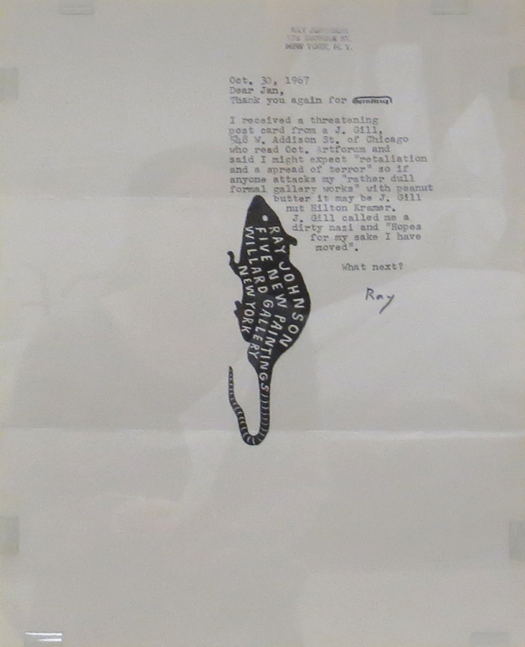
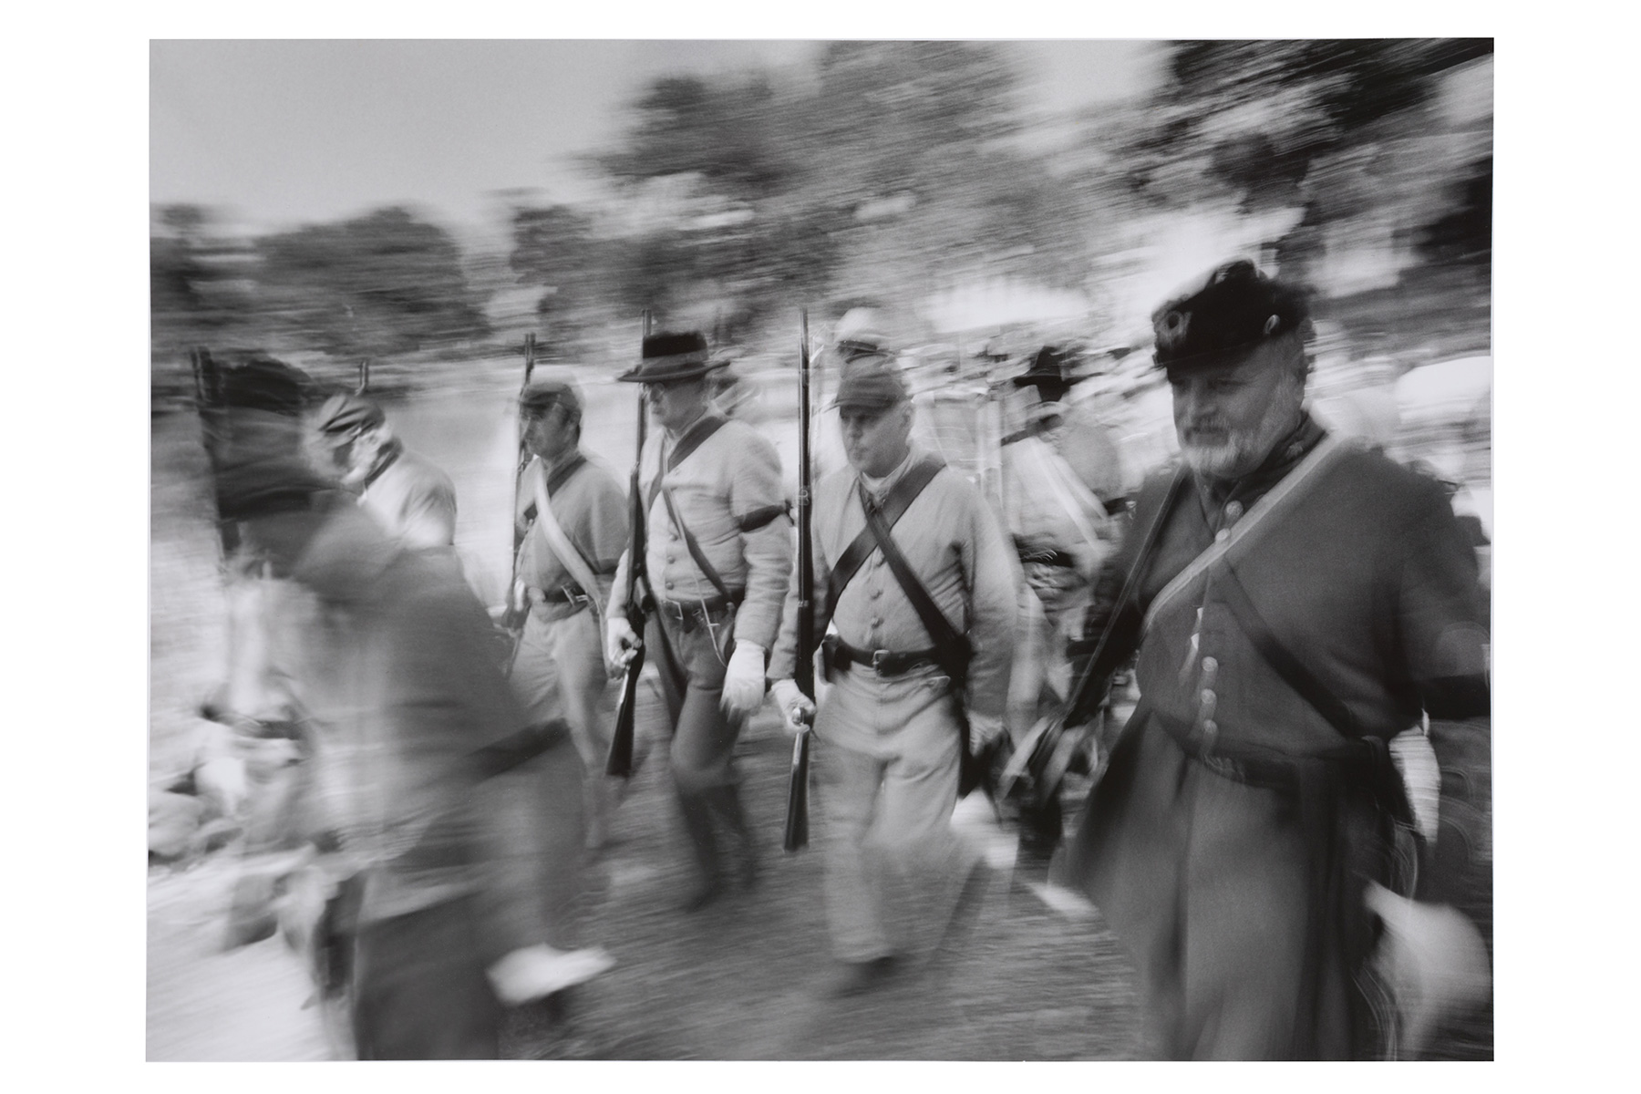
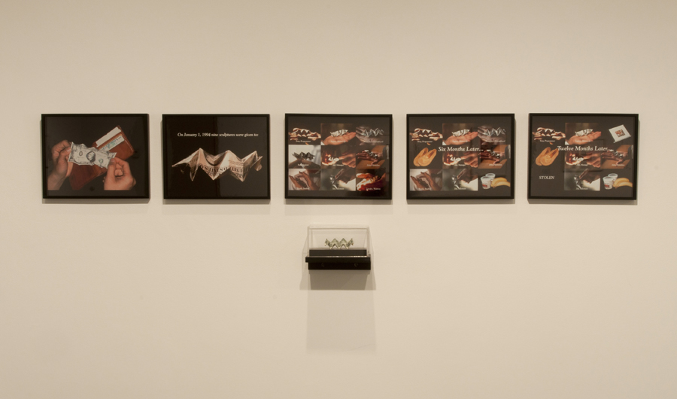
Making (Art) History: Acts, Actions, and Reenactments
January 10 – July 18, 2026
Thomas Daniel
Burial March of Eight H.L. Hunley Soldiers from the series Southern Cause
2004
Gelatin silver print
Lee Mingwei
Money for Art #4
1997
Five dye destruction prints and origami sculpture
Raymond Johnson
Thank You Again
October 30, 1967
Magic marker ink on paper

Slide 24
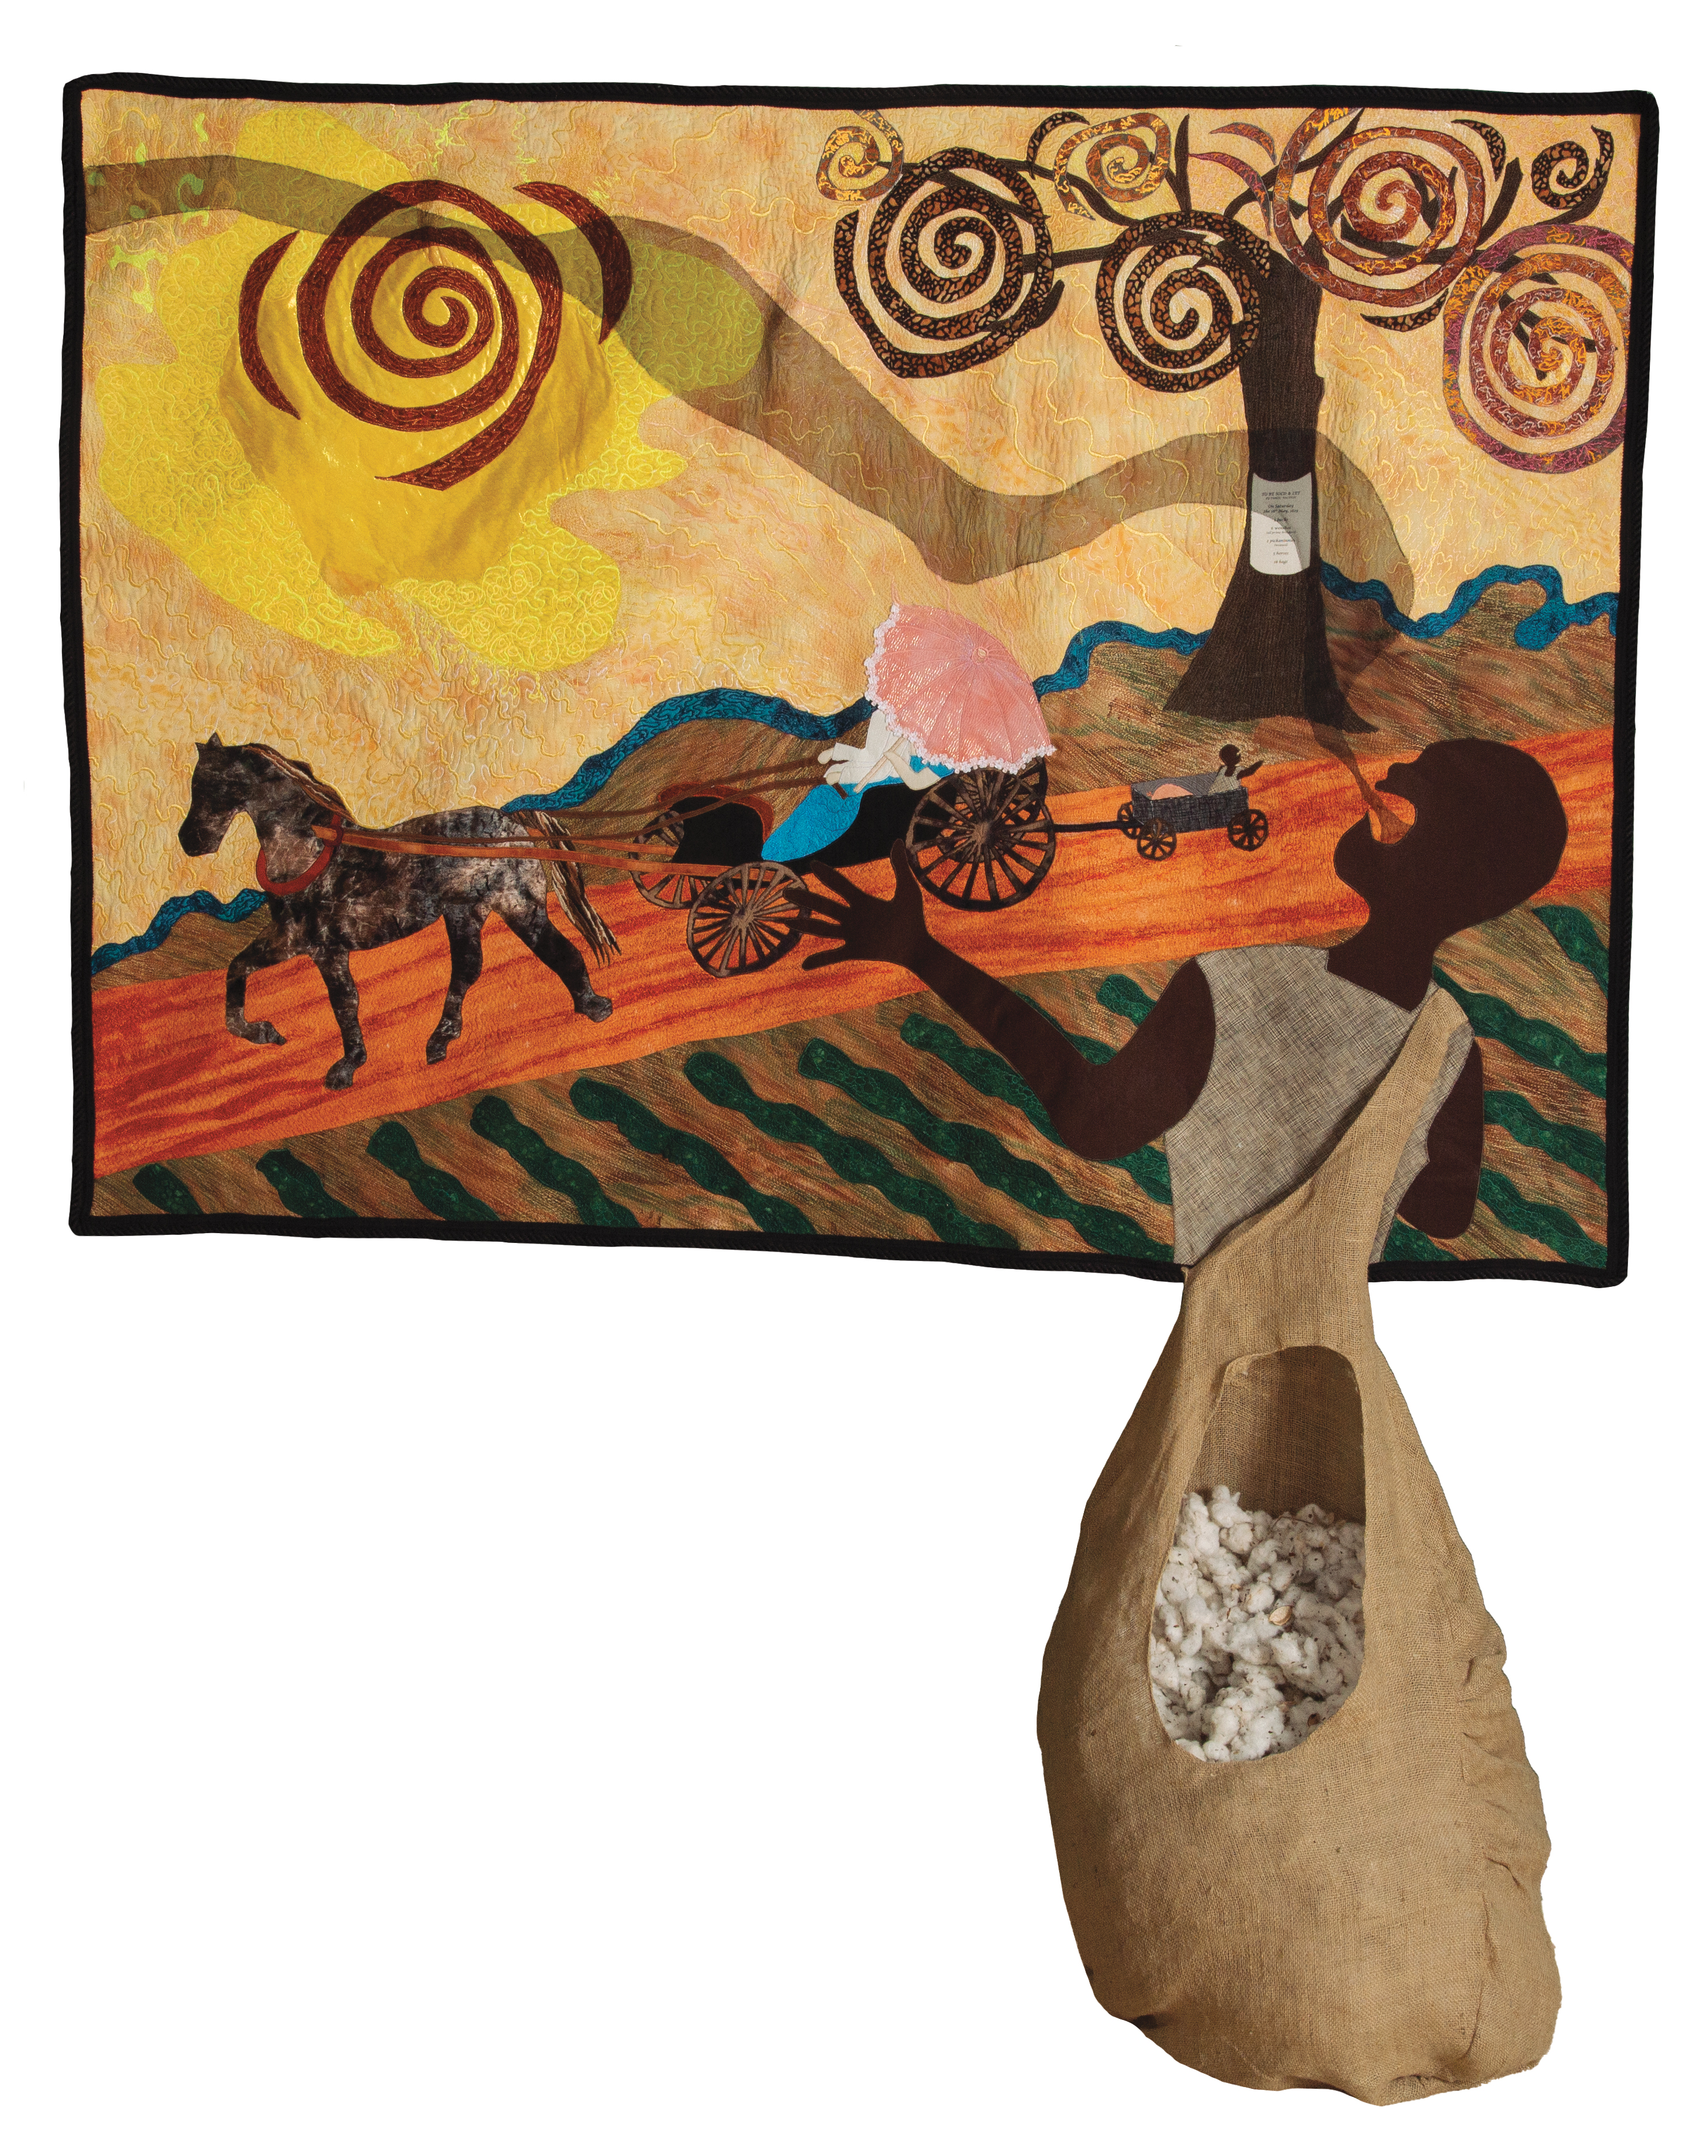
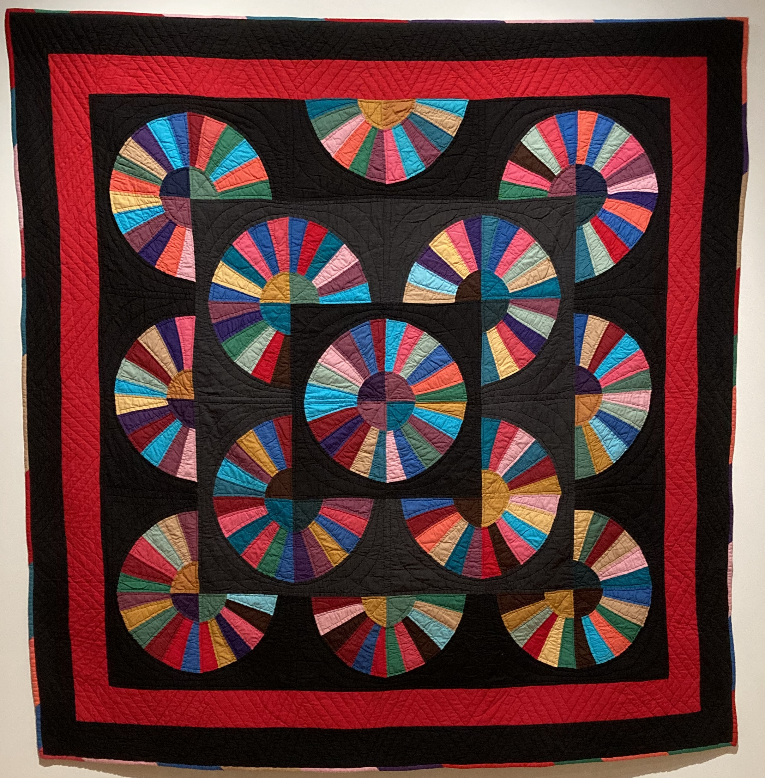

Of Salt and Spirit: Black Quilters in the American South
February 7–August 1, 2026
Gustina Atlas, Variation on Dresden Plate Quilt,1998
Gwendolyn A. Magee, When Hope Unborn Had Died, from Lift Every Voice and Sing series, 2004.

Slide 25
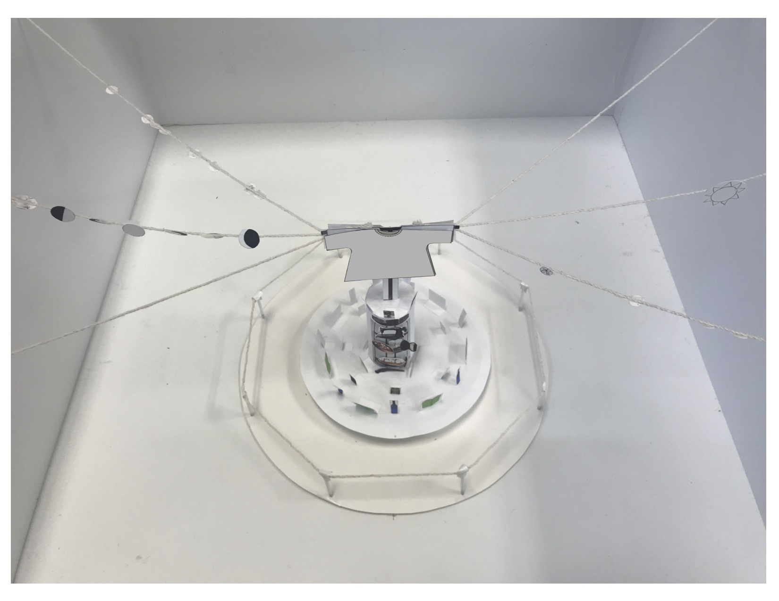
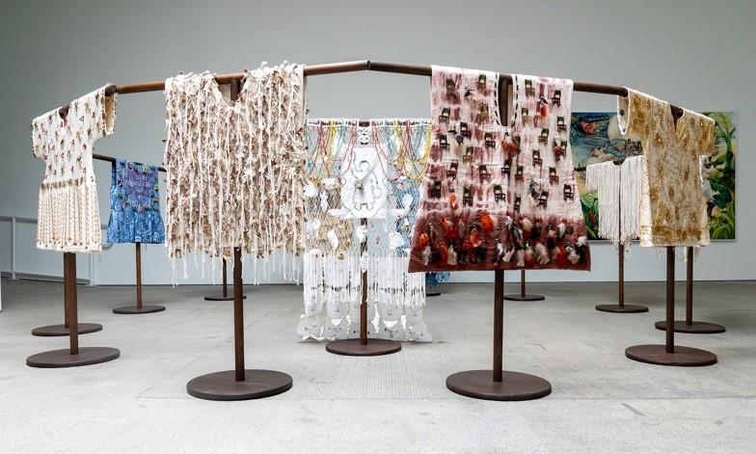
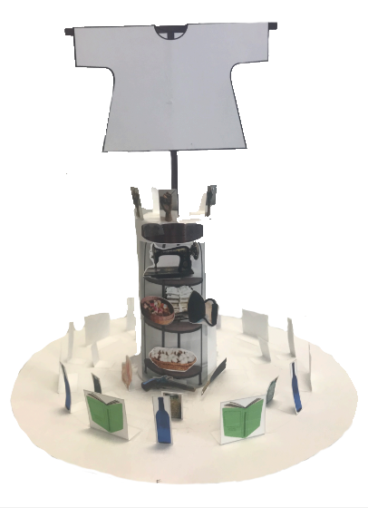
Draft scale models of Harriet's Powers
Precious D. Lovell, Warrior Women of the African Diaspora, 2023
Precious D. Lovell: Harriet's Powers
January 24–August 1, 2026
A commissioned project by the Weatherspoon Art Museum

Slide 26
Projects & Committee Reports
Old Business, & New Business

Slide 27
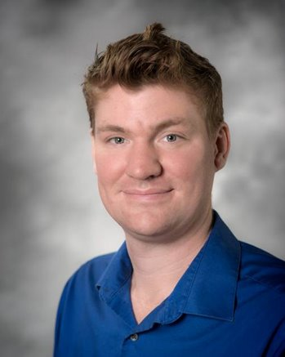
Ryan Milligan
Parlimenatarian &
Past Co-Chair
Elections

Slide 28
Staff Engagement

Slide 29
Upcoming Reminders

Slide 30
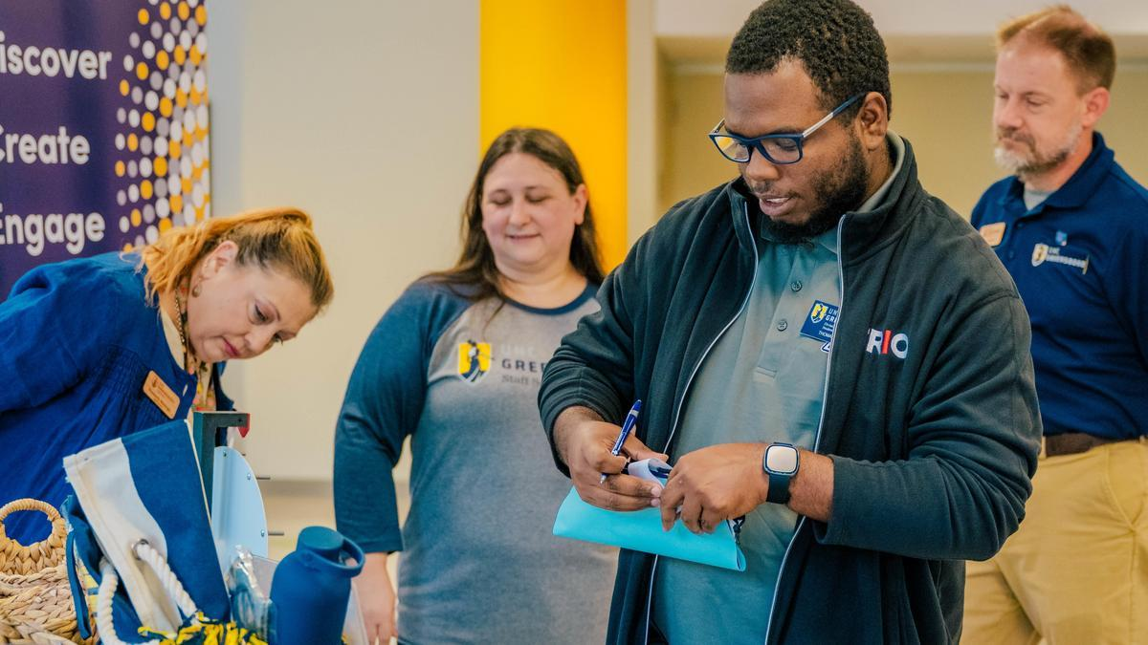
Welcome Back Luncheon
Tuesday, August 12th
11am – 1:30 pm
Moran Commons and Fountain View Dining Hall
Make sure you drop by the Staff Senate Table and say Hi!
Notes:
his event offers the opportunity to enjoy a complimentary lunch while reuniting with colleagues, forging new relationships, discovering UNCG's newest initiatives, and celebrating the start of a new academic year.

Slide 31
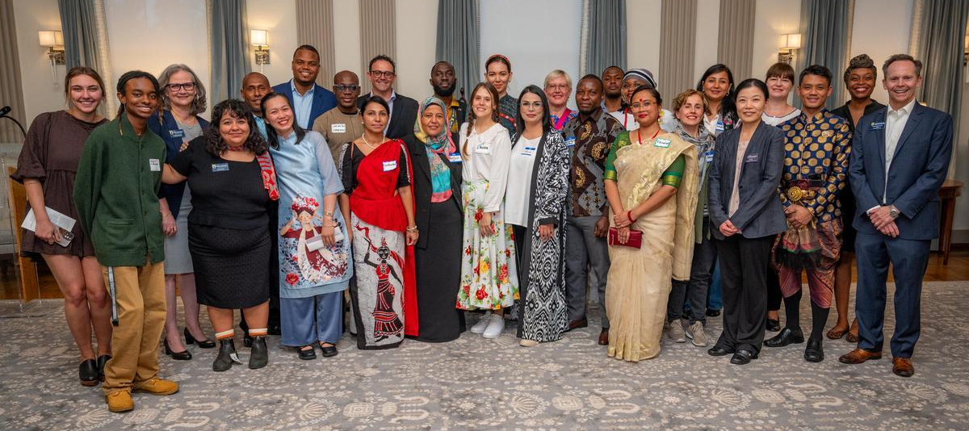
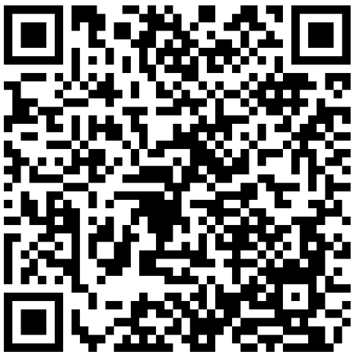
Fulbright TEA 2025:
Friendship Family Interest Form
The friendship hospitality weekend is scheduled the weekend of September 20-21.
This cultural experience will help participants connect with families in our community and learn about U.S. home life.
Fulbright TEA participants are secondary school teachers from all over the world.
Application deadline: August 29, 2025
go.uncg.edu/fulbrightfriendshipfamily

Slide 32
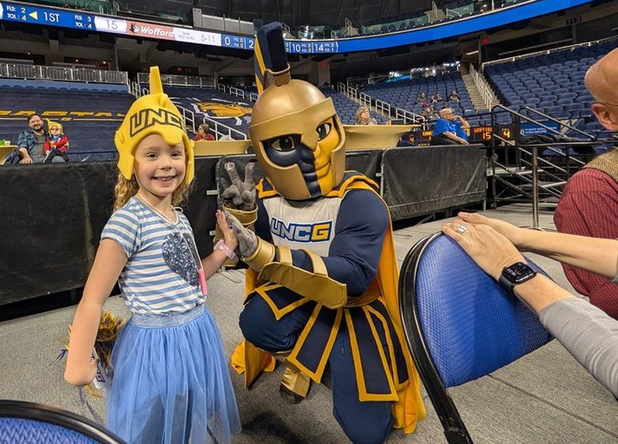
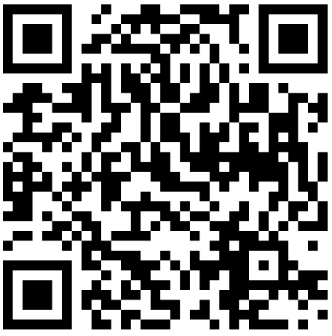
All-Southern Conference Staff Award
Recognizes faculty & staff who have made a significant impact in the lives of students and served their institution in significant ways
DEADLINE: AUG 29TH
Learn more:
go.uncg.edu/socon_staff

Slide 33

CCGT | Waynesville Inn & Golf Club| 9/29/25
Money raised to support the UNC System Janet B. Royster Memorial Staff Scholarship Fund
Event includes a Captain’s Choice Format, box lunch, and awards reception following the tournament.
UNCG will sponsor 1-2 teams
Interested? Contact staffsenate@uncg.edu
Notes:
Support the UNC System staff by participating in a great day of golf.
The purpose of the Janet B. Royster Memorial Staff Scholarship Fund is to provide scholarship(s) to full-time, permanent non-faculty employees who are taking either undergraduate or graduate-level courses at an accredited institution of higher education, or enrolled in approved – short courses, licensure, certificate or continuing education programs that support staff development.

Slide 34
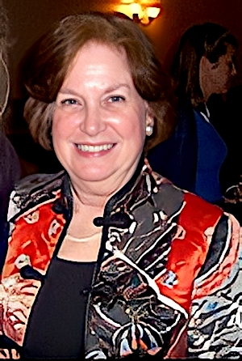
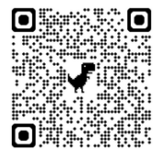
Janet B. Royster (JBR) Memorial Staff Scholarship Fund
Application open August 15 – September 30
Promotes Staff Professional Development
Visit the webpage for more
information about the
scholarship and to
access the application.
Notes:
This scholarship promotes staff development for permanent, full-time, non-faculty employees, as well as recognizes and honors Janet’s leadership and dedication to all UNC employees.

Slide 35
Adjournment

Slide 36
