Slide 1

2023 - 2024
UNC G
STAFF APPRECIATION
Awards
May 29, 2024

Slide 2
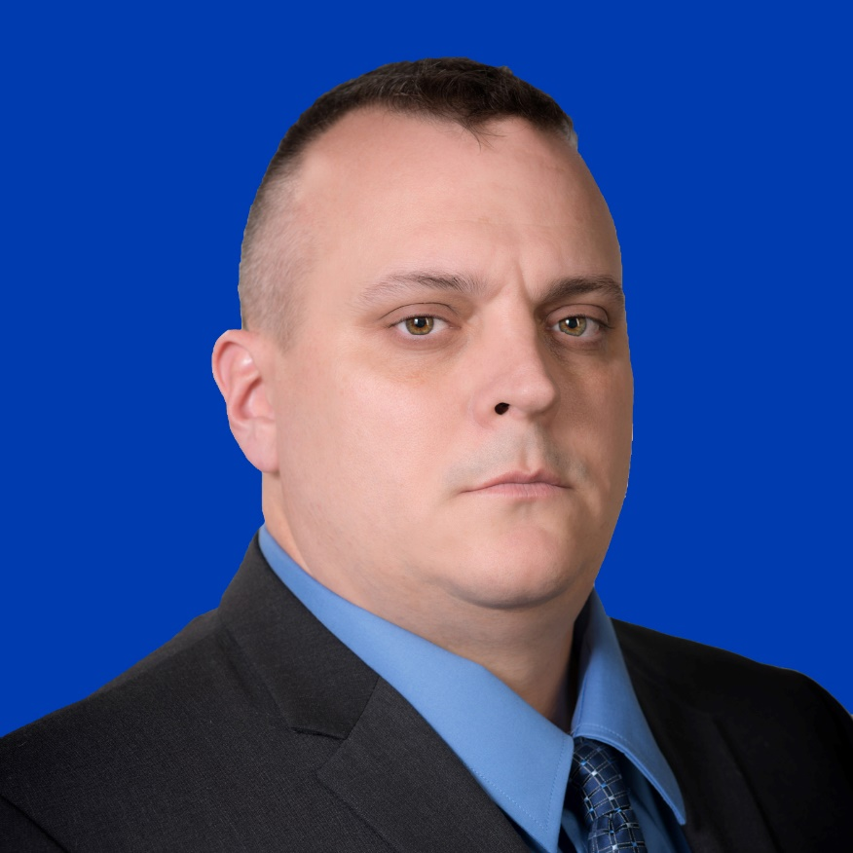
Staff Senate Staff Excellence Award Winners
Andrew Hollady
Chemistry and BioChemistry

Slide 3
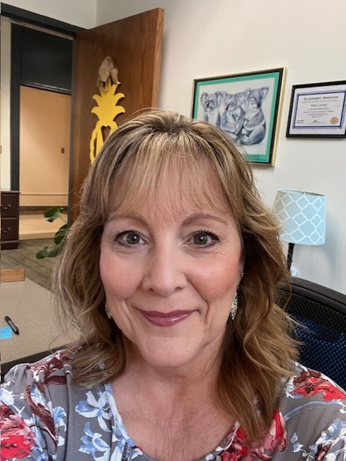
Staff Senate Staff Excellence Award Winners
Mitzi Lorenz
Counseling and Educational Development

Slide 4
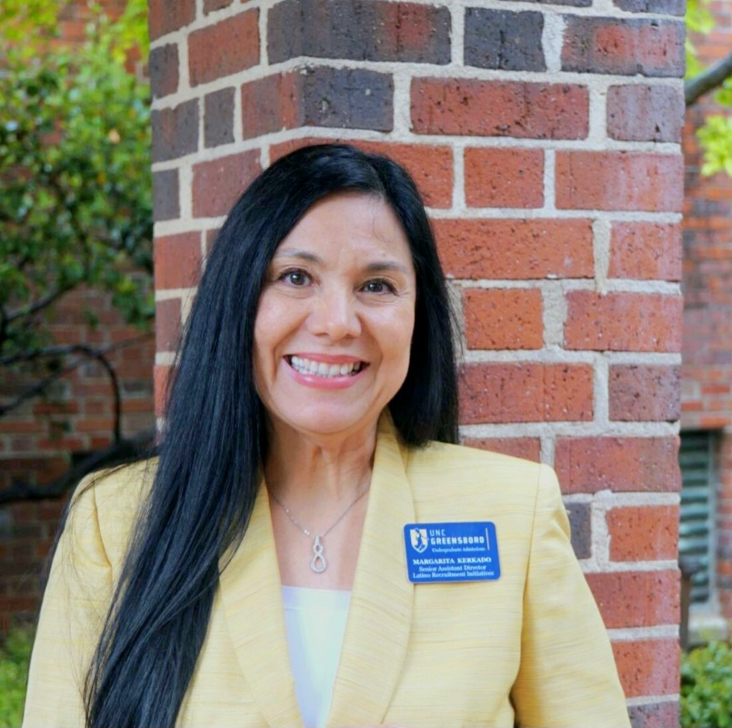
The Gladys Strawn Bullard Staff Award Winner
Margarita Kerkado
UNCG Office of Undergraduate Admissions

Slide 5
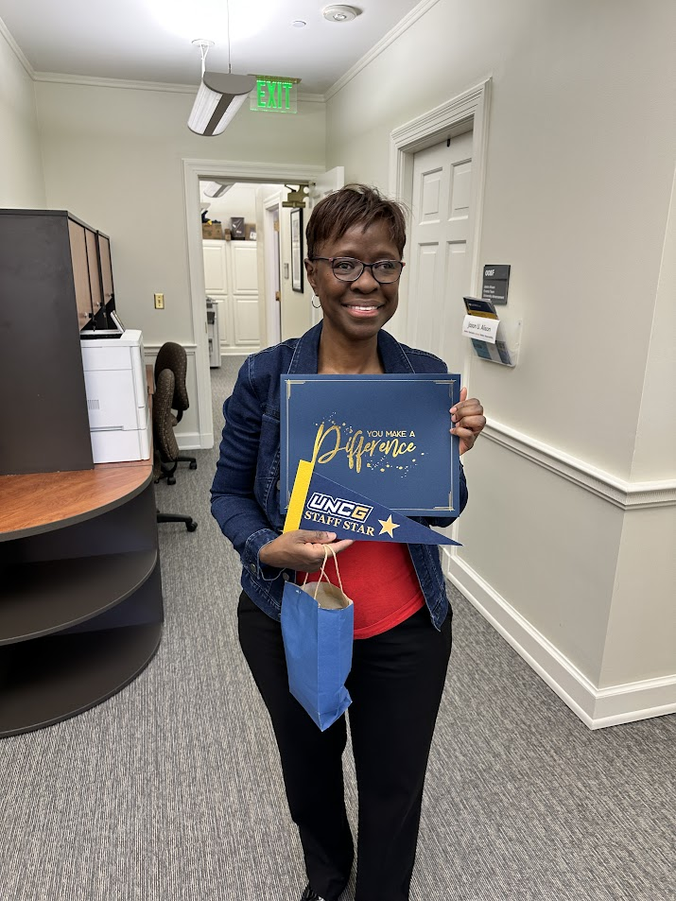
Staff Stars
Debbie Rogers
Bryan Undergraduate Student Services (now in Philanthropic Engagement)

Slide 6
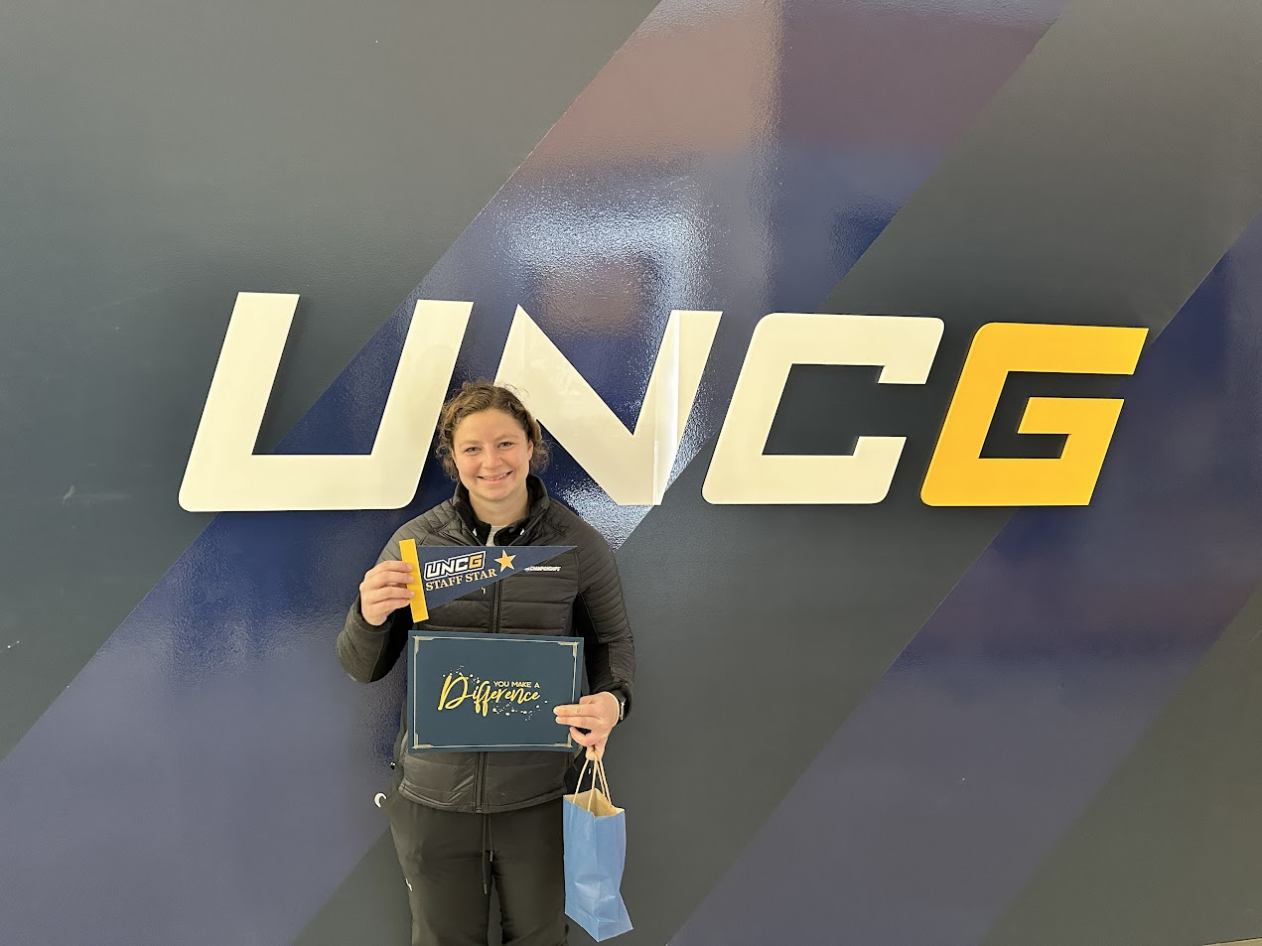
Staff Stars
Laura Mazziota
Athletics

Slide 7
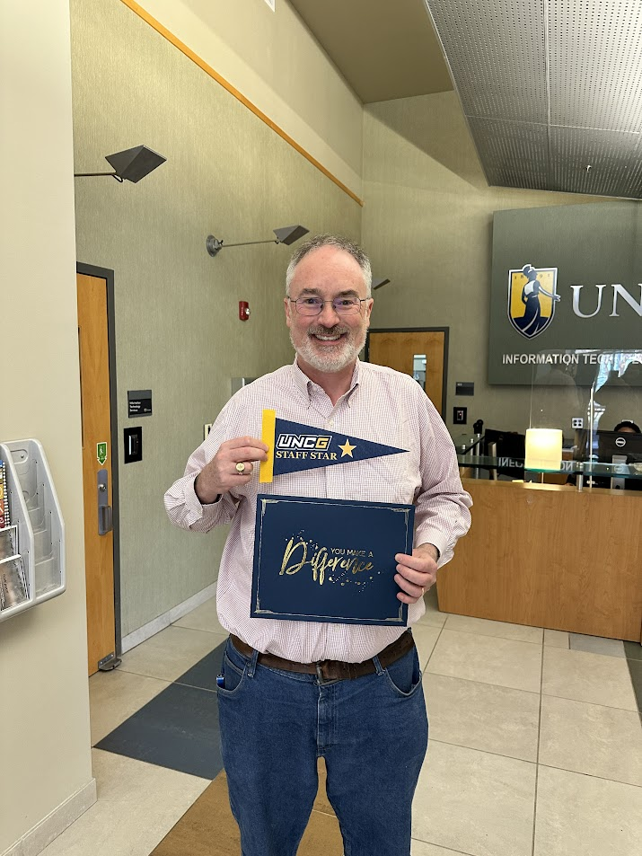
Staff Stars
Moreland Smith
Information Technology Services

Slide 8
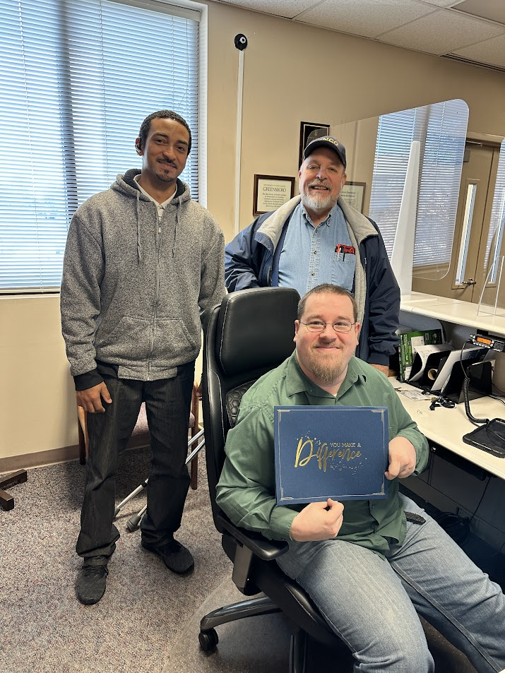
Staff Stars
Michael Milius
Facilities Operations

Slide 9
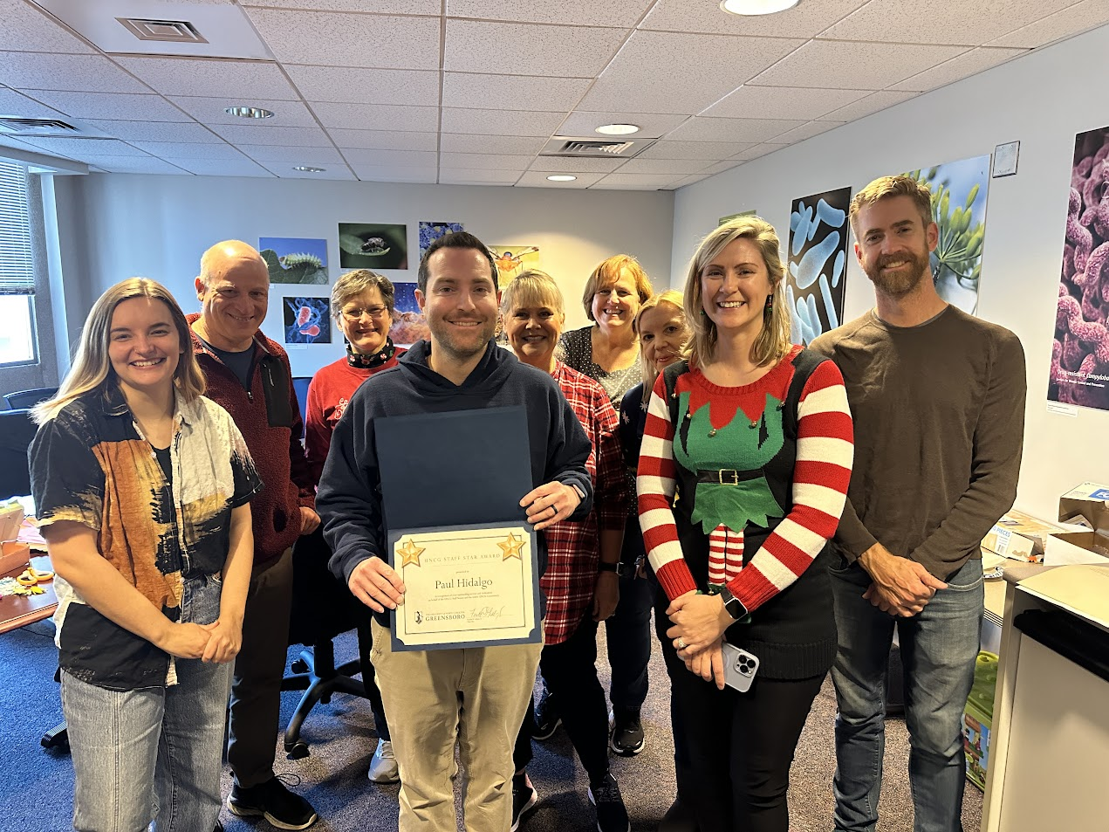
Staff Stars
Paul Hildalgo
Biology

Slide 10
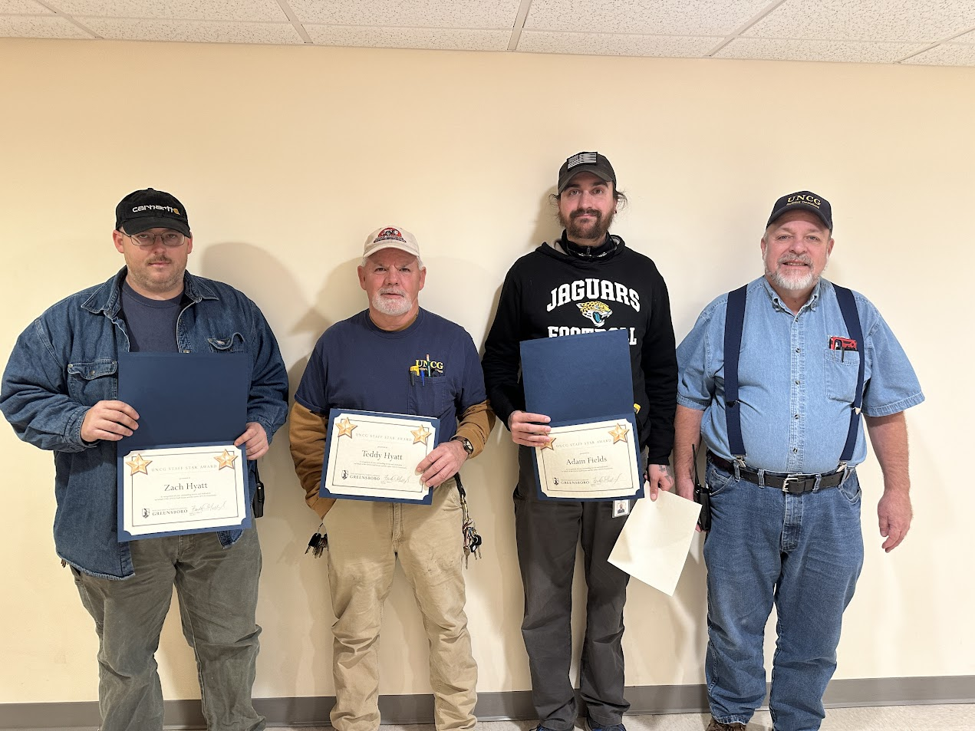
Staff Stars
Teddy Hyatt, Zach Hyatt, and Adam Fields
Facilities

Slide 11
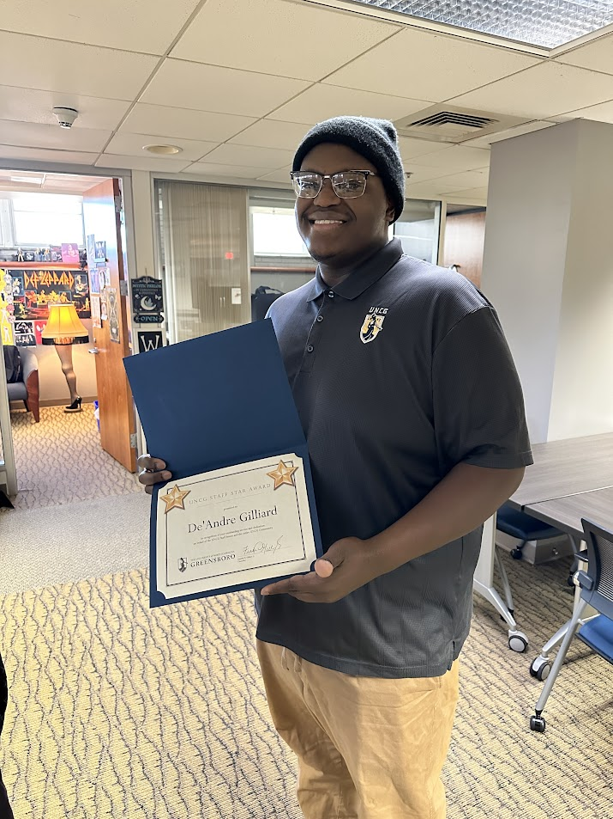
Staff Stars
De’Andre Gilliard
University Communications

Slide 12
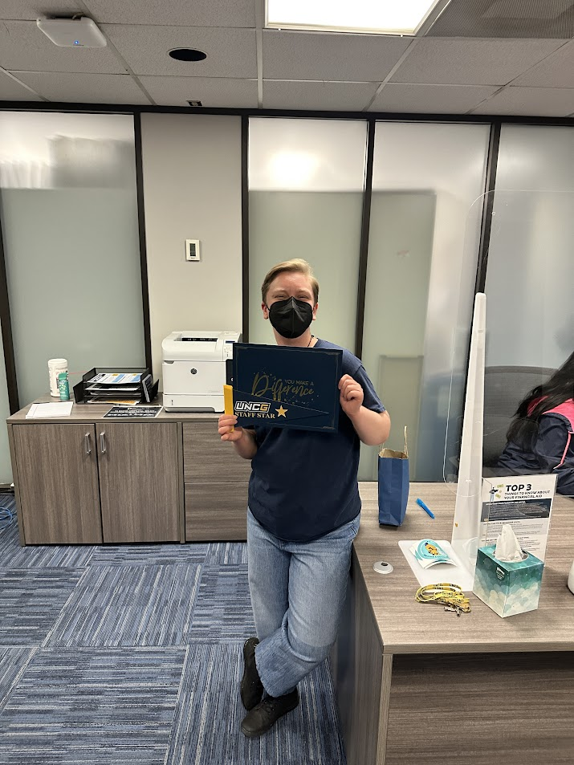
Staff Stars
K McBane
Financial Aid and Scholarships

Slide 13
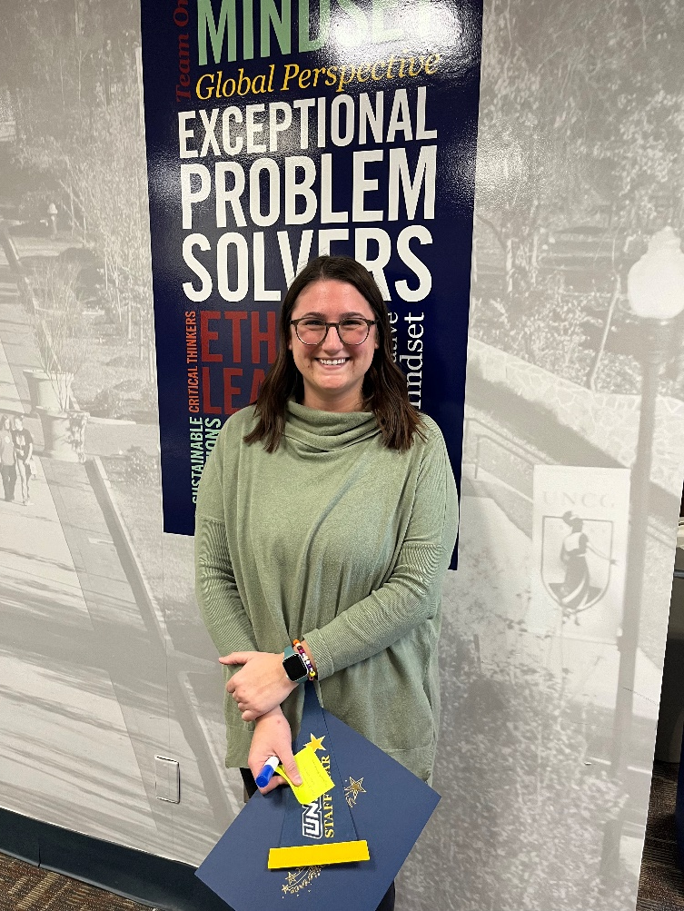
Staff Stars
Courtney Mazzuca
Bryan School, Graduate Program Office

Slide 14
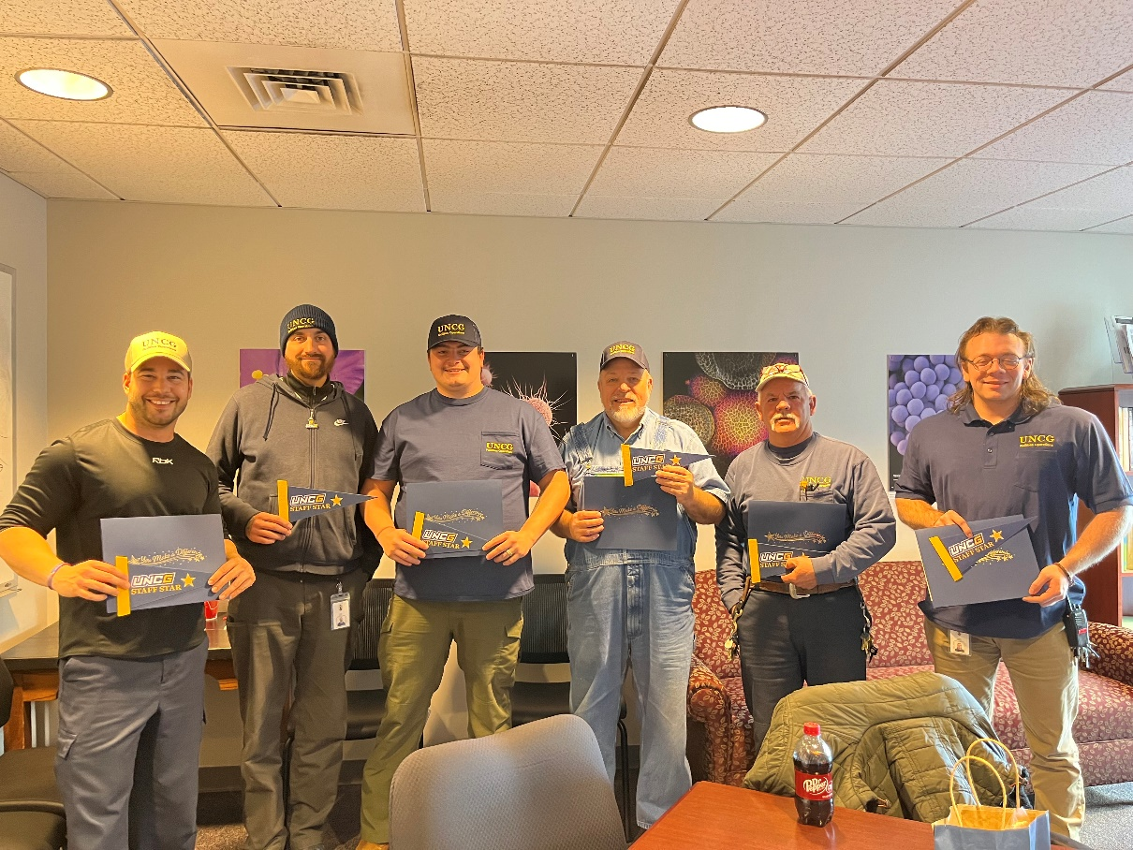
Staff Stars
Brandon Thompson, Adam Fields, Taylor Brim, Mark Cable, Teddy Hyatt, Brock Waynick, and Zach Hyatt (not pictured)
Zone Maintenance

Slide 15
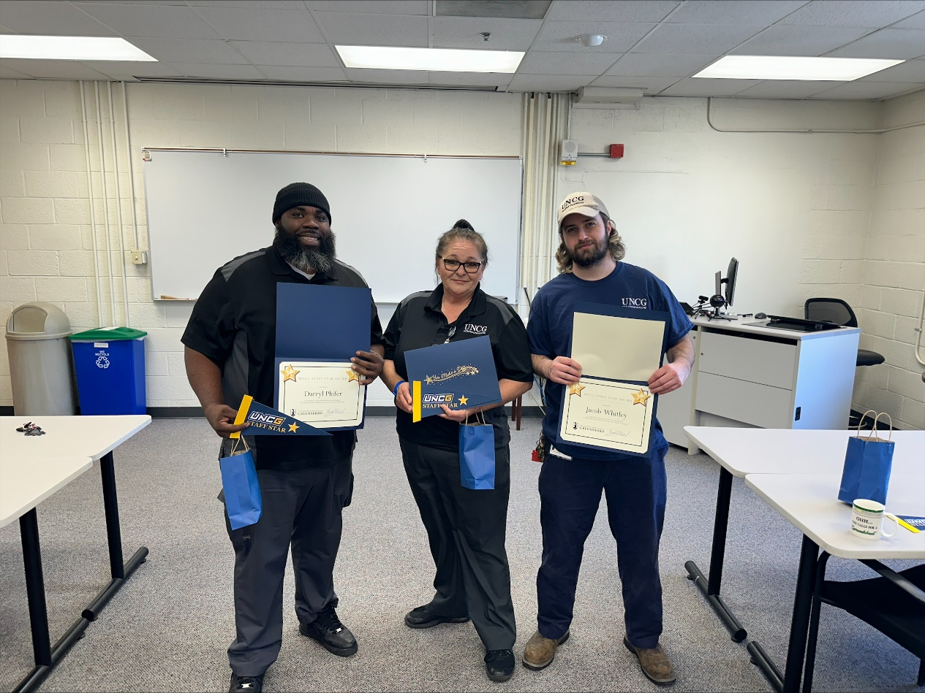
Staff Stars
Darryl Phifer, Rebecca Jones, and Jacob Whitley
Campus Supply

Slide 16
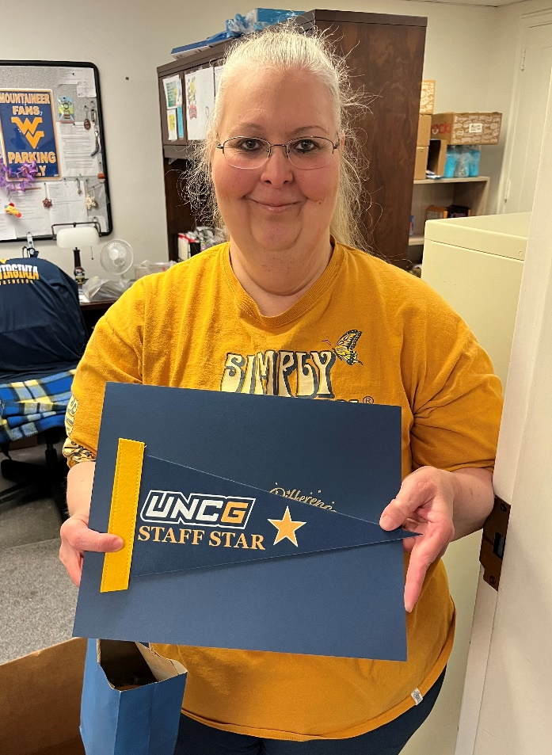
Staff Stars
Robin Paschal
University Libraries

Slide 17
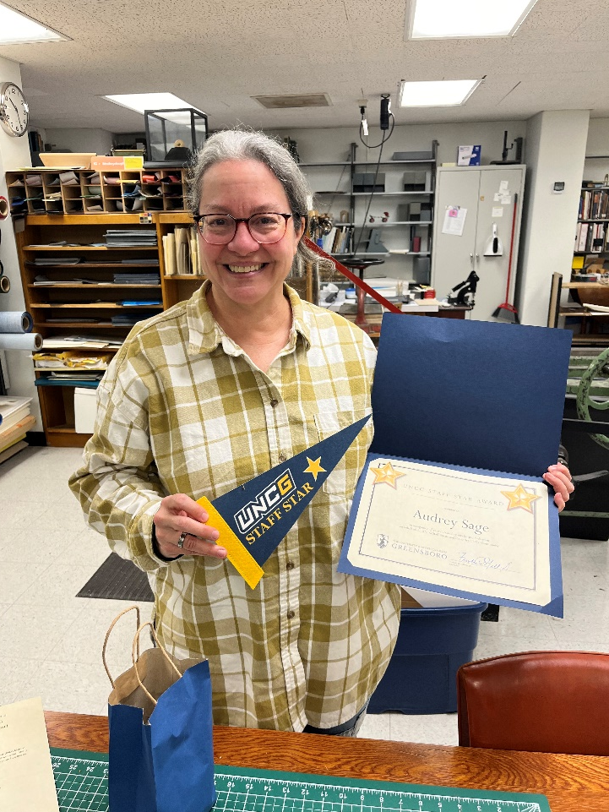
Staff Stars
Audrey Sage
University Libraries

Slide 18
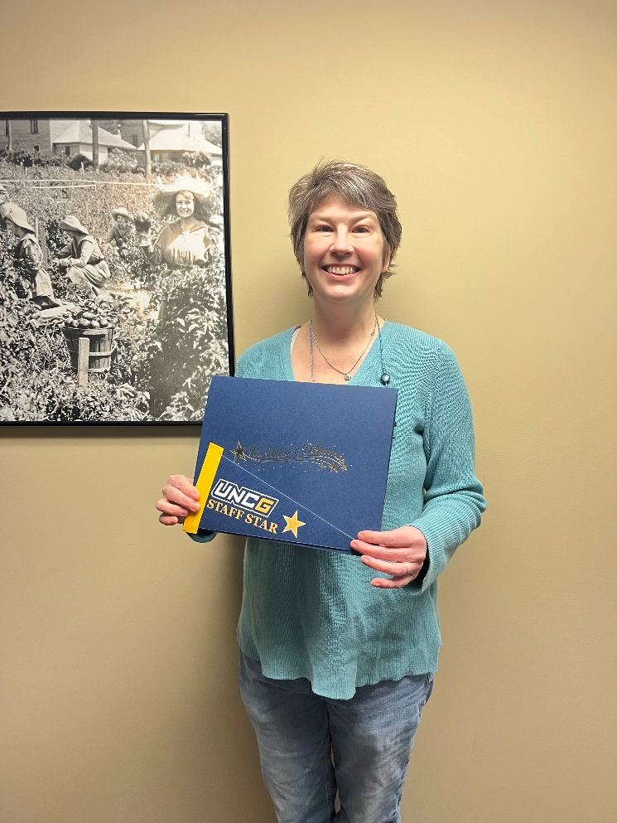
Staff Stars
Carolyn Shankle
University Libraries

Slide 19
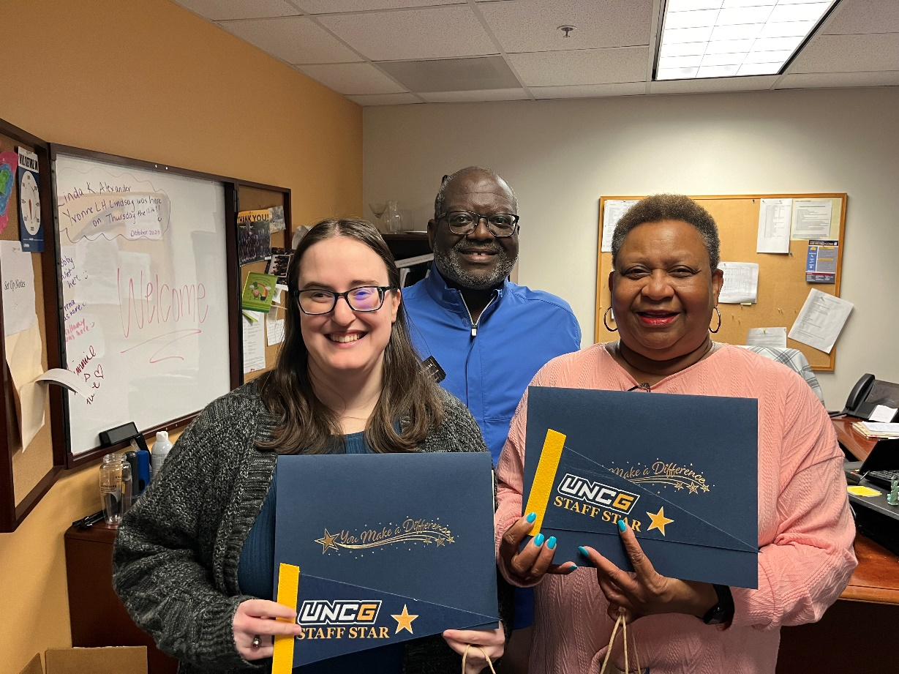
Staff Stars
Kerzie Ford and Linda Alexander
Elliot University Center

Slide 20
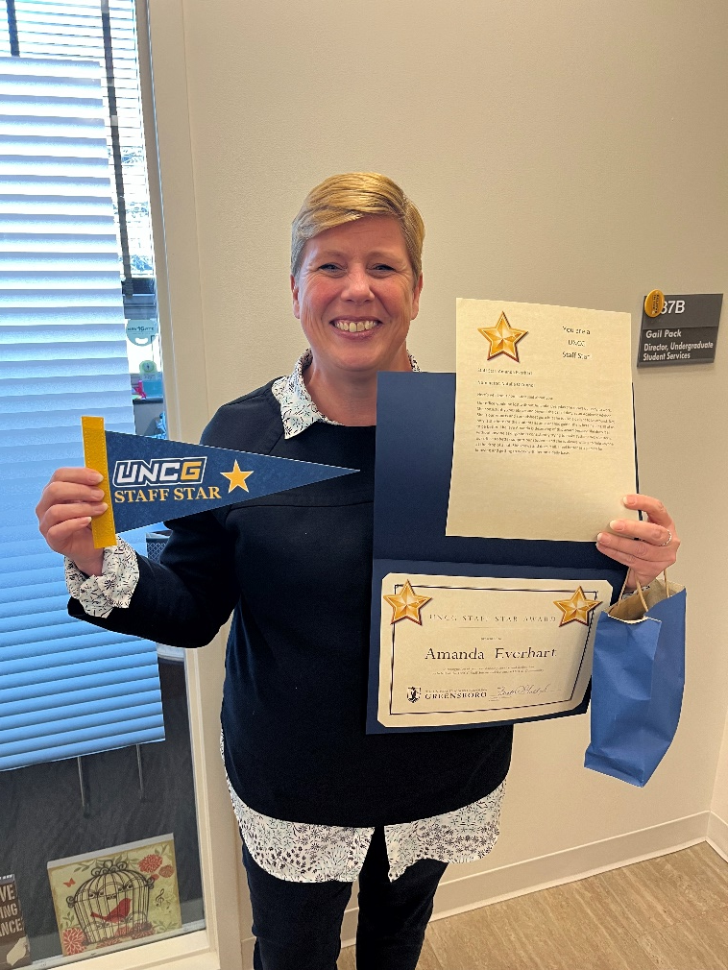
Staff Stars
Amanda Everhart
Bryan School, Undergraduate Student Services

Slide 21
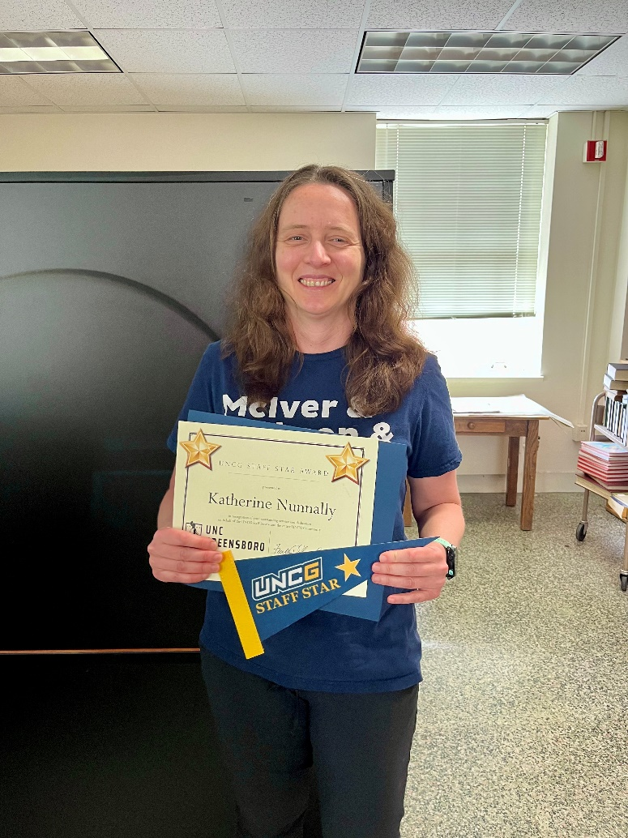
Staff Stars
Katherine Nunnally
University Libraries

Slide 22
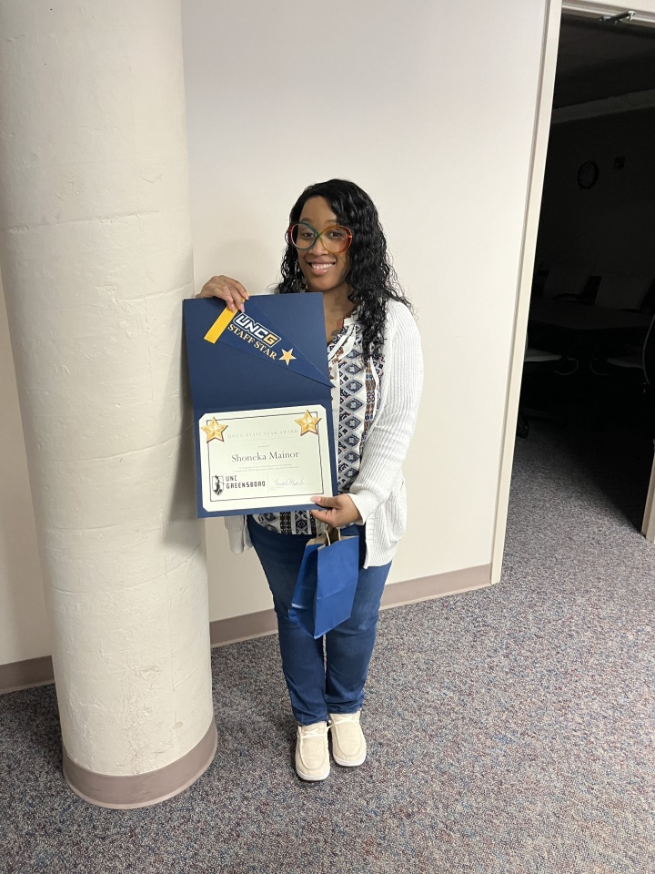
Staff Stars
Shoneka Mainor
Facilities Operations

Slide 23
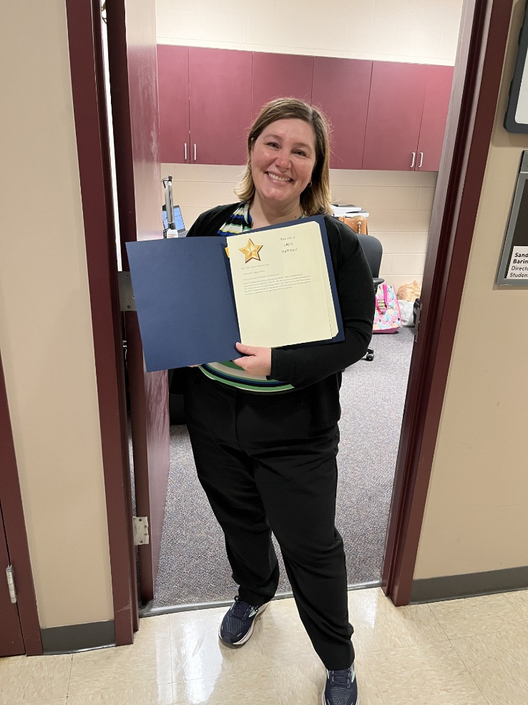
Staff Stars
Sandra Baranowski
CVPA

Slide 24
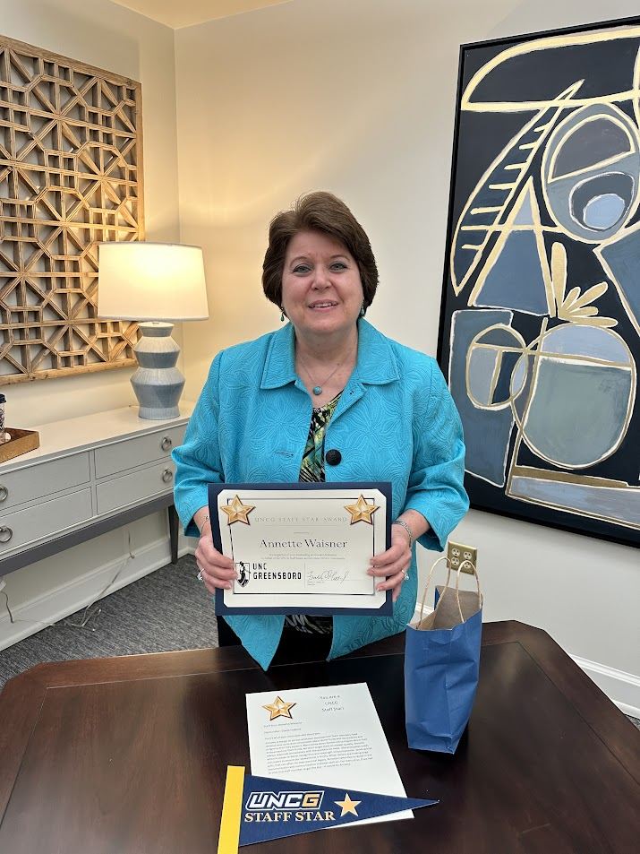
Staff Stars
Annette Waisner
Donor Stewardship

Slide 25
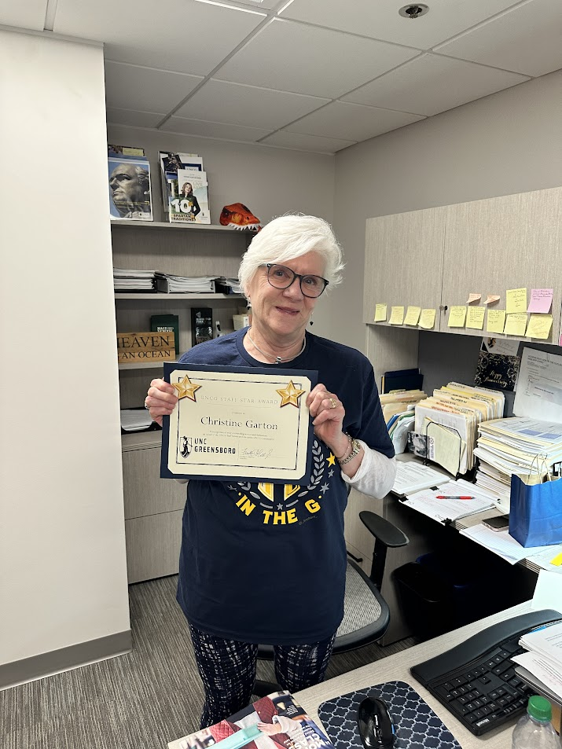
Staff Stars
Christine Garton
University Advancement

Slide 26
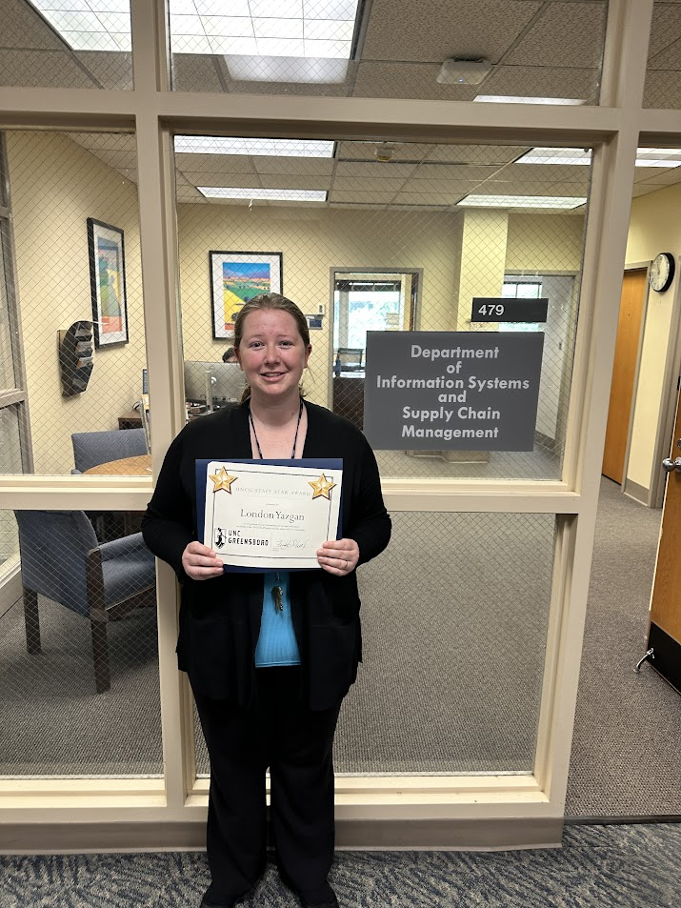
Staff Stars
London Yazgan
ISSCM

Slide 27
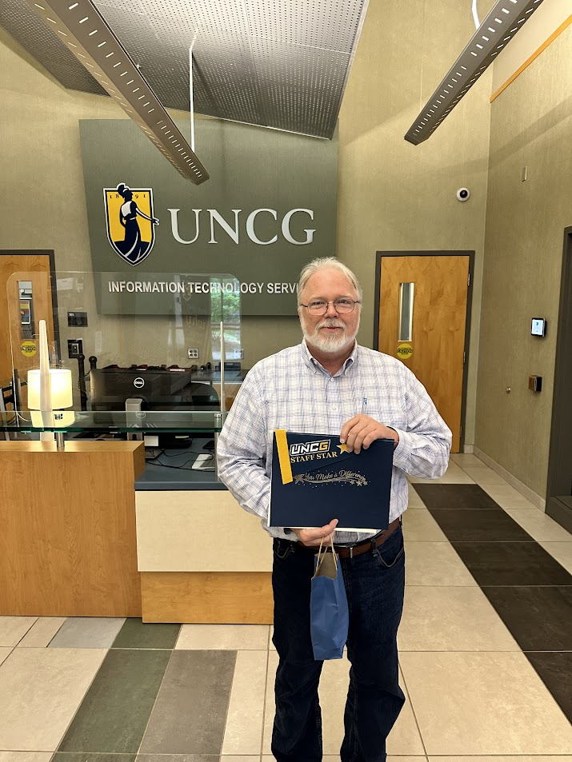
Staff Stars
Jimmy Ferriter
ITS

Slide 28
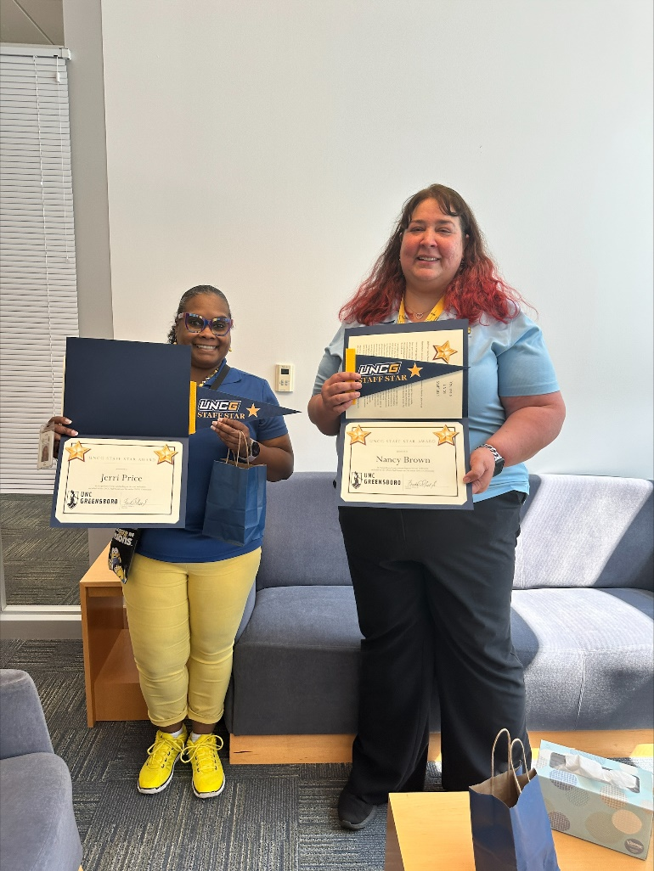
Staff Stars
Jerri Price and Nancy Brown
Joint School of Nanoscience and Nanoengineering

Slide 29
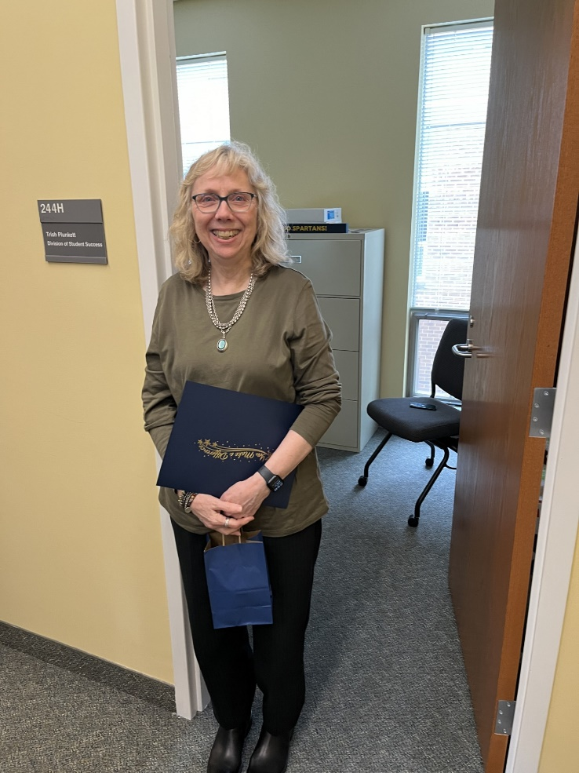
Staff Stars
Trish Plunkett
Division of Student Success

Slide 30
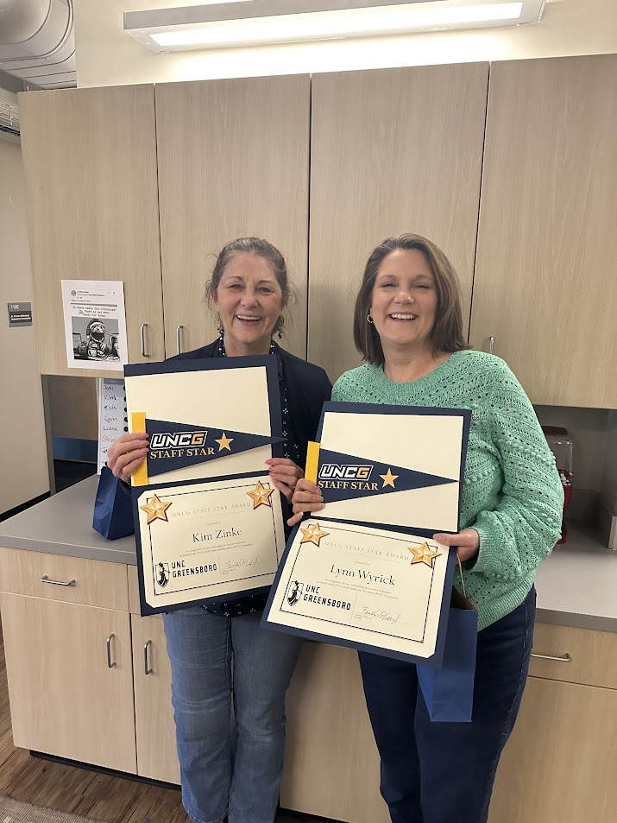
Staff Stars
Kim Zinke and Lynn Wyrick
Office of Assessment, Accreditation, and Academic Program Planning

Slide 31
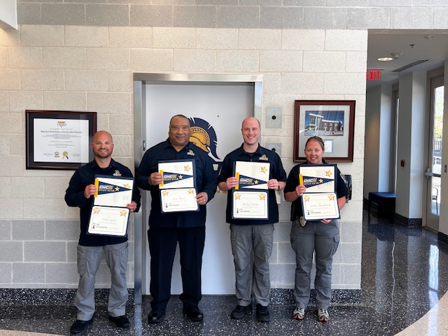
Staff Stars
Chris Jasso, Eric Boyce, Michael Burke, and Ashley Westbrook
UNCG Police

Slide 32
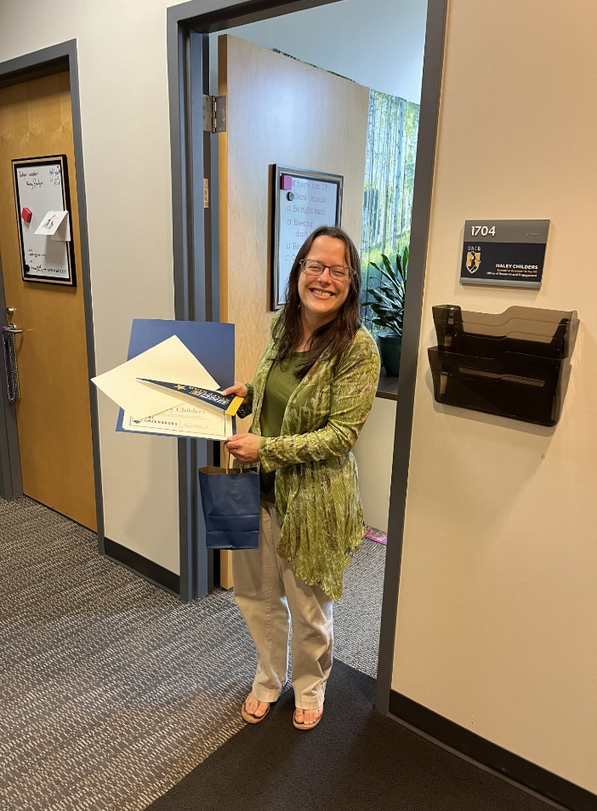
Staff Stars
Haley Childers
Office of Research and Engagement

Slide 33
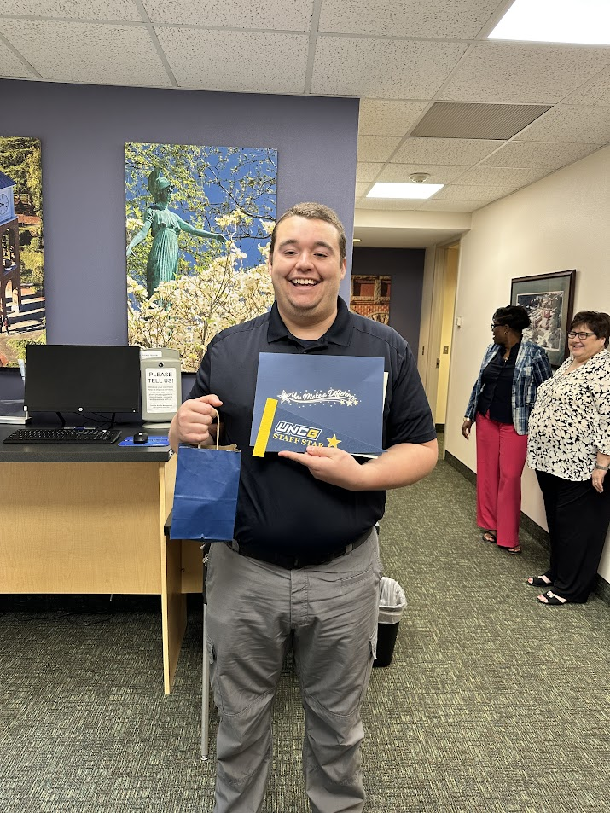
Staff Stars
Grant Harris
Parking Operations and Campus Access Management

Slide 34
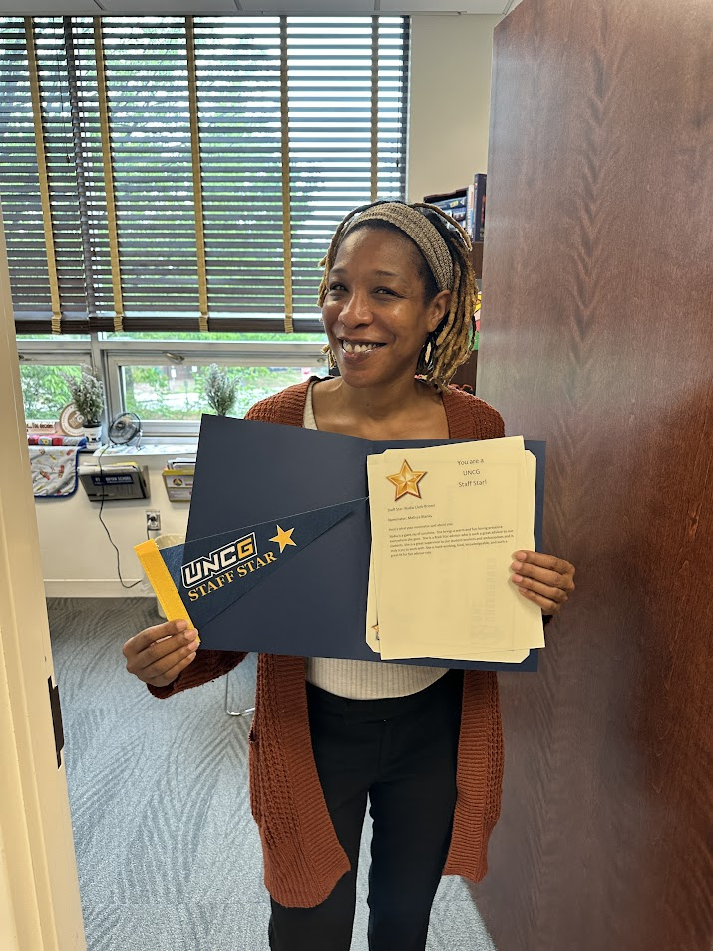
Staff Stars
Nadia Clark-Brown
Bryan School Undergraduate Student Services

Slide 35
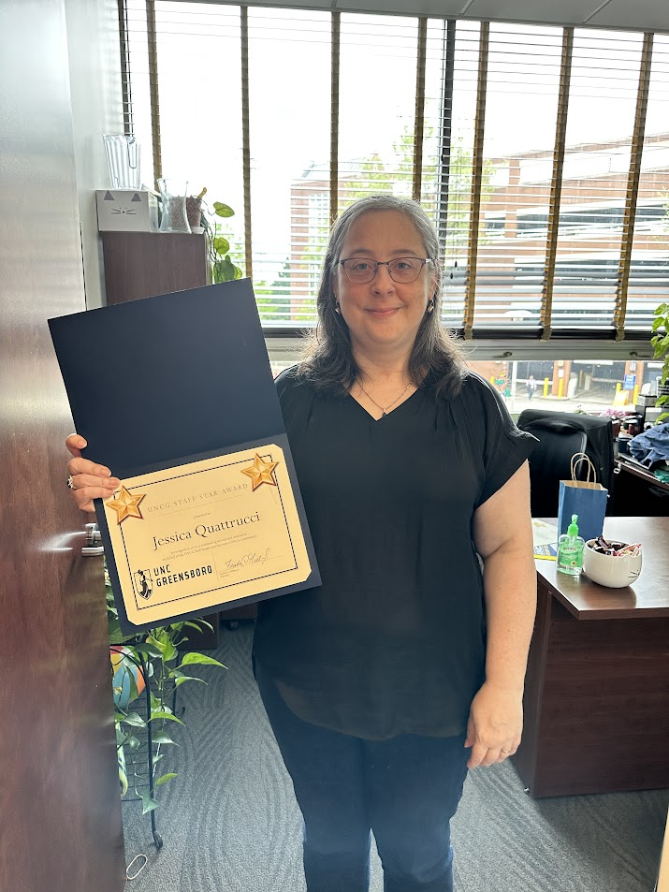
Staff Stars
Jessica Quattrucci
Bryan School Undergraduate Student Services

Slide 36
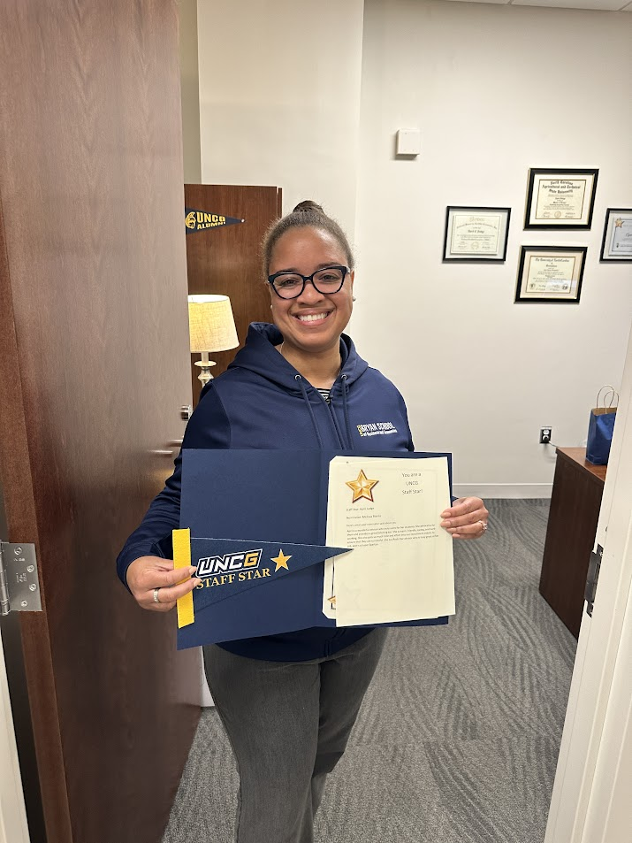
Staff Stars
April Judge
Bryan School Undergraduate Student Services

Slide 37
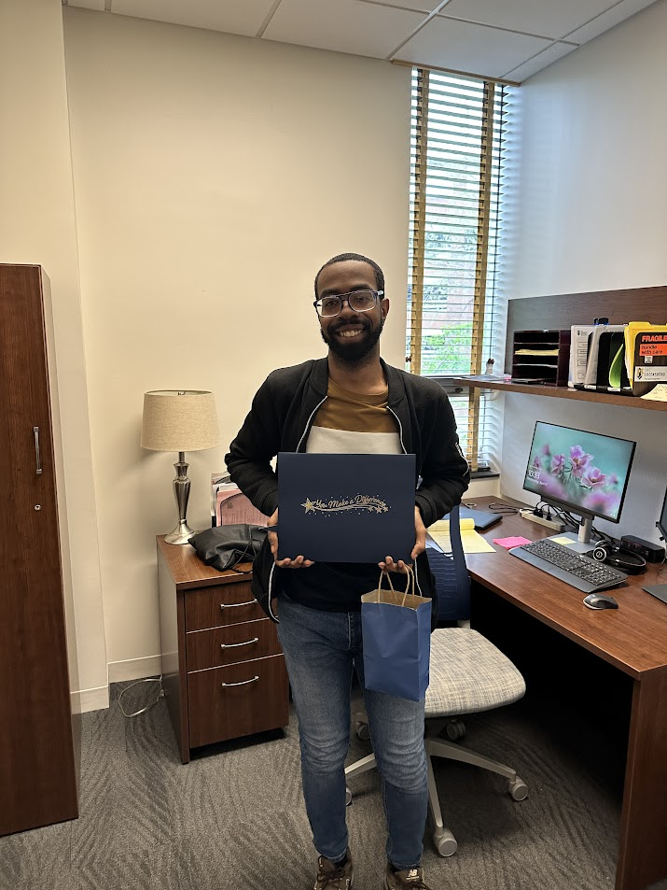
Staff Stars
Tyrell Spencer
Bryan School Undergraduate Student Services

Slide 38
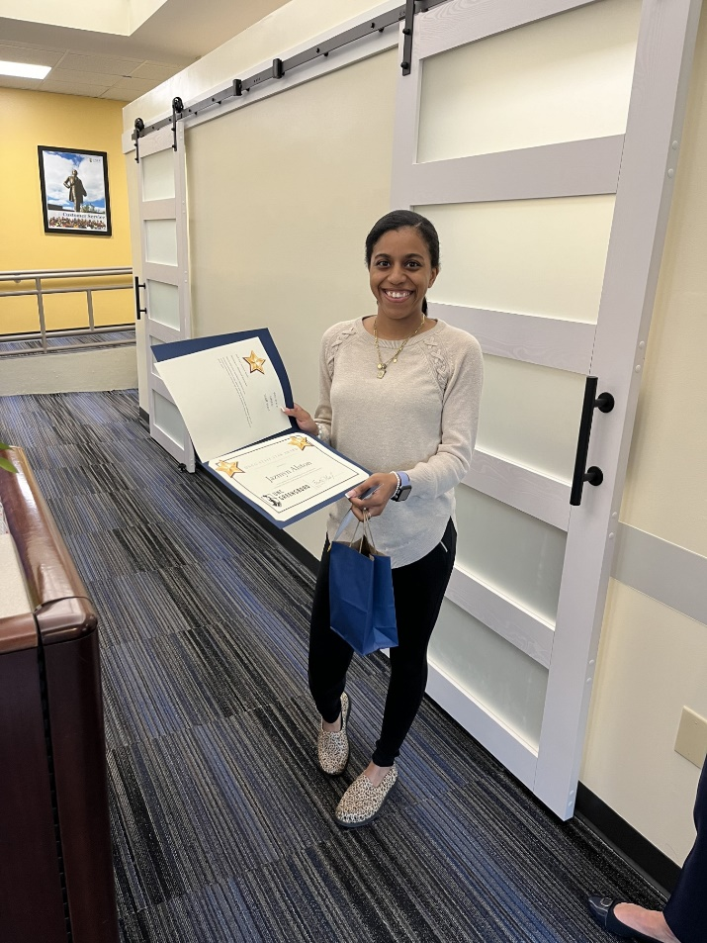
Staff Stars
Jazmyn Alston
Human Resources

Slide 39
Staff Stars
Not Pictured –
Natalie O’Connor
Bryan School Undergraduate Student Services
Ryan Ridpath
College of Arts Advising Center

Slide 40
Staff Awards around campus

Slide 41
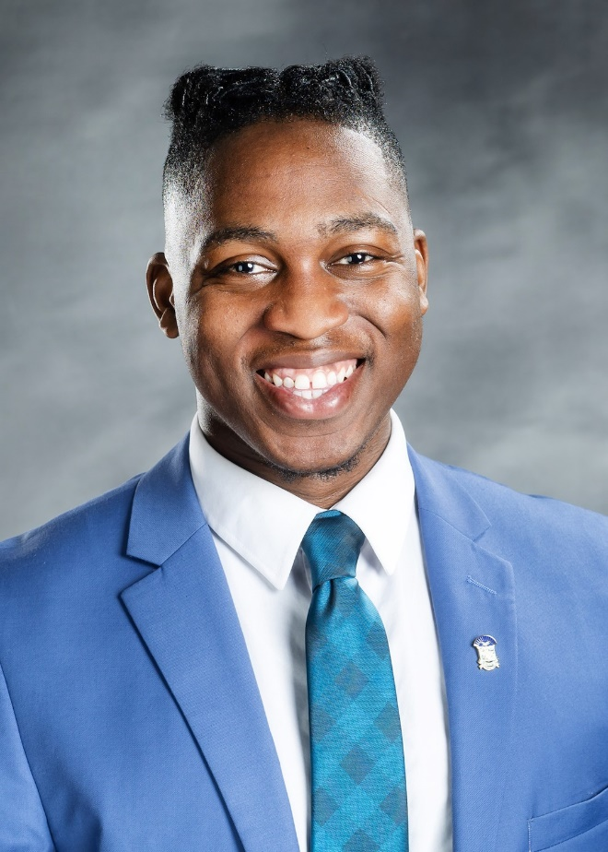
UNC System Staff Assembly’s Janet B. Royster Memorial Scholarship Fund
Tervis Belle
Housing and Residence life

Slide 42
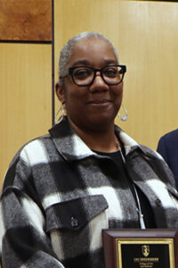
All Southern Conference Staff Award
Trina Porcher
Department of Chemistry and Biochemistry

Slide 43
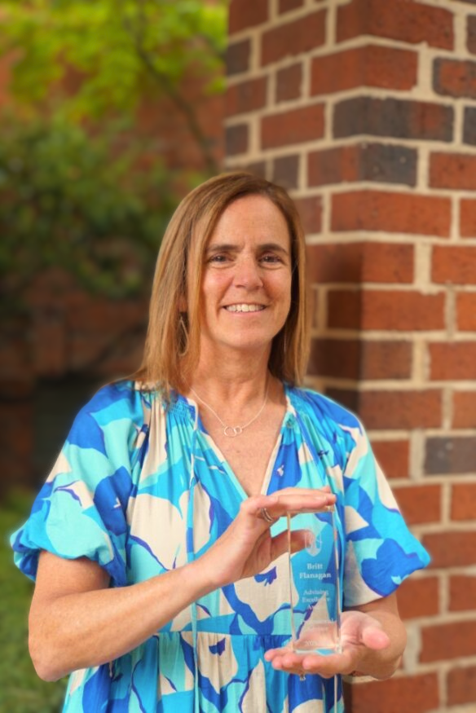
Advising Excellence Award - Professional Advisor The UNCG Advising Excellence awards recognize the commitments of faculty and staff who make significant contributions to student success through the delivery of exemplary academic advising.
Britt Flannagan
Academic Advisor, School of Nursing

Slide 44
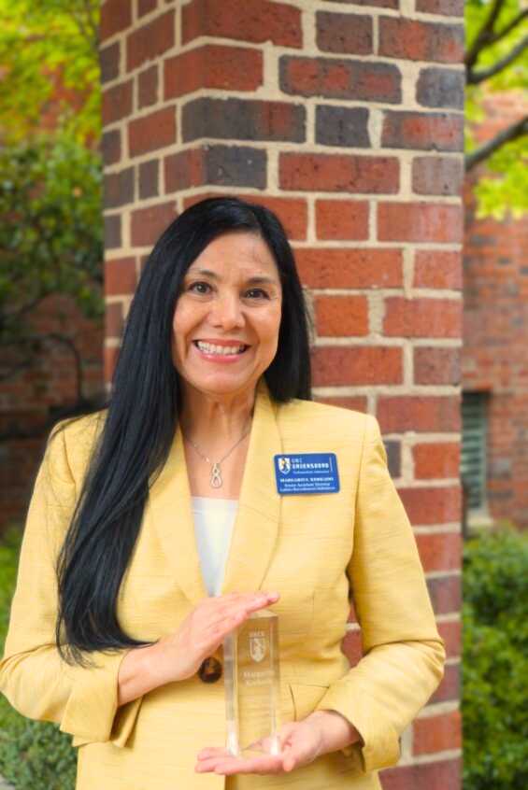
Outstanding First-Year Student Advocate Award Winner The Outstanding First-Year Student Advocate Award recognizes and celebrates the efforts and significant contributions of UNCG faculty and staff who provide leadership in creating a positive transition to college and a successful learning environment for first-year students.
Margarita Kerkado
Senior Assistant Director for Latino / Hispanic Initiatives, Undergraduate Admissions

Slide 45
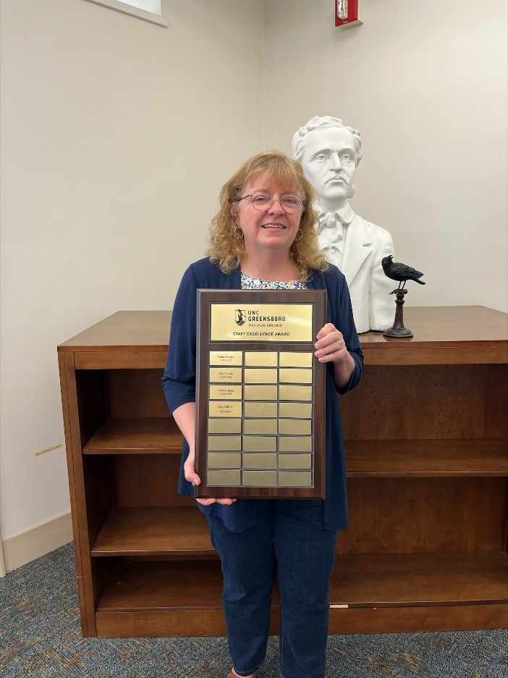
University Libraries Staff Awards - Staff Excellence Award
Cathy Griffin
University Libraries

Slide 46
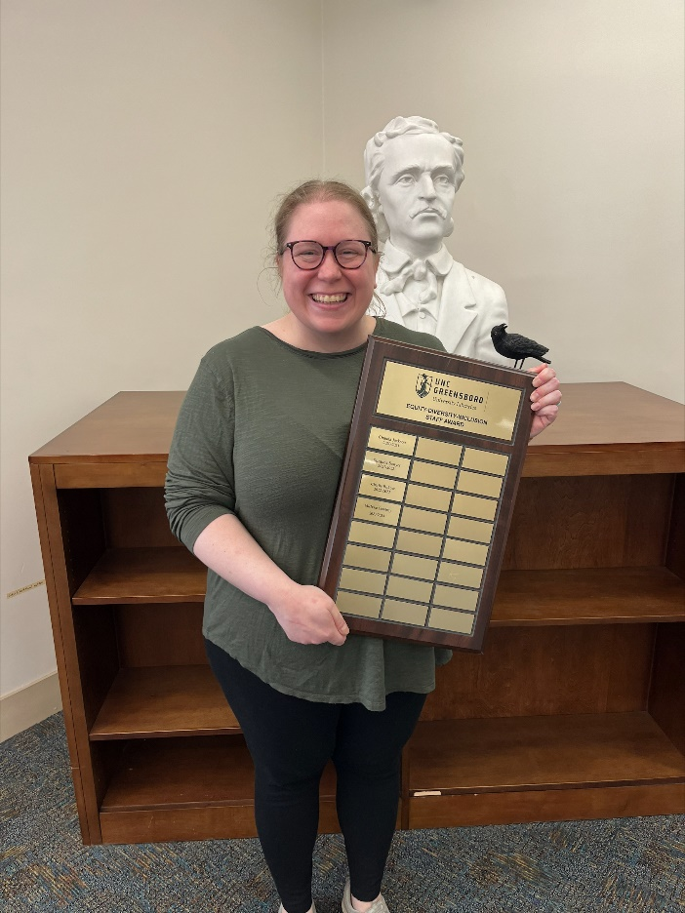
University Libraries Staff Awards - EDI Award
Michelle Courtney
University Libraries

Slide 47

University Libraries Staff Awards - Staff Outstanding Service Award
Robin Paschal
University Libraries

Slide 48
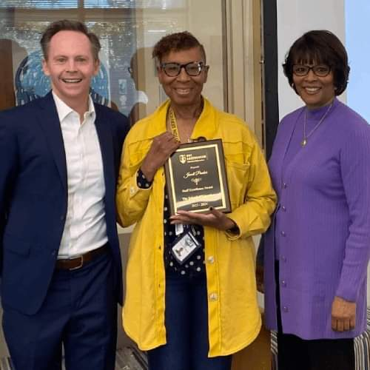
School of Education- SOE Staff Excellence Award
Jewell Pradier
Specialized Education Services

Slide 49
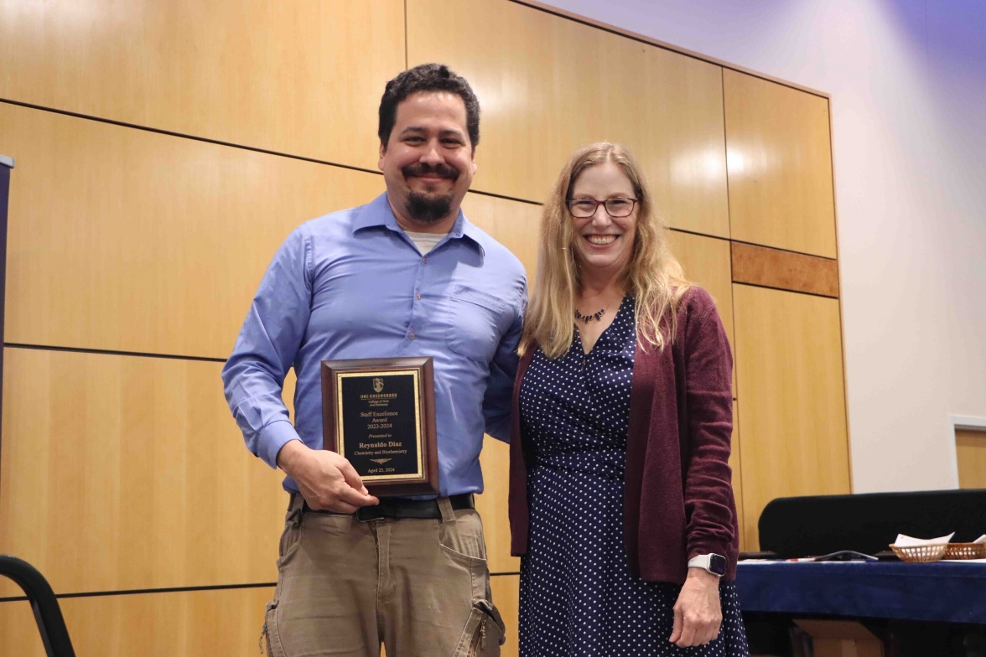
College of Arts and Science - College Staff Excellence Award
Reynaldo Diaz
Chemistry and Biochemistry

Slide 50
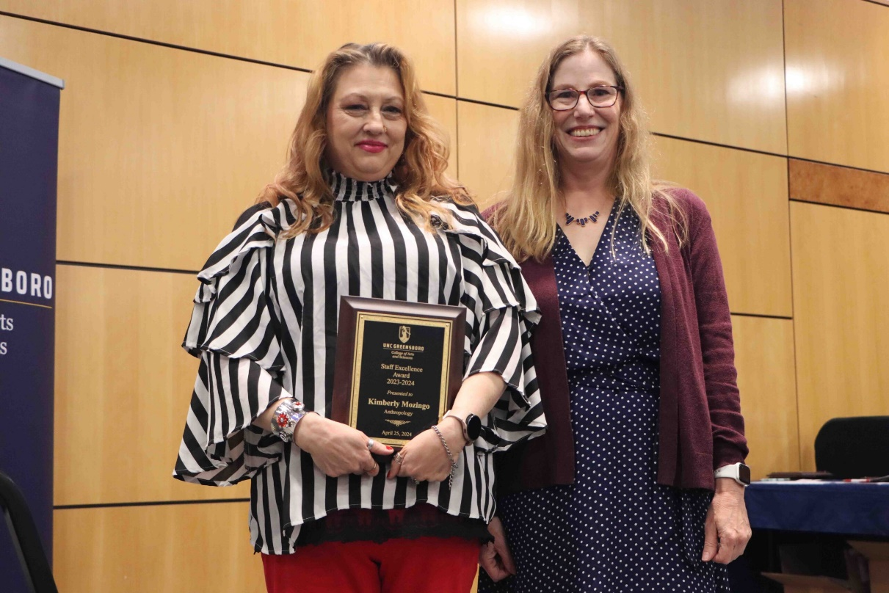
College of Arts and Science - College Staff Excellence Award
Kimberly Mozingo
Anthropology

Slide 51
College of Arts and Science - College Staff Excellence Award
Not pictured –
Paul Cloninger
English

Slide 52
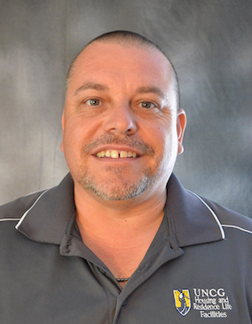
Division of Student Affairs Awards – Unsung Hero Award
Steven Raye
Housing and Residence Life

Slide 53
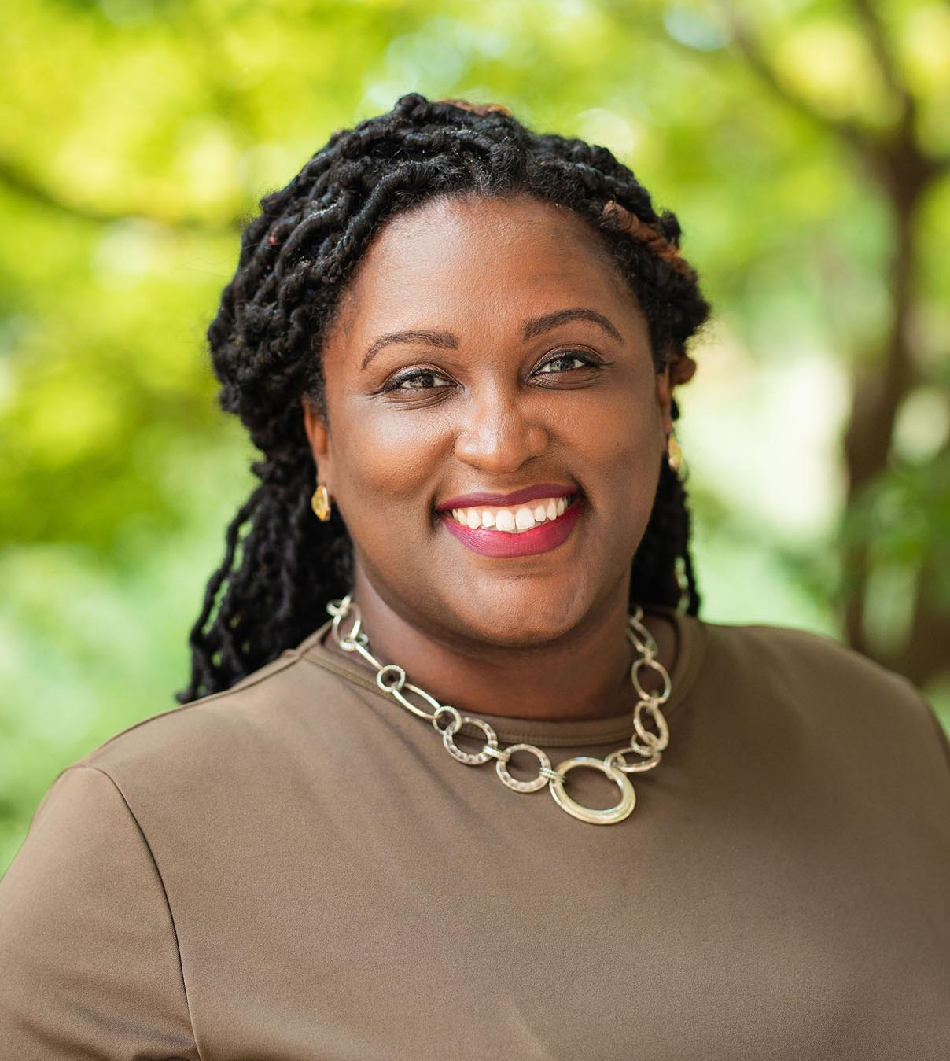
Division of Student Affairs Awards – Team Player Award
Ashley Jones
Campus Activities and Programs

Slide 54
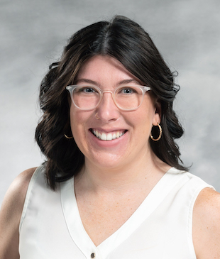
Division of Student Affairs Awards – Team Player Award
Allisen Greathouse
Housing and Residence Life

Slide 55
Division of Student Affairs Awards – Rookie of the Year
Not pictured -
Katherine Faulkner
Career and Professional Development

Slide 56
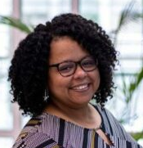
Division of Student Affairs Awards – Culture of Care Award
Ashley Marshall
Recreation and Wellness

Slide 57

Division of Student Affairs Awards – Culture of Care Award
Jenn Whitney
Student Health Services

Slide 58

Division of Student Affairs Awards – Culture of Care Award
Shahnaz Khawaja
Student Health Services

Slide 59

Division of Student Affairs Awards – Culture of Care Award
Sikirat Kazeem
Recreation and Wellness

Slide 60

Division of Student Affairs Awards – Culture of Care Award
Jill Beville
Recreation and Wellness

Slide 61

Division of Student Affairs Awards – Culture of Care Award
Jacqueline Blabon
Recreation and Wellness

Slide 62

Division of Student Affairs Awards – Community Impact Award
Keeyana Talley
Housing and Residence Life

Slide 63

Division of Student Affairs Awards – Excellence in Assessment Award
Joseph “JoJo” Johnson
Housing and Residence Life

Slide 64

Division of Student Affairs Awards – Diversity and Inclusion Award
Brian Daniel
Dean of Students

Slide 65

Division of Student Affairs Awards – Diversity and Inclusion Award
Bri Welsh
Intercultural Engagement

Slide 66

Division of Student Affairs Awards – Legacy Award
Regina King
Housing and Residence Life

Slide 67

Joint School of Nanoscience and Nanoengineering Awards– Staff Excellence Award
Kyle Nowlin
Nanoscience

Slide 68

Joint School of Nanoscience and Nanoengineering Awards– Staff Excellence Award
Olubunmi Ayodele
Nanoscience

Slide 69

Joint School of Nanoscience and Nanoengineering Awards– Staff Excellence Award
Nancy Brown
Nanoscience

Slide 70

Joint School of Nanoscience and Nanoengineering Awards– Staff Excellence Award
Jerri Price
Nanoscience

Slide 71

Joint School of Nanoscience and Nanoengineering Awards– Excellence in Service for Core Facilities Administration
Steven Crawford
Nanoscience

Slide 72

Joint School of Nanoscience and Nanoengineering Awards– Excellence in Service for Program Management
Chartanay Bonner
Nanoscience

Slide 73
Joint School of Nanoscience and Nanoengineering Awards– Excellence in Service for Program Management
Chartanay Bonner
Nanoscience

Slide 74

School Of Nursing Avahleen Cain Staff Excellence Award
Caroline Kernahan
School of Nursing

Slide 75
Special “Thank you” to this year’s Staff Recognition Committee! Nancy Brown (Co-Chair) Patrick Brown (Co-Chair) Christopher Jasso Kate Humphries Callie Coward Lee Griffin Clara Hidalgo Mark Cable Laura Drew Heather Bishop

Slide 76


